Slide 1
Notes:
Speaker 1 [Sam]:
Good evening and thank you for joining us. My name is Sam Gold, and I am Executive Director of the Lower Connecticut River Valley Council of Governments, or RiverCOG. Joining me in giving this presentation is RiverCOG’s Senior Planner Megan Jouflas. We also have in attendance members of our the Regional Planning Committee, other RiverCOG staff members and our project consultant Fitzgerald and Halliday. Finally, and most importantly, we are joined by land use commissioners, first selectmen, town planners, other stakeholders and interested members of the public from across the region. Thank you for being here.

Slide 2
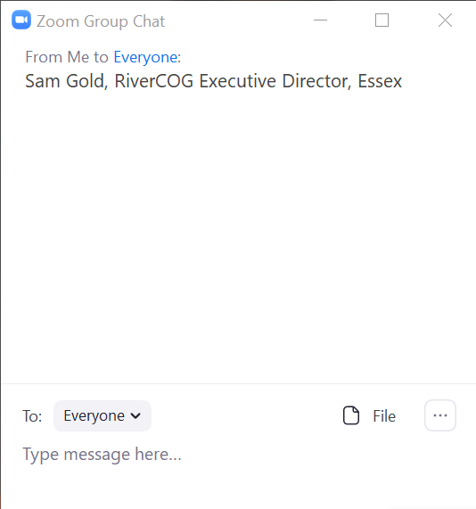
Notes:
First, we ask you to please sign into the meeting with your name, town, and email address in the zoom chatbox. The chat icon is found on the bottom of the zoom screen.

Slide 3
Notes:
This presentation will be given in Webinar format with a Question and Answer segment at the end. Everyone but the presenters will be muted. We expect the presentation will be approximately twenty minutes in length, followed by ten minutes of questions and answers.

Slide 4
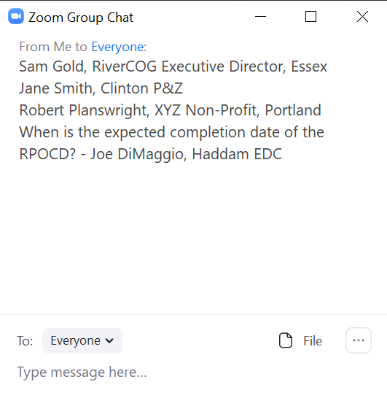
Notes:
If you have questions during the presentation please feel free to type into the zoom chat box. After the completion of the presentation we will read your questions aloud and provide answers. We will answer as many questions as time allows. If you signed in with your email address, and add your name to the submitted question, we can follow up with you directly on any questions that we don’t get to.

Slide 5
Notes:
This presentation and the questions and answers will be recorded and posted to our project website rivercogregionalplan.org at the conclusion of this webinar. We will also send you a link to this presentation so you can share it with anyone in town that should be involved in the creation of the Lower Connecticut River Valley’s first Regional Plan or RPOCD.
Before we get started, I would like to recognize the Regional Planning Committee’s Chair Frank DeFelice for a few words of welcome.

Slide 6
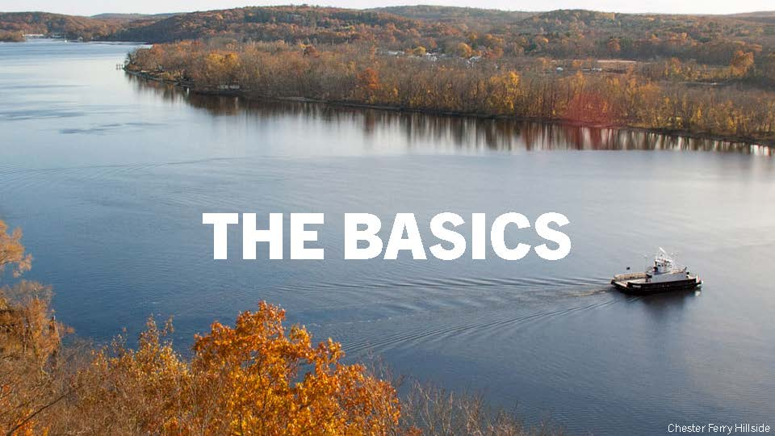
Notes:
Speaker 1:
Let’s begin with the basics:

Slide 7
Notes:
Speaker 1:
First and foremost, why are we here talking with you this evening?
We are here because RiverCOG, the Regional Planning Committee (RPC), and our consultant Fitzgerald and Halliday, are working on the first Regional Plan of Conservation and Development (RPOCD) for the Lower Connecticut River Valley and we need your help.
Our goal is a Regional Plan that you will find to be relevant, useful, and facilitates towns working together on common issues and goals. This is the beginning of a process and we are looking forward to your involvement.
The purpose of tonight’s presentation is to be a primer on What is RiverCOG? What is the RPC? What is the RPOCD? And why it all matters? We will also touch on the concept of regionalism and thinking regionally.
This presentation is the first of two initial outreach efforts, the second of which will be an interactive meeting with each municipality in the region (more on that later). You can think of this presentation as prep before we come to your town and hold the interactive meetings. We hope this presentation provides you with the background information you need to engage in the process of creating our first RPOCD.

Slide 8
Notes:
Speaker 1:
RiverCOG was formed in 2012 by the merger of two smaller predecessor Regional Planning Agencies. RiverCOG is one of nine state designated COGs in Connecticut. COGs are voluntary associations of municipalities and every city and town in the state has chosen to be a member of a COG.
The RiverCOG was created by ordinances adopted by its seventeen member municipalities: Chester, Clinton, Cromwell, Deep River, Durham, East Haddam, East Hampton, Essex, Haddam, Killingworth, Lyme, Middlefield, Middletown, Old Lyme, Old Saybrook, Portland and Westbrook.[Pictured]
The municipal Chief Elected/Executive Officials, your First Selectman, Mayor, or Town Manager, sit on the RiverCOG board, this Board, along with representatives of the region’s two bus companies and the Middlesex County Chamber of Commerce, serve as the policy committee of RiverCOG Metropolitan Planning Organization, a decision making body for state and federal transportation funds.
RiverCOG currently has eight full-time and one part-time staff members, with professional certification and advance degrees in urban planning, law, digital mapping, environmental science, geography and geology. RiverCOG staff has decades of professional work experience in the Lower Connecticut River Valley Region.

Slide 9
Notes:
Speaker 1:
RiverCOG acts as an extension of the region’s city and towns and provides shared regional services under direction of your First Selectmen, Town Mangers, and Mayor.
We serve the region by reviewing municipal land use decisions for intermunicipal impacts, offering planning support and temporary staffing to the region’s municipalities, and facilitating regional cooperation, collaboration, and action within our areas of focus. These include regional transportation, land use, emergency preparedness, land conservation, and economic development. And most recently COVID-19 response and recovery.
As mentioned in the previous slide, RiverCOG is both a federally designated Metropolitan Planning Organization (MPO) responsible for planning for and programming of transportation funds, and a state designated Regional Planning Organization (RPO), responsible for overseeing regional land use and the creation of a Regional Plan of Conservation and Development.

Slide 10
Notes:
Speaker 1:
The Regional Planning Committee, or RPC, is an appointed committee, created by the RiverCOG Board and made up of appointed representatives from each of the 17 municipalities. Several planning responsibilities have been delegated to the RPC, including oversite and review of plans and studies, review of municipal zoning amendments and subdivisions on town boundaries for intermunicipal impacts, and oversite of the creation of the Regional Plan of Conservation and Development for Board approval. On completion of the RPOCD, the Board may adopt the RPC’s plan, or propose revisions to it.

Slide 11
Notes:
Speaker 2 [Megan]:
What is an RPOCD?
The RPOCD is a visionary policy document. This means that it is not binding on municipalities and commissions in the region. Rather, it is an aspirational document, identifying preferred land uses, development patterns and types, and desirable areas for conservation, based on existing and emerging regional trends and challenges.
The RPOCD can be a tool used to guide funding for projects in the region and its creation is required under Connecticut Statute (CGS Chapter 127 Section 8-35a).
You may be familiar with the State POCD or the POCD for your city or town. The RPOCD is similar, but with a regional perspective. This has several advantages, which we will discuss more as we go.

Slide 12
Notes:
Speaker 2:
Overall, the job of an RPOCD is to balance the needs of both conservation and development based on a review of existing state, regional, and local plans and studies. An RPOCD will identify areas that are preferred for either conservation or development, as well as areas whose characteristics can support both conservation and development.
Some areas will be clear cut, and others less so. The research and analysis in the RPOCD is intended to provide clarity and resolution to some of these issues.

Slide 13
Notes:
Speaker 2:
Because of its regional perspective, an RPOCD is able to look beyond city and town boundaries to create a cohesive regional vision. This regional vision is not intended to supersede the unique identities of each municipality, but rather, to knit them together as part of an overarching identity. After all, what makes each of our cities and towns unique is what makes our region so special.
That said, while each municipality is unique in character, their proximity means that certain issues and opportunities will necessarily be shared. An RPOCD can coordinate land use across municipal boundaries and identify opportunities for intermunicipal cooperation. It can also consolidate municipal goals and objectives and apply them at a regional scale.
The future land use maps shown here are examples from other regional plans. These maps express the vision for future conservation and development in their respective regions over the next 10 years. The creation of a future land use map for the Lower Connecticut River Valley will be a key component of the RPOCD.

Slide 14
Notes:
Speaker 2:
The RPOCD is important to the region because of its perspective. As previously mentioned, many municipalities in the region have similar issues and goals. In addition, many issues and goals have impacts that cross municipal boundaries.
And while municipalities in our region have many issues and goals in common, each also has individual strengths and weaknesses. Our municipalities are interdependent – relying on each other for support in areas such as housing, jobs, infrastructure, and critical public services.
By looking at the region as a whole, an RPOCD is able to identify similar issues and goals, as well as areas where municipalities can support one another, and provide a roadmap for coordination and cooperation that will have local impact.
This type of regional coordination is not uncommon. In fact, you may already be familiar with some of these regional services. For example: Public Health Districts, 9-1-1 and Paramedics, and Regional Transit Districts.

Slide 15
Notes:
Speaker 2:
Some examples of regional issues and opportunities that could be addressed in an RPOCD are:
Managing and utilizing new technology (ride sharing, delivery, autonomous vehicles, 5g Mobile Network)
Attracting and retaining younger residents
Supporting an aging population
Protecting and connecting natural resources
Identifying appropriate locations for growth and types of development
Supporting existing small business and attracting new business investment
Many more to be determined by discussion with you…

Slide 16
Notes:
Speaker 2:
An RPOCD impacts decision making at the regional level. This includes guiding the review of land use proposals, establishing funding priorities, and identifying projects of regional significance.
Equally important, an RPOCD can serve as a major resource to municipalities. It is based on the collection and analysis of large amount of data that can be useful in local decision making.
An RPOCD also makes recommendation on how to achieve the regional vision. These plans can serve as a foundation for future municipal work. By establishing this foundation, an RPOCD can save municipalities time and resources. We hope that you would include the RPOCD in your future municipal updates.
Finally, by working regionally, municipalities can cooperate to maximize benefits and minimize costs that local land use decision will have.

Slide 17
Notes:
Speaker 1:
Now that you are familiar with what an RPOCD is and why it’s important, let’s talk about the project to create RiverCOG’s first RPOCD…

Slide 18
Notes:
Speaker 1:
As we mentioned at the outset, RiverCOG, the RPC, and our consultant Fitzgerald and Halliday are working to create our first Regional Plan or RPOCD.
Here, you can see the project team, many of whom are joining us on this evening’s webinar. As we move through this process, these will be the people reaching out for your input, keeping you connected, and writing the draft plan.

Slide 19
Notes:
Speaker 1:
The RPC members are your representatives in this process.
Take a look at this list and find your representatives. Feel free to reach out to them with your thoughts, comments, and concerns via the email links on the project webpage. The RPC will be meeting regularly to review drafts of the RPOCD and direct the regional land use policies in it. They are here to represent you.
In addition, your RPC members can provide you with the latest information on the plan or connect you to the team members who can answer your questions.

Slide 20
Notes:
Speaker 1:
Also you will notice that we have a few vacancies on the RPC. If you want to get involved in this project, please get in touch with us and we can help get you appointed. Participation in the RPC is the best way to make sure your town’s interests are represented.

Slide 21
Notes:
Speaker 1:
As we move forward with the planning process, it is important to know that we are not starting from zero.
The plan will be, first and foremost, based on a review of your municipal POCDs.
In addition, the plan will utilize relevant data and analysis from previous State and RiverCOG reports. Including the state plan of conservation and development, RiverCOG’s Grow Smart Economic Growth Strategy, and the U.S. Census.
Finally, we are committed to creating a data driven plan that incorporates YOUR INPUT.

Slide 22
Notes:
Speaker 1:
The RPOCD will be based on the issues and goals set out in YOUR municipal POCDs. Yes, we have read all 17 municipal POCDs and compared them to each other. Our region’s municipal POCDs share a great deal in common and provide a strong foundation for our work.

Slide 23
Notes:
Speaker 1:
Upon completion of this project, the RPOCD will consist of three parts:
First, an existing conditions report. This will not be part of the plan document, but a stand-alone report, attached to the final regional plan as an appendix. The Existing Conditions Report will focus on current trends and key issues in the region. It will be graphically rich, with maps, images, and diagrams, conveying data about demographics and important trends, and will form the basis for the recommendations in the regional plan.
Second, Regional Goals and objectives will be based on the findings in the existing conditions report. These goals and objectives will lay out recommendations and strategies for addressing key issues in the region. They will serve as our roadmap for how to move forward over the next 10 years and the steps necessary to realize our regional vision.
Finally, the future regional land use map is an illustration of the RPOCD’s vision. Based on the findings in the existing conditions report, the future land use map will provide a graphic depiction of recommendations as to where growth and development should occur and what areas should be set aside for conservation. Importantly, this map is not intended to be a parcel by parcel analysis. It is a visioning tool, meant to be conceptual. The individual municipalities will be responsible for making parcel level decisions, consistent with the vision in the plan (we hope).
All of these documents will be accessible and hosted on the project website rivercogregionalplan.org.

Slide 24
Notes:
Speaker 2: Here you can see a breakdown of the anticipated timeline for the creation of the RPOCD. We kicked off the project in the winter of 2019 and we anticipate completion in Spring of 2021. We are currently in Phase 2 of this process, at the Introductory Presentation (Second Column, First Line).
The next step will be a series of Municipal Meetings, where members of the Project Team will (virtually) visit each of your towns to discuss issues and goals specific to you, and ways that working regionally can help you address those issues and achieve those goals.

Slide 25
Notes:
The Municipal Meetings are currently being scheduled with your Planning and Zoning Commissioners and will begin in July (that’s in just 2 days!). On the screen, you can see a list of meetings that have been scheduled as of today. All of this information is also available on the project website, which will be updated frequently. Check the website for more details on how to access your town’s municipal meeting or, if your meeting has not yet been scheduled, to see when we will be heading to your town!

Slide 26
Notes:
Speaker 2:
Right now there are several ways that you can get involve including visiting the website, signing up for email notifications, and sharing this presentation with others in your community. Signing up for notifications means you will be kept informed of upcoming meetings, project news, and links to the documents and presentation videos as they are posted online.

Slide 27
Notes:
Speaker 2:
Let’s review those key questions we set out to answer today:
Why are we here? We are creating the Regional Plan of Conservation and Development.
What is RiverCOG? The Regional Planning Organization for the Lower Connecticut River Valley.
What is the RPC? The RPC is made up of appointed representatives from each of our 17 municipalities and has been tasked to oversee the creation of the RPOCD.
What is the RPOCD? It is a visionary policy document that guides land use patterns in the region over the next 10 years.
Why do we think regionally? Thinking regionally can help our municipalities solve common problems and achieve common goals.

Slide 28
Notes:
Speaker 2:
As previously mentioned, the next step in this process will be the Municipal Meetings beginning July 1st. Those meetings will be based on discussing your answers to these questions. We are giving them to you now in the hopes that you will take some time and consider your responses. I will take a moment to read through these questions now….
Our goal is to format these Municipal Meetings as a productive dialogue where we learn more from you about your town and your thoughts on the region.
Again, the scheduling of these meetings is still underway, but they are expected to run through July and August, so please check the project website to see when we will be coming to your town!

Slide 29
Notes:
Speaker 1 [Sam]:
Now we will turn to the question in the chat box.

