Slide 1
Workshop One
Addressing the Region’s Changing Demographics
12/9/20
Notes:
[Sam] Hello, and thank you for joining us this evening. My name is Sam Gold and I am the Executive Director of the Lower Connecticut River Valley Council of Governments, or RiverCOG. I am joined today by [list names and titles] who will be assisting me in conducting this workshop.
We ask you to please sign in to the meeting with your name, town, and email address in the zoom chatbox. The chat icon is found on the bottom of the zoom screen.
We will conduct this workshop in three segments – each segment will begin with a presentation of regional data followed by a group discussion where we will ask for your input.
Don't worry - we will provide more guidance on logistics as we go!

Slide 2
THE PROJECT
Regional Plan of Conservation and Development (RPOCD)
Policy document that sets goals and makes recommendations for the region
Previous Public Outreach
Introductory Presentations (June 29, 2020 and July 7, 2020)
Municipal Meetings (July 2020 – September 2020)
Existing Conditions Report
Statistical data on current trends and key issues in the region
Regional Thematic Meetings (Virtual Workshops)
Demographics (December 9, 2020)
Visioning/Branding (December 15, 2020)
Future Land Use Map – Part A (December 21, 2020)
Future Land Use Map – Part B (January 5, 2021)
Notes:
Let's begin with a little background -
We are here this evening because RiverCOG, the Regional Planning Committee (RPC), and our consultant Fitzgerald and Halliday are working on the first ever Regional Plan of Conservation and Development (RPOCD) for the region.
As you may be aware, the RPOCD is a visionary policy document that sets goals and makes recommendations regarding preferred land uses, development patterns and types, and desirable areas for conservation, based on existing and emerging regional trends and challenges.
On June 29th and July 7th, we held a region-wide Introductory Presentation (and encore performance) that offered a primer on RiverCOG, the RPC, and the RPOCD. We then spent the summer (virtually) visiting each of the 17 towns in our region, gathering input on the issues and goals of each town and how they see their role in the region. All of these meetings are available to view on the project website (a link will be provided at the end of this workshop).
Throughout this time, we have also been working on creating an Existing Conditions Report which compiles statistical data on current trends and key issues in the region. This document is in the process of being finalized and will be attached to the RPOCD as an appendix.
All of this effort has brought us to tonight's workshop, the first in a series of four, which will focus on the issues we heard were important to you at the Municipal Meetings over the summer. This workshop will focused specifically on demographic changes in the region, and we will be presenting statistical demographic data compiled as part of the existing conditions report.
After presenting a series of data points, we will separate into breakout groups and ask for your thoughts on what you've heard. The feedback we receive from you will directly inform the recommendations in the RPOCD.

Slide 3
AGENDA
Introduction
Topic Discussions
Population Changes
Household Composition
Racial and Ethnic Diversity
Breakout Discussion and Report Back
Education
Jobs
Workforce
Income
Breakout Discussion and Report Back
Housing Supply and Market
Breakout Discussion and Report Back
Next Steps

Slide 4
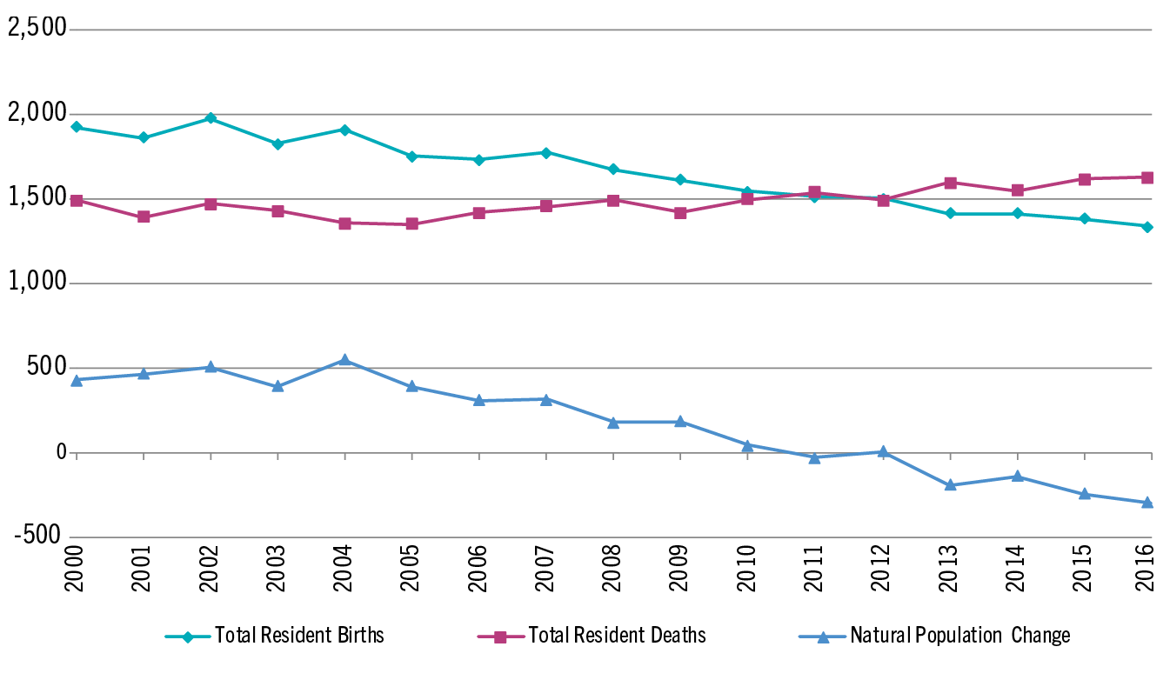
POPULATION CHANGES
The Region has a Stagnating/Declining Population
Death rate begins to exceed birth rate in 2012
Data Source: US 2010 Census and 2013-2018 American Community Survey

Slide 5
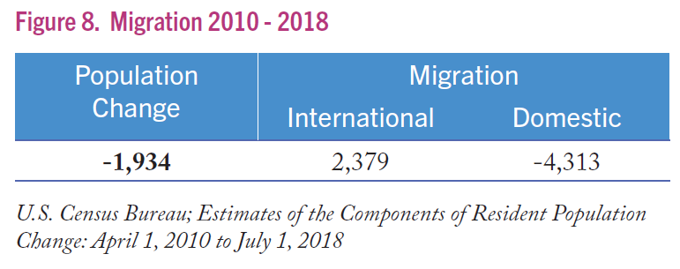
POPULATION CHANGES
Domestic migration was negative between 2010 and 2018 (loss of residents to other locations in US) while International migration increased (gain of residents from outside of US).

Slide 6
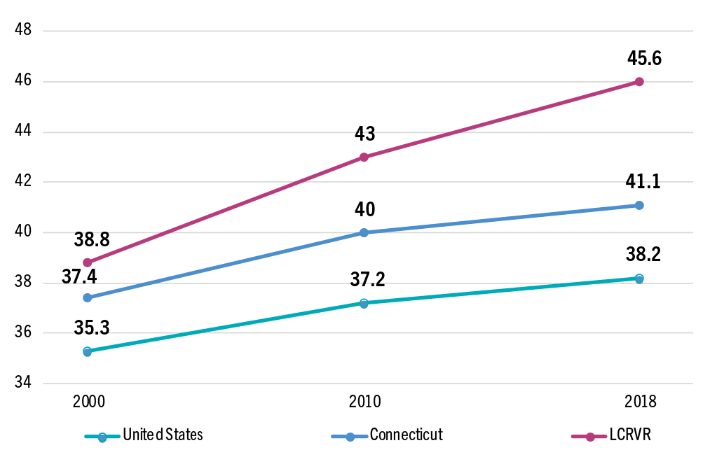
POPULATION CHANGES
The Region’s population is also getting older.
7 years older on average than in 2000
Source: US 2010 Census and 2013-2018 American Community Survey

Slide 7
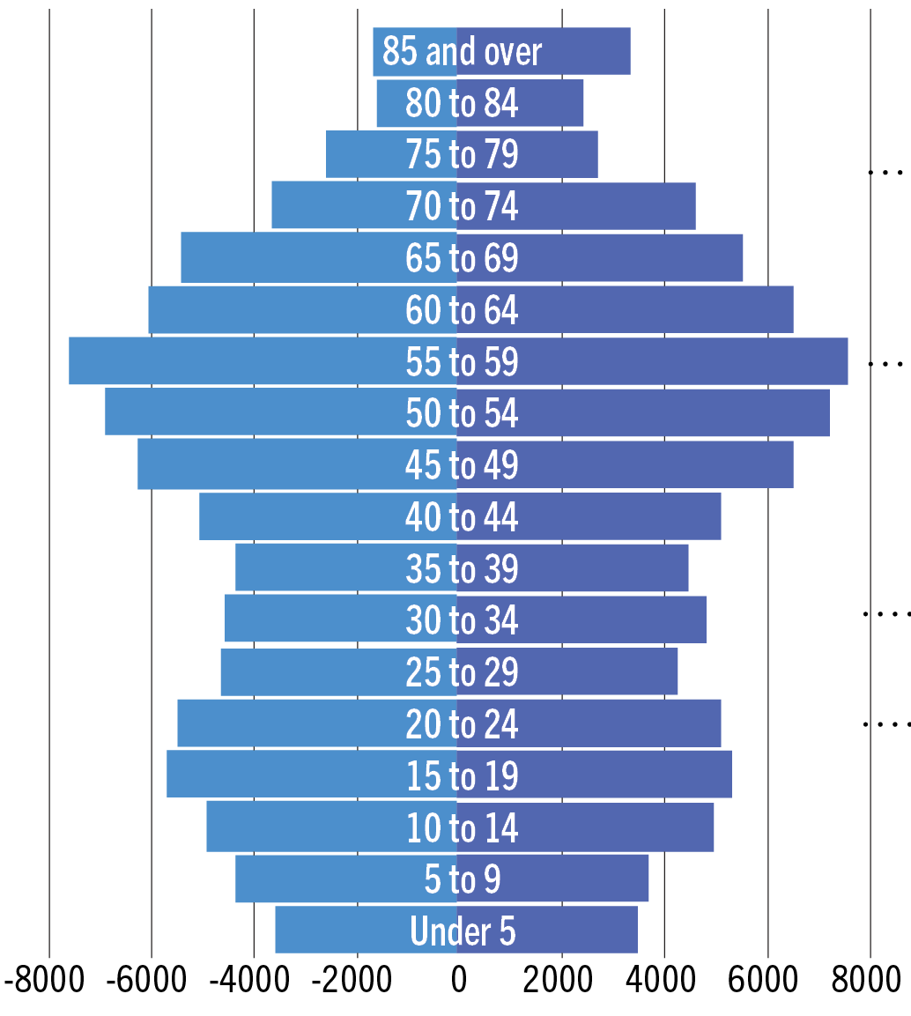
POPULATION CHANGES
Far more Boomers and Gen X’ers than Millenials or Gen Y’ers in the Region.
Female
Male
Boomer
Gen X
Millennial
Gen Y
Source: US Census Bureau, American Community Survey 2013-2018

Slide 8
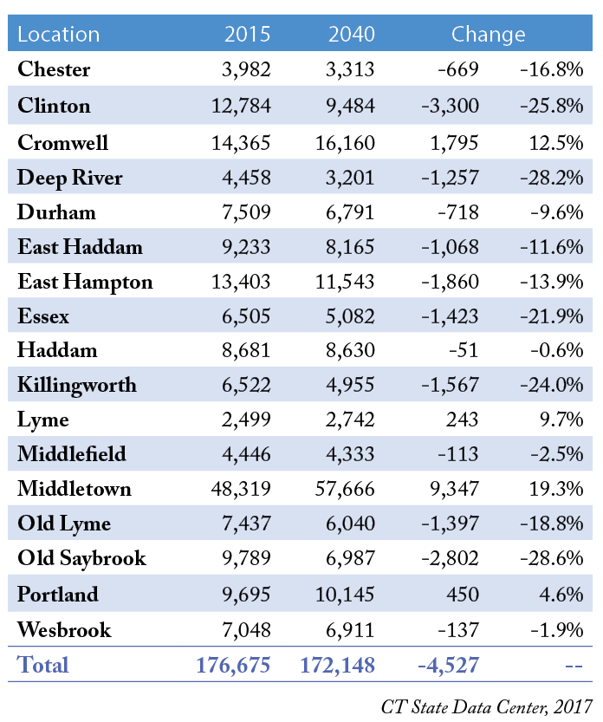
POPULATION CHANGES
State demographers project population contraction in most LCRVR communities.
Only Cromwell, Lyme, Middletown, and Portland are expected to grow.
Clinton, Deep River, Essex, Killingworth, and Old Saybrook are expected to contract the most
These projections are now several years old, and these trends may have since changed, especially considering migration related to COVID-19

Slide 9
HOUSEHOLD COMPOSITION
Household size in the Region is slightly lower than the Statewide average
LCRVR
2.3 persons per household
Connecticut
2.5 persons per household
Source: 2013-2018 American Community Survey

Slide 10
HOUSEHOLD COMPOSITION
More non-family households than Statewide average and a smaller share of households with children
Source: US Census Bureau, American Community Survey 2013-2018

Slide 11
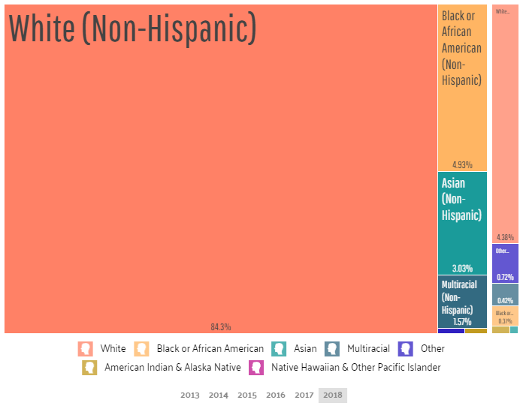
RACIAL AND ETHNIC DIVERSITY
The Region is overwhelmingly White and non-Hispanic (84.3%)
Source: US Census Bureau, American Community Survey 2013-2018

Slide 12
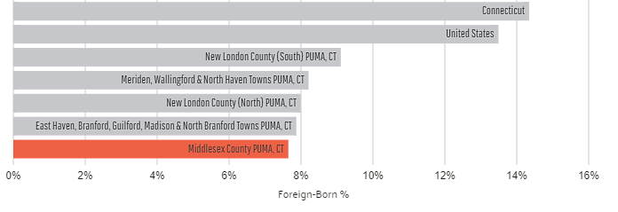
RACIAL AND ETHNIC DIVERSITY
Middlesex and New London Counties have a smaller share of foreign-born residents than Connecticut or the US.
2018
US Census Bureau, American Community Survey 2013-2018
A Public Use Microdata Area, or PUMA, are geographic units used by the US Census for providing statistical and demographic information. Each PUMA contains at least 100,000 people. PUMAs do not overlap and are contained within a single state.a

Slide 13
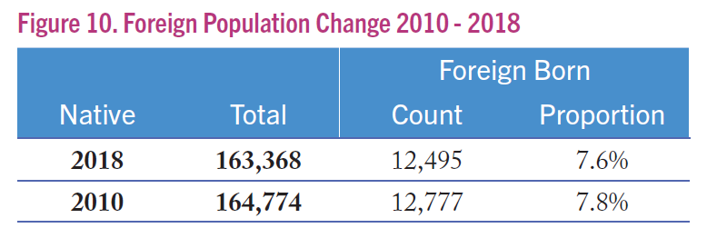
RACIAL AND ETHNIC DIVERSITY
Foreign Born population has decreased since 2010
Source: U.S. Census Bureau, American Community Survey 2006-2010; 2013-2017

Slide 14
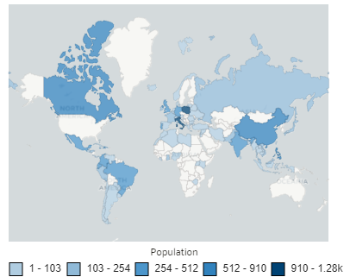
RACIAL AND ETHNIC DIVERSITY
Immigration
Most common birthplace of foreign-born residents
Italy
Poland
China
Source: US Census Bureau, American Community Survey 2013-2018

Slide 15
RACIAL AND ETHNIC DIVERSITY
Languages
10.7% of Middlesex County PUMA (Public Use Microdata Area), CT citizens are speakers of a non-English language. National average is 21.9%.
Top foreign languages in the region are:
Spanish 3.9%
Italian 1.1%
Polish 0.8%
French 0.6%
Mandarin & Cantonese 0.5%

Slide 16
BREAK-OUT DISCUSSION
Is this information consistent with your experience in your town/the greater region?
x

Slide 17
BREAK-OUT DISCUSSION
What issues do you see for your town/the region based on these trends?
x

Slide 18
BREAK-OUT DISCUSSION
What are some steps we can take in the plan to address these issues?
x

Slide 19
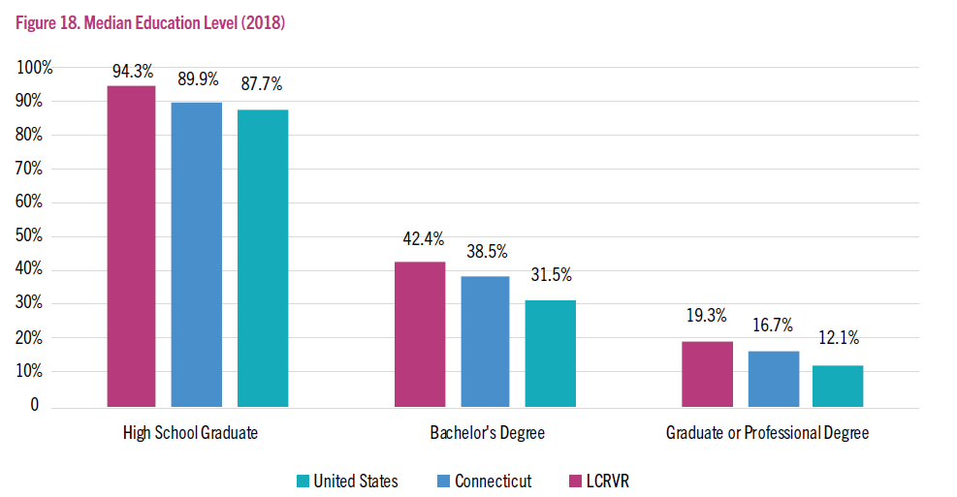
EDUCATION
The Region has higher education levels than Connecticut and the US at secondary, college, and graduate school levels
Source: US Census Bureau, American Community Survey 2013-2018

Slide 20
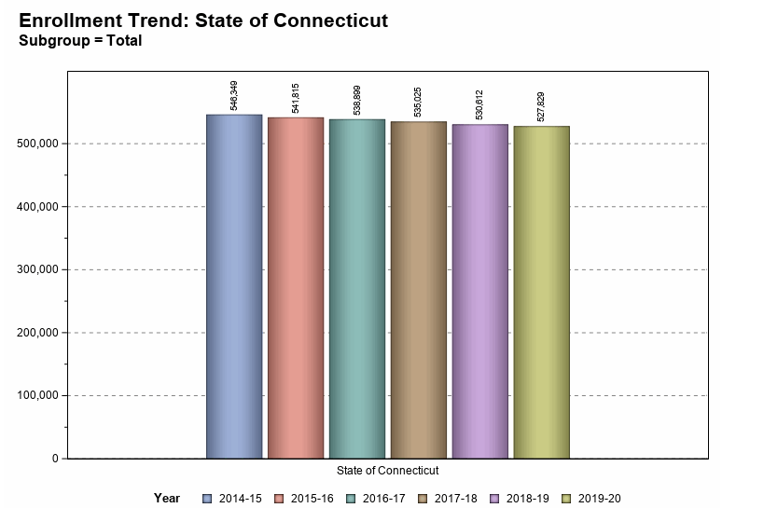
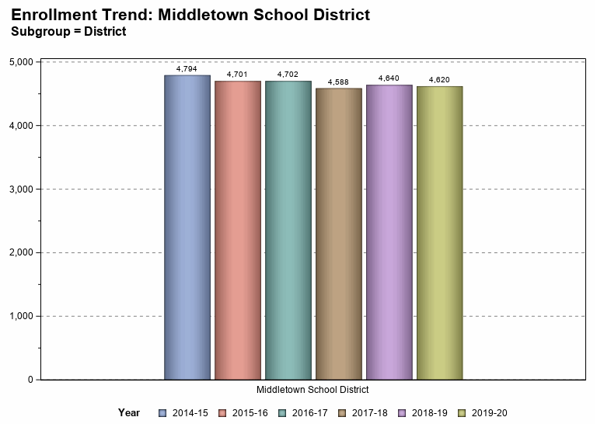
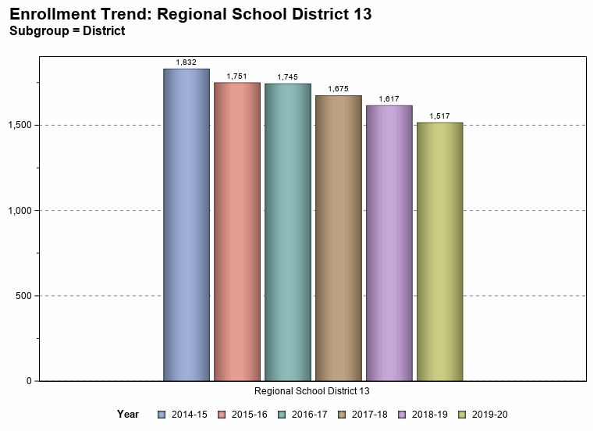
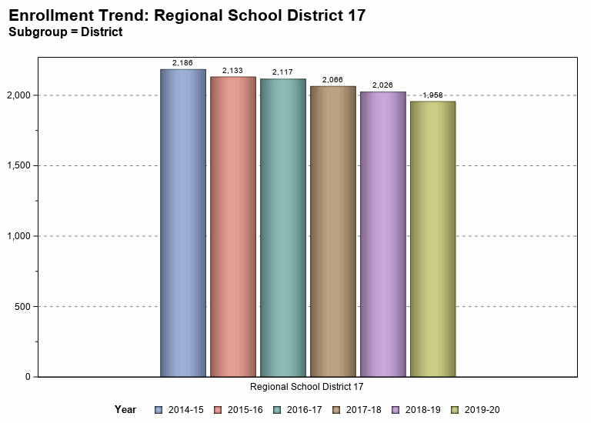
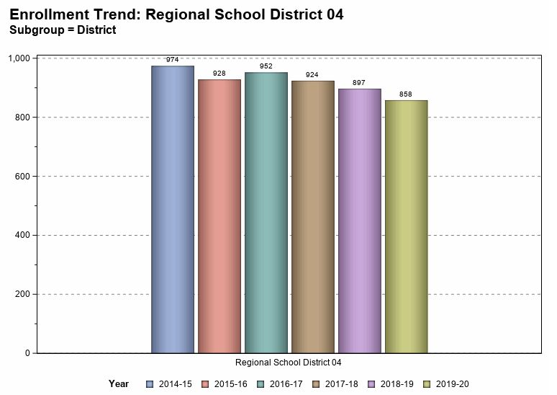
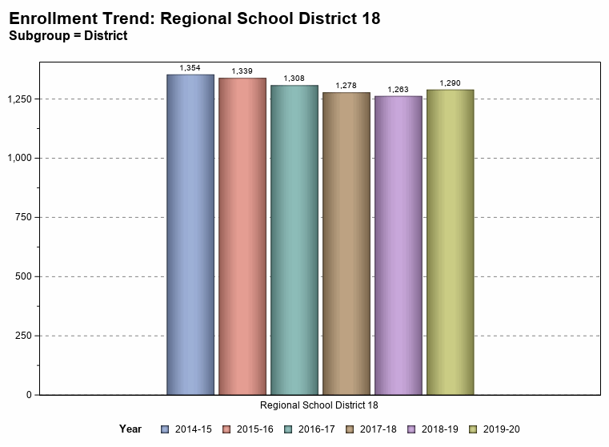
EDUCATION
School enrollment trends vary by district. Like Connecticut as a whole, overall trends are down, particularly in smaller districts.
Source: CT Department of Education

Slide 21
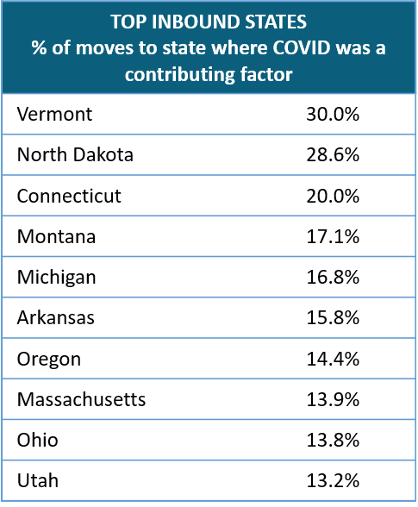
EDUCATION
Domestic migration as a result of COVID-19 could have positive long-term impacts on population and school enrollment in Connecticut.
Source: United Van Lines

Slide 22
JOBS
Jobs by Industry
Middlesex County
2019
Heavily Impacted by COVID-19
Source: 2018 US Census Longitudinal Employer-Household Dynamics

Slide 23
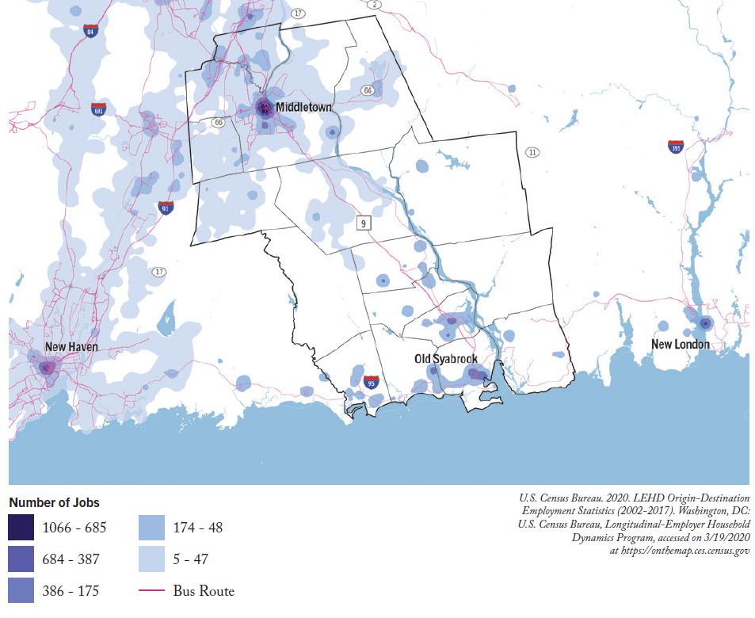
JOBS
Most jobs in the region are concentrated in the northern part of the region, with a small cluster along the shore and I-95.

Slide 24
JOBS
Steady growth in jobs since 2010
Source: US Bureau of Labor Statistics Employment and Wages, Annual Averages 2019

Slide 25
JOBS
Wage Growth outpaced by Inflation
18.1% growth
19.2% inflation rate
Source: US Bureau of Labor Statistics Employment and Wages, Annual Averages 2019

Slide 26
JOBS
12.6% growth in number of business establishments since 2011
Source: US Bureau of Labor Statistics Employment and Wages, Annual Averages 2019

Slide 27
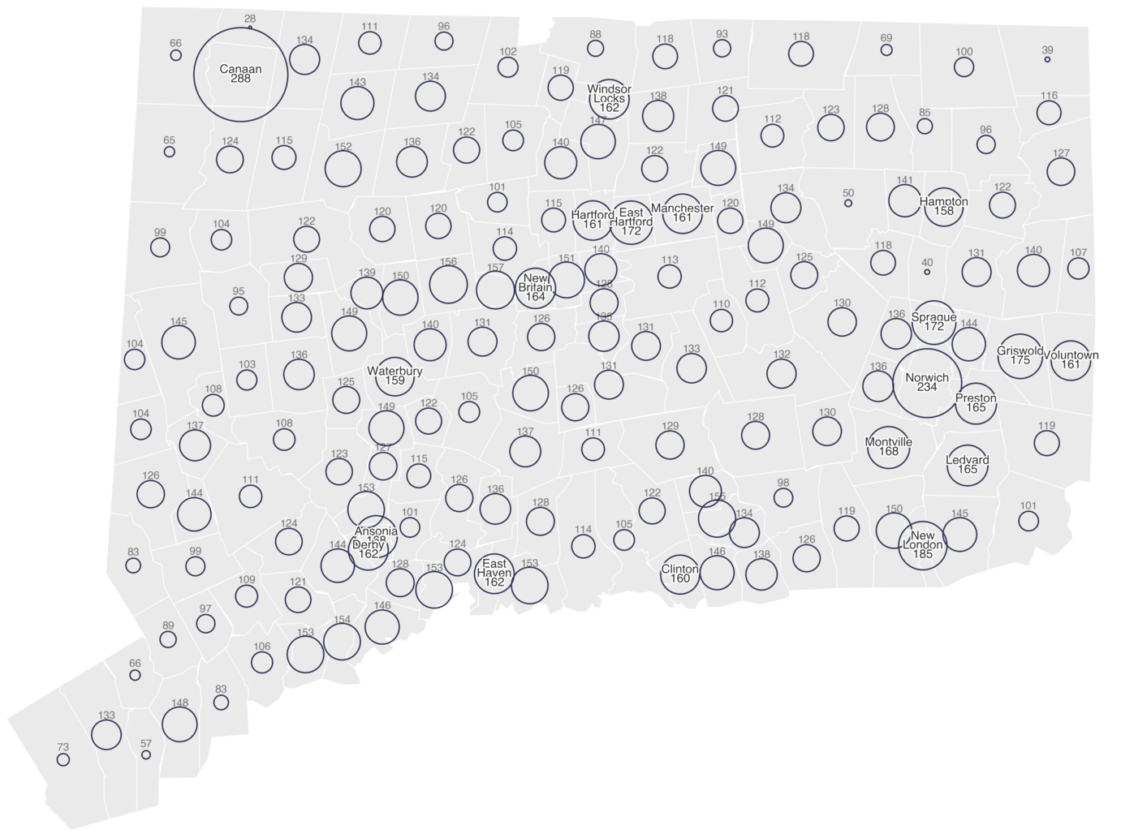
JOBS
COVID Related Job Impacts in the Region are comparable to Statewide impacts.
Claims are shown by place of residents of worker making the claim.
Source: CT Department of Labor, Unemployment Insurance Claims 3/15-8/02

Slide 28
WORKFORCE
The Region’s workforce (resident workers) is Management, Business, Science, and Arts based.
Source: US Bureau of Labor Statistics Employment and Wages, Annual Averages 2019

Slide 29
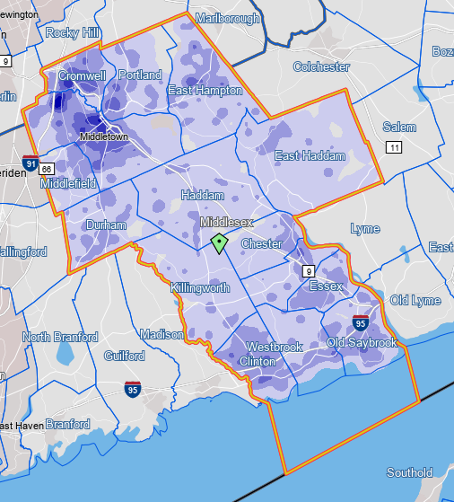
WORKFORCE
The Region’s workers live close to major employment areas such as Middletown and along the Shore.
Source: US Census Longitudinal Employer-Household Dynamics

Slide 30
WORKFORCE
Trends over the Past Ten Years:
Loss of resident workers since 2009, but a recovery since 2014
Source: US Bureau of Labor Statistics

Slide 31
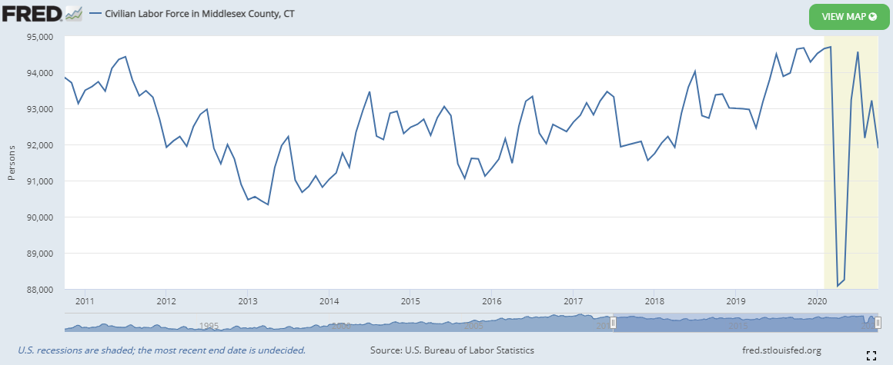
WORKFORCE
Trends over the Past Ten Years: Significant Season Fluctuations
Source: FRED, US Bureau of Labor Statistics

Slide 32
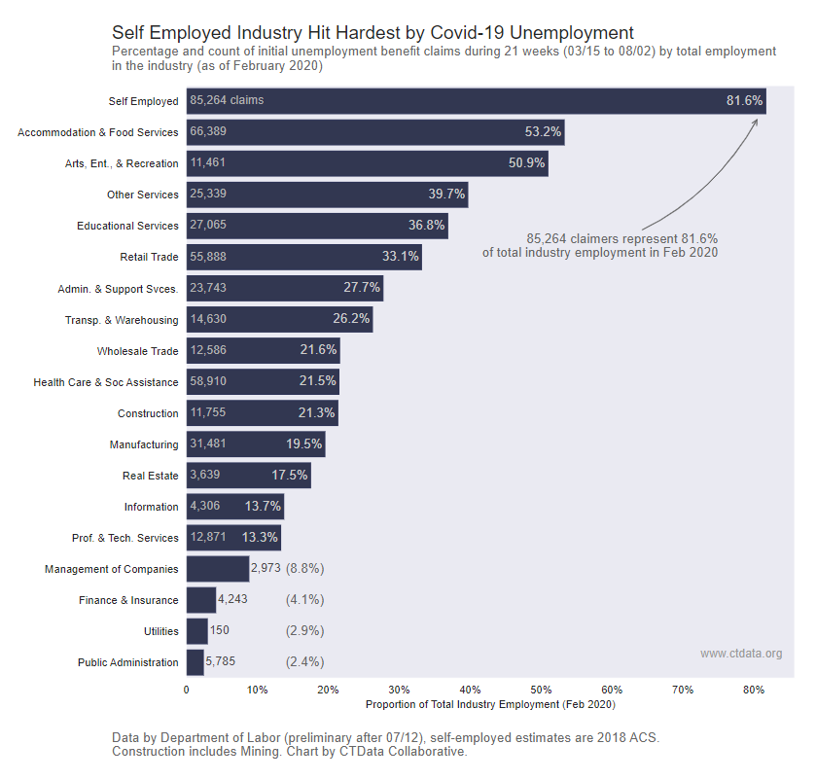
WORKFORCE
Statewide, the biggest employment impact of COVID-19 has been experienced by:
Self-Employed
Accommodation and Food Services
Arts, Entertainment, & Recreation
Statewide Unemployment Insurance Claims 3/15-8/02

Slide 33
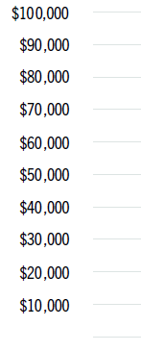
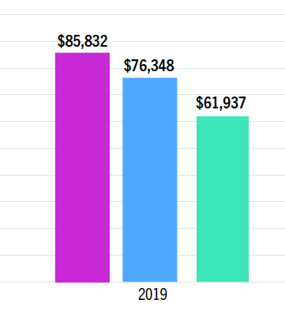
INCOME
Median household income in the Region was $85,832 in 2019. This is higher than the State’s median income and significantly higher than that of the United States.
In Connecticut, Fairfield County is the only Region with a higher median income.
2018
Source: US Census Bureau, American Community Survey 2013-2018

Slide 34
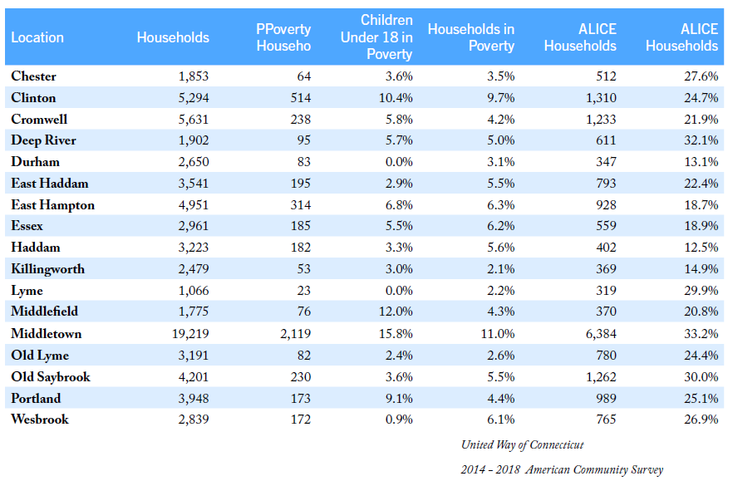
INCOME
INCOME CONSTRAINED HOUSEHOLDS
An average of 28% of Region’s households were ALICE (Asset Limited, Income Constrained, Employed).
The highest (33.2%) in Middletown
The lowest (12.5%) in Haddam

Slide 35
INCOME
POVERTY RATES
7% of the Region’s total population and 4% of its households live in poverty.
While the region’s poverty rate is lower than Connecticut’s (10%) and the U.S. (15%), it has significantly increased in recent years.

Slide 36
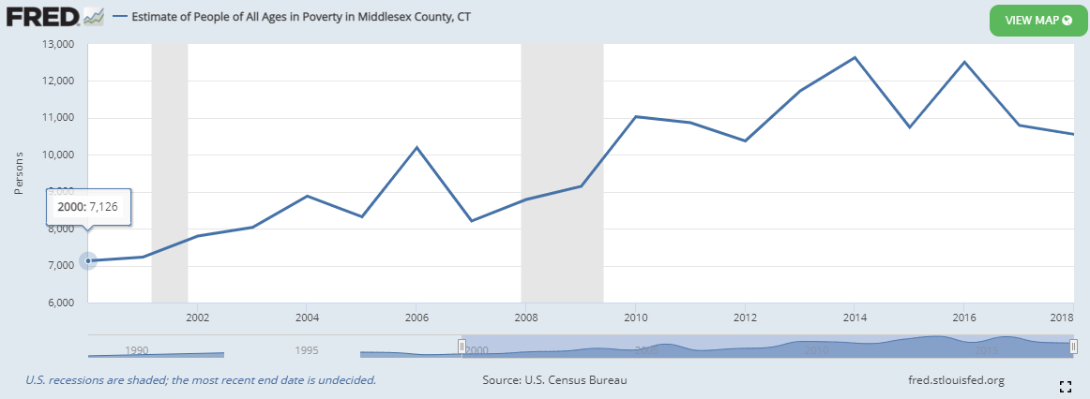
INCOME
POVERTY RATES
The number of people living in poverty in Middlesex County has increased by 42% since 2000 and totaled 12,358 persons in 2018. Trends in New London County and statewide are similar.

Slide 37
BREAK-OUT DISCUSSION
Is this information consistent with your experience in your town/the greater region?
x

Slide 38
BREAK-OUT DISCUSSION
What issues do you see for your town/the region based on these trends?
x

Slide 39
BREAK-OUT DISCUSSION
What are some steps we can take in the plan to address these issues?
x

Slide 40
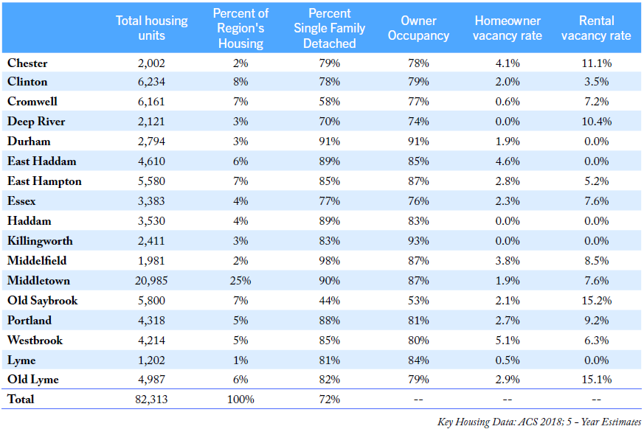
HOUSEHOLD SUPPLY AND MARKET
72% of the Region's housing stock is comprised of single-family detached units.
Rental vacancy rates are highest in the beach communities of Old Lyme and Old Saybrook where seasonal rentals comprised most of the rental stock.
Five towns have a 0% rental vacancy rate.

Slide 41
HOUSEHOLD SUPPLY AND MARKET
HOUSING BY TYPE
72% of the Region's housing stock are single-family detached units.
Source: US Census Bureau, American Community Survey 2013-2018

Slide 42
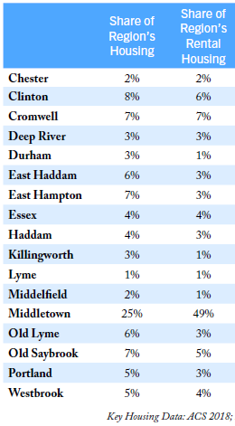
HOUSEHOLD SUPPLY AND MARKET
HOUSING STOCK
Middletown makes up 25% of the Region's housing stock but supplies nearly half (49%) of the Region's rental housing.
Most communities are home to less than 5% of the Region’s share of rental housing

Slide 43
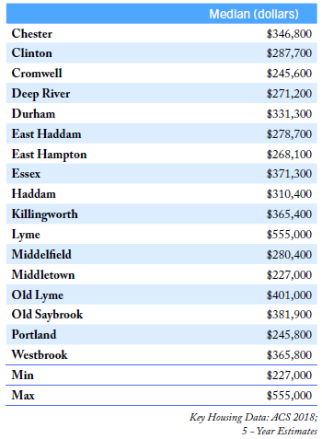
HOUSEHOLD SUPPLY AND MARKET
MEDIAN HOME VALUES
Middletown has the Region's lowest median home values at $227K.
Lyme has the Region's highest median home values at $555K.
Average median home value in the Region is $325K.
The median home value in Connecticut is $227k (same as Middletown’s)

Slide 44
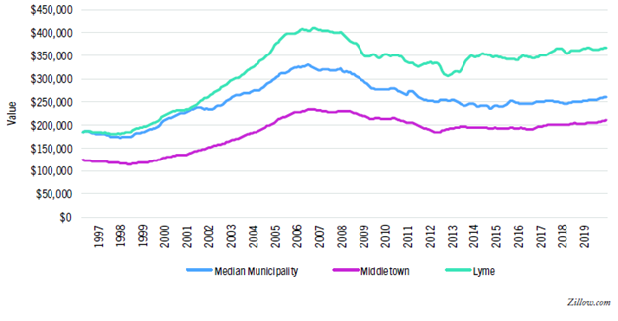
HOME VALUES
HOUSEHOLD SUPPLY AND MARKET
Home values across the Region plummeted following 2008 and have not yet reached 2007 levels.
Statewide median home value is currently $276,319.
Middlesex County median home value is currently $306,865
Source: Zillow.com

Slide 45
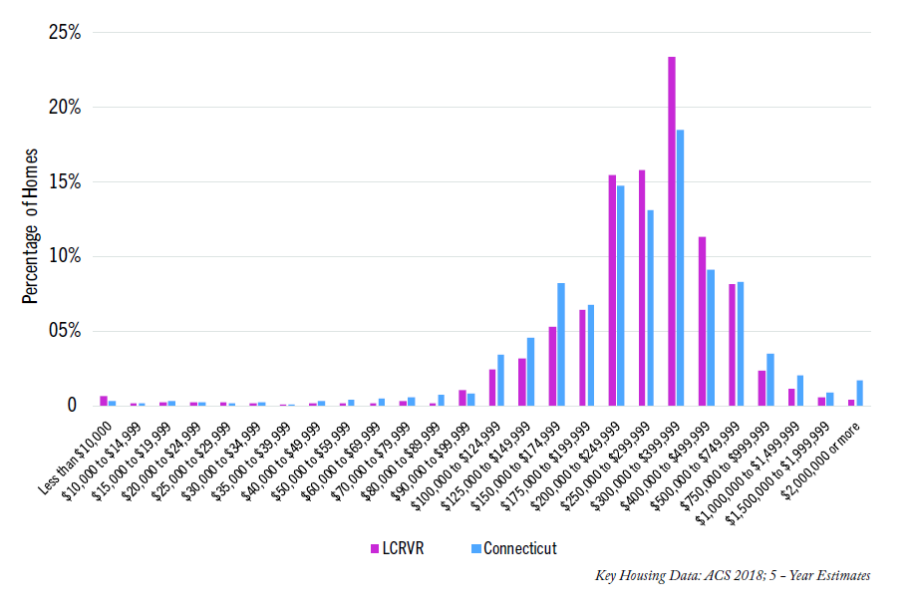
Home values in the Region compared to the State
HOUSEHOLD SUPPLY AND MARKET
The Region has a higher share of homes valued between $200k and $500k than the State, with a lesser share at lower and higher values.

Slide 46
HOUSEHOLD SUPPLY AND MARKET
HOUSING COST BURDEN HOUSEHOLDS (2018)
51% of the Region's renters are considered housing cost burdened (greater than 30% of income goes towards housing expenses).
30% of the region’s homeowners with a mortgage, and 19% of homeowners without a mortgage, are cost burden.
Source: US Census Bureau, American Community Survey 2013-2018

Slide 47
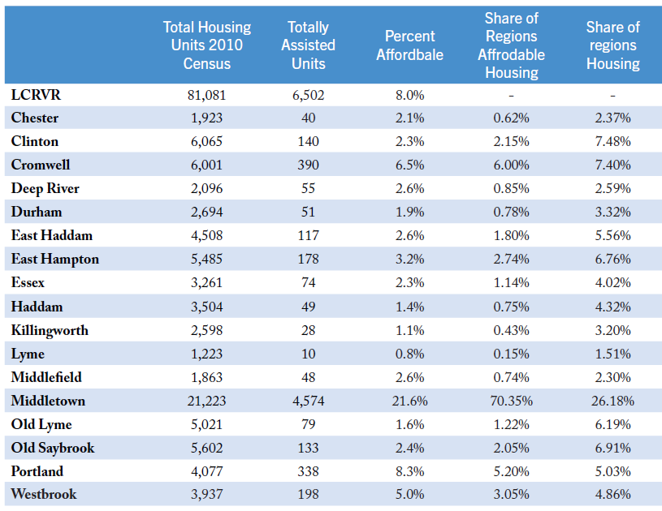
HOUSEHOLD SUPPLY AND MARKET
Share of Region’s Affordable
Housing
AFFORDABLE HOUSING
8% of the housing in the Region meets the 8-30g definition of “Affordable”.
Middletown accounts for 70% of the Region’s Affordable Housing.
Percent Affordable
Source: CT Department of Housing, Affordable Housing Appeals List, 2019

Slide 48
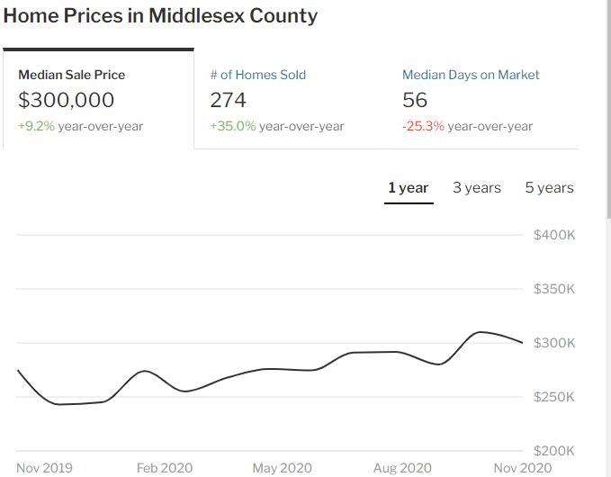
HOUSEHOLD SUPPLY AND MARKET
COVID IMPACTS
Home values in Middlesex County are up 9.2% since November of 2019 and sales are up 35%.
This is correlated with COVID-19 related migration to Connecticut.
Median sale price across Connecticut is currently $270,000.
Source: Redfin.com

Slide 49
BREAK-OUT DISCUSSION
Is this information consistent with your experience in your town/the greater region?
x

Slide 50
BREAK-OUT DISCUSSION
What issues do you see for your town/the region based on these trends?
x

Slide 51
BREAK-OUT DISCUSSION
What are some steps we can take in the plan to address these issues?
x

Slide 52
ANTICIPATED TIMELINE
Notes:
Here you can see a breakdown of the anticipated timeline for the creation of the RPOCD. We kicked off the project in the winter of 2019 and do not anticipate completion until Spring of 2021.
We are currently in Phase 4 of this process, at the Region Thematic Meetings (Fourth Column, First Line).
Following the Regional Thematic Meetings (the last one will be January 5, 2021), we we will be posting the draft RPOCD for public comment.
Check the website for access to the draft document and to provide your thougths and comments.

Slide 53
GET INVOLVED
Visit the website for project updates: RiverCOGRegionalPlan.org
Sign up for email notifications
Share this presentation with others in your community
Interact with your RPC Member
Provide comments on the draft document
Join us at the next meeting!
Notes:
Going forward, there are several ways that you can get involved, including visiting the project website, signing up for email notificaitons, and sharing this presentation with others in your community.
Most importantly, please join us at the upcoming workshops and have your opinions heard!

Slide 54
YOUR RPC MEMBERS
Notes:
The RPC oversees the creation of the RPOCD and its members are your representatives in this process.
Take a look at this list and find your representatives. You can reach out to them with your thoughts, comments, and concerns via the email links on the Project website.
You are also welcome to reach out to RiverCOG staff directly. Our email is also available on the website.

Slide 55
Contact Us
Chester ChesterRPC@gmail.com
Clinton ClintonRPC@gmail.com
Cromwell CromwellRPC@gmail.com
Deep River DeepRiverRPC@gmail.com
Durham DurhamRPC@gmail.com
East Haddam EastHaddamRPC@gmail.com
East Hampton EastHamptonRPC@gmail.com
Essex EssexRPC1@gmail.com
Haddam – HaddamRPC@gmail.com
Killingworth KillingworthRPC@gmail.com
Lyme LymeRPC@gmail.com
Middlefield MiddlefieldRPC@gmail.com
Middletown MiddletownRPC@gmail.com
Old Lyme OldLymeRPC@gmail.com
Old Saybrook OldSaybrookRPC@gmail.com
Portland PortlandRPC1@gmail.com
Westbrook WestbrookRPC1@gmail.com
Megan Jouflas MJouflas@Rivercog.org
RivercogRegionalPlan.org

Slide 56
NEXT STEPS
Upcoming Workshops:
Visioning and Branding – December 15, 2020 at 6:00pm
Mapping Workshop (Part a) - December 21, 2020 at 6:00pm
Mapping Workshop (Part b) - January 5, 2021 at 6:00pm

