Slide 1
Workshop Two
Visioning and Branding for the Region
12/15/20
Notes:
[Sam] Hello, and thank you for joining us this evening. My name is Sam Gold and I am the Executive Director of the Lower Connecticut River Valley Council of Governments, or RiverCOG. I am joined today by [list names and titles] who will be assisting me in conducting this workshop.
We ask you to please sign in to the meeting with your name, town, and email address in the zoom chatbox. The chat icon is found on the bottom of the zoom screen. Please be sure to include your email address – without it, we won't be able to reach out about progress on the RPOCD or upcoming events.

Slide 2
THE PROJECT
Regional Plan of Conservation and Development (RPOCD)
Policy document that sets goals and makes recommendations for the region
Previous Public Outreach
Introductory Presentations (June 29, 2020 and July 7, 2020)
Municipal Meetings (July 2020 – September 2020)
Existing Conditions Report
Statistical data on current trends and key issues in the region
Regional Thematic Meetings (Virtual Workshops)
Demographics (December 9, 2020)
Visioning/Branding (December 15, 2020)
Future Land Use Map – Part A (December 21, 2020)
Future Land Use Map – Part B (January 5, 2021)
RiverCOGRegionalPlan.org
Notes:
[Sam] As with Workshop 1, we'll begin with a little background. This information will not be new to those who joined us at the last workshop, but for those who are joining us for the first time, welcome!
We are here this evening because RiverCOG, the Regional Planning Committee (RPC), and our consultant Fitzgerald and Halliday are working on the first ever Regional Plan of Conservation and Development (RPOCD) for the region.
The RPOCD is a visionary policy document that sets goals and makes recommendations regarding preferred land uses, development patterns and types, and desirable areas for conservation, based on existing and emerging regional trends and challenges.
On June 29th and July 7th, we held a region-wide Introductory Presentation (and encore performance) that offered a primer on RiverCOG, the RPC, and the RPOCD. We then spent the summer (virtually) visiting each of the 17 towns in our region, gathering input on the issues and goals of each town and how they see their role in the region. All of these meetings are available to view on the project website (RiverCOGRegionalPlan.org).
Throughout this time, we have also been working on creating an Existing Conditions Report which compiles statistical data on current trends and key issues in the region. This document is in the process of being finalized and will be attached to the RPOCD as an appendix.
With the information we gathered so far, we began a series four Regional Thematic Meetings/Virtual Workshops, the first of which was held last Wednesday, December 9. There, we presented data on demographic issues and trends from the Existing Conditions Report and heard your thoughts on addressing those issues and trends in the region.
In tonight's workshop, Workshop 2, we will focus on the responses we received to visioning questions asked at the Municipal Meetings and will ask for your help in crafting a vision statement and key themes based on those responses.

Slide 3
AGENDA
Introduction
Vision for the Region
Breakout Discussion
Reporting Back
Themes in Planning
Breakout Discussion
Reporting Back
Next Steps
Notes:
[Sam]
We will conduct this workshop in two parts. The first part will focus on identifying a vision for the region. Specifically, we will review the responses to two questions that were asked at the Municipal Meetings – 1) What is your vision for the Lower Connecticut River Valley; and 2) What do you see as your town's role in the region. Then we will break out into groups to discuss your thoughts on consolidating those responses into a single vision statement. The breakout session will last for 20 minutes, after which we will reconvene to report on our findings.
Then we will move into the second part of the workshop which will focus on developing key themes for the RPOCD. We will explain a little bit about what we mean by themes and provide some examples. Then we will break out into groups again. Each group will work to generate a list of potential themes that can build to our regional vision. After 20 minutes in the breakout groups, we will reconvene and again report on our findings.
We will conclude this workshop with an overview of where we are in the process, ways you can get involved, and next steps.
[Pass to Megan]

Slide 4
VISION FOR THE REGION
What do we mean by vision?
A vision statement for a community or region, as expressed in a comprehensive plan, is an aspirational description of the community.
The plan, both in the process of creation and in its recommendations, is instrumental in achieving the vision.
What makes the LCRVR:
A place where people want to live and work;
A place where businesses want to locate; and
A place that people want to visit.
Notes:
[Megan]
If we are going to spend the first portion of this meeting discussing the regional vision and trying to come up with a "vision statement," it is important that we first explain what we mean by vision – what is it that we are trying to capture.
In terms of a community or regional planning document, like the RPOCD, a "vision statement" refers to an "aspirational description" of the community. It is forward looking. Where do we want to go? What do we want to look like or be as a region?
The vision statement really forms the basis for everything else in the RPOCD – all of the goals and recommendations in that document will be aimed at taking incremental steps toward achieving this overall vision.
When thinking about the vision statement, what we're really asking ourselves is - what makes [or will make] our region a place where people want to live and work, a place where businesses want to locate, and a place that people want to visit?

Slide 5
VISION FOR THE REGION
Connectivity
Question 1: What is your vision for the Lower Connecticut River Valley?
Shoreline Tourism
Diversity
Agritourism
River/Waterfront
Natural Environment
Diversity of Businesses
Lifestyle Economy
Eco-Tourism
Arts and Culture
Historic Character
Notes:
This is not the first time we've brought up the regional vision. When we visited the 17 towns for the Municipal Meetings over the summer, the first question we asked was, "What is your vision for the Lower Connecticut River Valley?". The idea with this workshop is to share what we learned from those meetings and to build upon it.
From those Municipal Meetings we heard that the vision for the region should focus on :
Natural Environment
Historic Character
Shoreline Tourism
Connectivity
Agritourism
Eco-Tourism
Lifestyle Economy
Diversity of Business
Historic Character
River/Waterfront
Arts and Culture
Diversity
These concepts were sometimes mentioned in terms of things we have and should protect (like Natural Environment or the Connecticut River) or things we should improve upon or have more of (like Connectivity and Eco-Tourism), but they were all identified as important to the future vision, or where we need to go as a region.

Slide 6
VISION FOR THE REGION
Town Responses by the Numbers
Notes:
Interestingly, though maybe not surprisingly, we found that certain concepts were repeatedly mentioned across all of the municipal meetings:
Natural Environment/Eco-Tourism, as well as the River or Waterfront came up in 13 of 17 towns
Historic Character and/or Arts & Culture came up in 9 of 17 towns
Connectivity came up in 16 of 17 towns
And Tourism was mentioned (whether shoreline, eco, agritourism, or just in general) in 11 of 17 towns.
This chart represents how these elements, widely mentioned across by towns across the region, comprise the pieces of one unified vision.

Slide 7
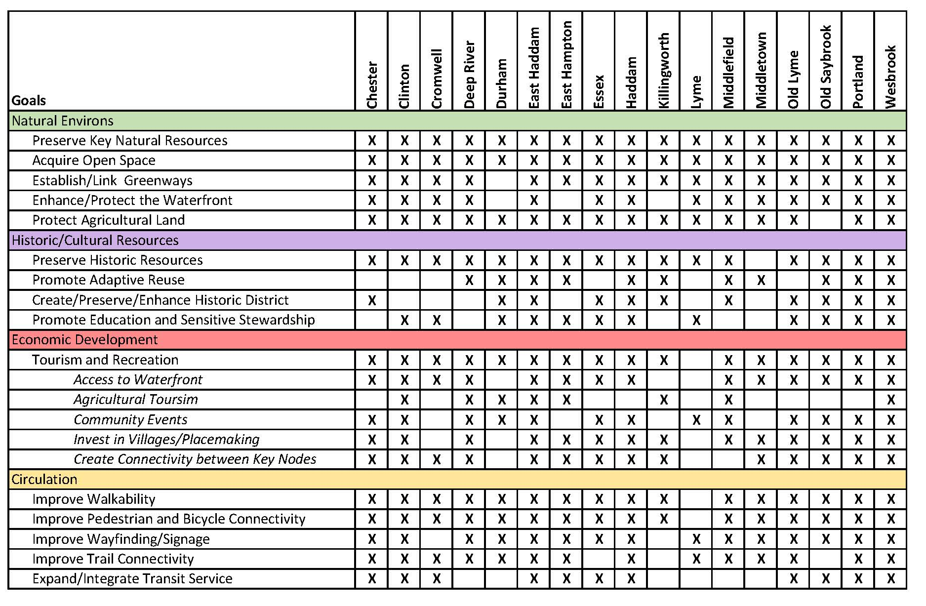
VISION FOR THE REGION
Municipal POCD
Goal Matrix
Notes:
And this is consistent with what we found when we looked at the POCDs for each of the towns. You'll see the towns listed across the top and goal topics down the left hand side. We looked through the plans from each of the towns and put an "x" in the boxes where a town had a goal or policy related to a specific topic. You'll notice the boxes are almost entirely filled in with "x's".
You may also notice (with the color coded headings) that these goals relate to the elements we heard at the municipal meetings (shown on the previous slide). We've distilled what we read in the plans to showcase the unity in these particular goals – Natural Environment, Historic/Cultural Resources, Economic Development (which in this case shows goals related to tourism), and circulation (which is largely related to the idea of connectivity – walkability, wayfinding, bike connections, etc.)

Slide 8
VISION FOR THE REGION
Question 2: What do you see as your town's role in the region?
Old Saybrook: Commercial/Business Hub, Gateway from the South
Durham/Middlefield: Agriculture, Suburban/Housing
Middletown: Economic Center, Destination for Business/Shopping/Dining
Haddam: Eco-center
Clinton: Hub/Gateway, Shoreline Access
Westbrook: Shoreline Access, Restaurants
Lyme: Natural Environment, Agriculture, Place to get away
Old Lyme: Shoreline/Waterfront Access, Economic Diveristy, Shopping/Services
Notes:
Despite these consistencies, we also recognize each town is different – no town has everything and every town has something - so really, it's only together that we can realize our overall vision.
The second question that we asked at the municipal meetings was, "What do you see as your town's role in the region?" [ review slide – continue to next slide]

Slide 9
VISION FOR THE REGION
Question 2: What do you see as your town's role in the region?
Essex: Historic Character
Deep River: Mid-Region hub, Historic Character
Chester: Arts and Culture
Killingworth: Agriculture, Natural Environment
East Hampton: Recreation and Commercial Hub, Gateway to the East
Portland: Recreation Hub/Suburban
Cromwell: Retail Center/Commercial Hub
East Haddam: Recreation, Agriculture

Slide 10
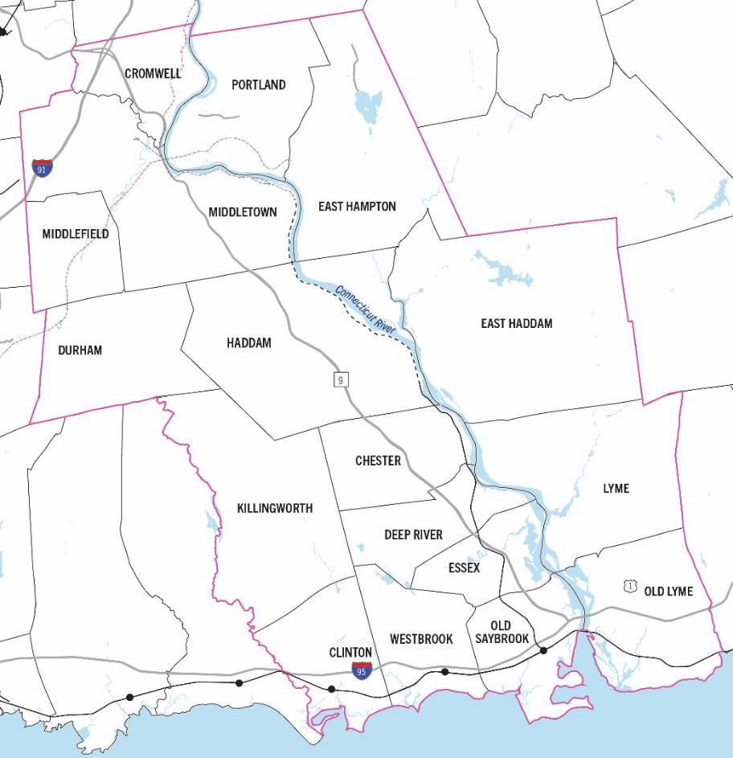
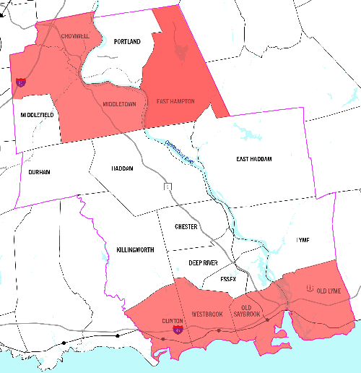
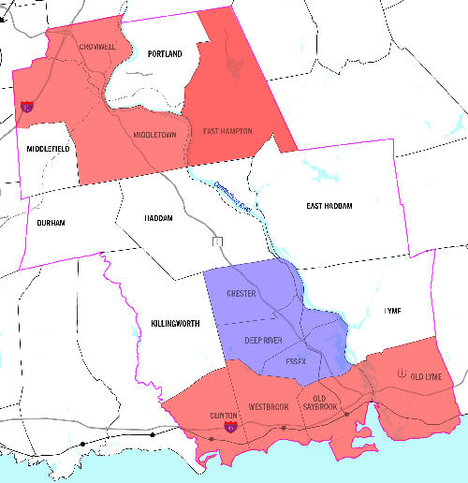
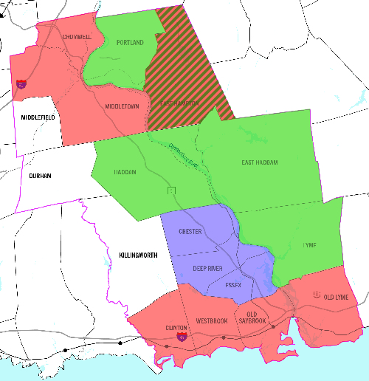
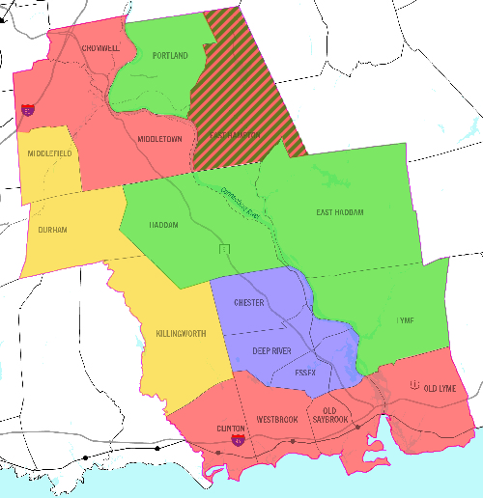
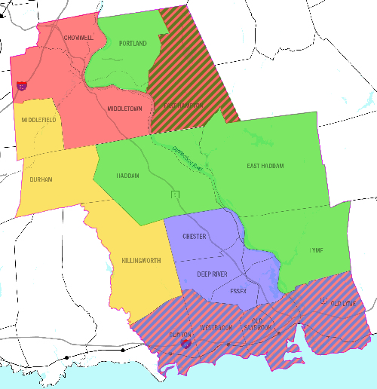
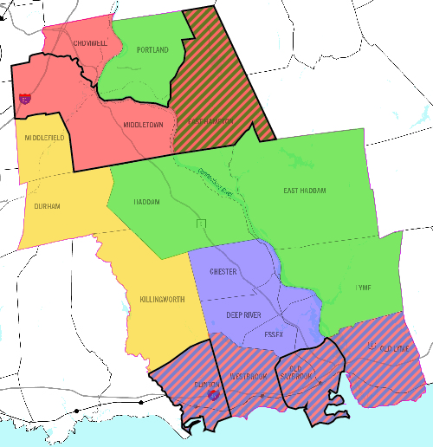
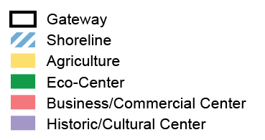
VISION FOR THE REGION
Each Town or City plays a role, or multiple roles, in the Region’s vision and identity.
Notes:
Based on these responses, we distilled the information we heard from the towns and came up with these groupings.
[animations]
As you can see from the map, some clear trendsemerged based on regional geography. We have our eco-centers to the east, farms to the west, a bustling shoreline to the south, a commercial hub to the north, and a historic central core.
And while we know that each town (has and will continue to have) multiple priorities and elements from all of these groups, these are the roles we heard the towns wanted to play in the greater regional vision.
Now we need to take these responses and identities, and try to consolidate that into a global vision statement – What will our region be?

Slide 11
VISION FOR THE REGION
How do we tie this vision together? What is our "elevator pitch"?
x
Notes:
Looking for a few one to two sentence pitches tieing all the aspects together
Remember the vision elements on Slide 6 – Natural Environment, River/Waterfront, Connectivity, Historic Character/Arts & Culture, Tourism
Remember also the map of towns: Our region has eco-centers to the east, farms to the west, a bustling shoreline to the south, a commercial hub to the north, and a historic central core.

Slide 12
VISION FOR THE REGION
Report Back
Notes:
[Megan]
Order of reporting:
Sam, Francisco, Megan (if I have a group)
Now I'm going to turn things over to Francisco for the second portion of our workshop to talk about themes -

Slide 13
THEMES IN PLANNING
What do we mean by themes?
Themes:
Summarize the core values and aspirations for a community or region
Are big picture ideas that build toward the vision statement
Goals and recommendations in the RPOCD will be geared toward and categorized by three/four themes
Themes will build toward the future land use map
Notes:
[Francisco]

Slide 14
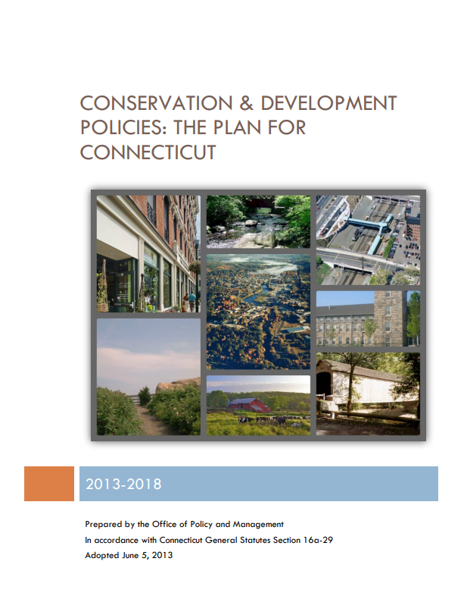
THEMES IN PLANNING
Example: Themes (principles) expressed in the Statewide Plan
Integrated Planning or investment
Efficiencies and coordination of services
Redevelopment of existing infrastructure
Transportation choices
Development of housing affordable to households of varying income
Concentrated, mixed use, mixed income development
Conservation and protection of natural resources
Notes:
[Francisco]

Slide 15
THEMES IN PLANNING
Example from the Capitol Region
Notes:
[Francisco]

Slide 16
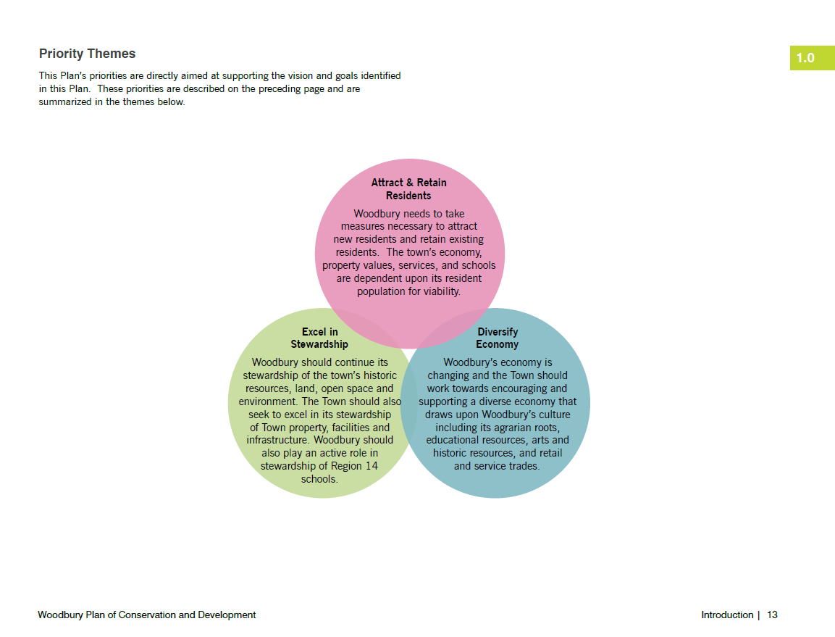
THEMES IN PLANNING
Example from the Town of Woodbury
Notes:
[Francisco]

Slide 17
THEMES IN PLANNING
What are common themes that are representative of our values and priorities for the region?
x
Notes:
Looking for key words or short phrases that can build toward the vision
Even though we won't have a vision statement, we can focus on the 5 elements – Natural Environment, River/Waterfront, Connectivity, Historic Character/Arts & Culture, Tourism
Also bring back what we heard in the first breakout group and the reporting from other groups
Try to focus on big ideas and short phrases. Remember that these will also build toward the LU map layers – we don't want the themes to be too nuanced at this stage.

Slide 18
THEMES IN PLANNING
Report Back
Notes:
[Megan]
Order of reporting:
Sam, Francisco, Megan (if I have a group)
Now I'm going to turn things over to Francisco for the second portion of our workshop to talk about themes -

Slide 19
ANTICIPATED TIMELINE
Notes:
[Megan]
This is another refresher for those of you who were at the first workshop, so bear with me if this is redundant!
Here you can see a breakdown of the anticipated timeline for the creation of the RPOCD. We kicked off the project in the winter of 2019 and do not anticipate completion until Spring of 2021.
We are currently in Phase 4 of this process, at the Region Thematic Meetings (Fourth Column, First Line).
Following the Regional Thematic Meetings (the last one will be January 5, 2021), we we will be posting the draft RPOCD for public comment.
Check the website for access to the draft document and to provide your thougths and comments.

Slide 20
GET INVOLVED
Visit the website for project updates: RiverCOGRegionalPlan.org
Sign up for email notifications
Share this presentation with others in your community
Interact with your RPC Member
Provide comments on the draft document
Join us at the next meeting!
Notes:
[Megan]
Going forward, there are several ways that you can get involved, including visiting the project website, signing up for email notificaitons, and sharing this presentation with others in your community.
Most importantly, please join us at the upcoming workshops and have your opinions heard!

Slide 21
YOUR RPC MEMBERS
Notes:
[Sam]
The RPC oversees the creation of the RPOCD and its members are your representatives in this process.
Take a look at this list and find your representatives. You can reach out to them with your thoughts, comments, and concerns via the email links on the Project website.
You are also welcome to reach out to RiverCOG staff directly. Our email is also available on the website.

Slide 22
Contact Us
Chester ChesterRPC@gmail.com
Clinton ClintonRPC@gmail.com
Cromwell CromwellRPC@gmail.com
Deep River DeepRiverRPC@gmail.com
Durham DurhamRPC@gmail.com
East Haddam EastHaddamRPC@gmail.com
East Hampton EastHamptonRPC@gmail.com
Essex EssexRPC1@gmail.com
Haddam – HaddamRPC@gmail.com
Killingworth KillingworthRPC@gmail.com
Lyme LymeRPC@gmail.com
Middlefield MiddlefieldRPC@gmail.com
Middletown MiddletownRPC@gmail.com
Old Lyme OldLymeRPC@gmail.com
Old Saybrook OldSaybrookRPC@gmail.com
Portland PortlandRPC1@gmail.com
Westbrook WestbrookRPC1@gmail.com
Megan Jouflas MJouflas@Rivercog.org
RiverCOGRegionalPlan.org
Notes:
[Sam]

Slide 23
NEXT STEPS
Upcoming Workshops:
Mapping Workshop (Part a) - December 21, 2020 at 6:00pm
Mapping Workshop (Part b) - January 5, 2021 at 6:00pm
Notes:
[Sam]
We have two workshops remaining in this process – both related to the creation of the Future Land Use Map. The first will be held next Monday, December 21 and the second will be three weeks from today, on January 5.
These workshops have been designed as a part a and b, so we really hope you attend both! In the first worship, we will present some baseline land use data that will be used in creating our future land use map. We will then send attendees home with an assignment – to mark up the map! The mark-up processess and what we are looking for will be explained at the first workshop. Then, at the second workshop, we will listen talk about your mark-ups and how you see the future land use map evolving.
Because the mapping workshops are essentially one workshop that has been split in two, they are anticipated to be much shorter, running no more than 1 hour.
If for whatever reason you are unable to attend part a of the mapping workshop, that’s ok! You will be able to view the presentation and map online and come to part b ready to participate!
Thank you for your participation so far and we hope you can join us at the upcoming workshops!

Slide 24
Extra Slides

Slide 25
VISION FOR THE REGION
Question 1: What is your vision for the Lower Connecticut River Valley?
Old Saybrook: Natural Environment, Historic Character, Shoreline Tourism, Connectivity
Durham/Middlefield: Agritourism, Eco-Tourism, Lifestyle Economy, Connectivity
Middletown: Eco-Tourism, River, Diversity of Business, Connectivity
Haddam: Natural Environment, Eco-Tourism, Historic Character, Connectivity
Clinton: Shoreline Tourism, Connectivity
Westbrook: Natural Environment, Shoreline Tourism, River/Waterfront, Historic Character, Lifestyle Economy, Connectivity

Slide 26
VISION FOR THE REGION
Question 1: What is your vision for the Lower Connecticut River Valley?
Lyme/Old Lyme: Natural Environment, River/Waterfront, Connectivity
Chester/Essex/Deep River: Natural Environment, River, Historic Character, Eco-Tourism, Arts and Culture, Connectivity
Killingworth: Natural Environment, Historic Character, River/Waterfront, Connectivity
East Hampton/Portland: Agriculture, Arts and Culture, River/Waterfront, Connectivity, Diversity
Cromwell: River/Waterfront, Connectivity
East Haddam: Eco-Tourism, Waterfront

