Slide 1
Workshop Three
Part A
Future Land Use Planning
12/21/20
Notes:
[Sam] Hello, and thank you for joining us this evening. My name is Sam Gold and I am the Executive Director of the Lower Connecticut River Valley Council of Governments, or RiverCOG. I am joined today by [list names and titles] who will be assisting me in conducting this workshop.
We ask you to please sign in to the meeting with your name, town, and email address in the zoom chatbox. The chat icon is found on the bottom of the zoom screen. Please be sure to include your email address – without it, we won't be able to reach out about progress on the RPOCD or upcoming events.

Slide 2
THE PROJECT
Regional Plan of Conservation and Development (RPOCD)
Policy document that sets goals and makes recommendations for the region
Previous Public Outreach
Introductory Presentations (June 29, 2020 and July 7, 2020)
Municipal Meetings (July 2020 – September 2020)
Existing Conditions Report
Statistical data on current trends and key issues in the region
Regional Thematic Meetings (Virtual Workshops)
Demographics (December 9, 2020)
Visioning/Branding (December 15, 2020)
Future Land Use Map – Part A (December 21, 2020)
Future Land Use Map – Part B (January 5, 2021)
RiverCOGRegionalPlan.org
Notes:
[Sam] As with the last two workshops, we'll begin with a little background. This is repeat information for those who have joined us before, so bear with me. For those who are joining us for the first time, welcome!
We are here this evening because RiverCOG, the Regional Planning Committee (RPC), and our consultant Fitzgerald and Halliday are working on the first ever Regional Plan of Conservation and Development (RPOCD) for the region.
The RPOCD is a visionary policy document that sets goals and makes recommendations regarding preferred land uses, development patterns and types, and desirable areas for conservation, based on existing and emerging regional trends and challenges.
On June 29th and July 7th, we held a region-wide Introductory Presentation (and encore performance) that offered a primer on RiverCOG, the RPC, and the RPOCD. We then spent the summer (virtually) visiting each of the 17 towns in our region, gathering input on the issues and goals of each town and how they see their role in the region. All of these meetings are available to view on the project website (RiverCOGRegionalPlan.org).
Throughout this time, we have also been working on creating an Existing Conditions Report which compiles statistical data on current trends and key issues in the region. This document is in the process of being finalized and will be attached to the RPOCD as an appendix.
With the information we gathered so far, we began a series four Regional Thematic Meetings/Virtual Workshops. The first workshop was held on Wednesday, December 9. There, we presented data on demographic issues and trends from the Existing Conditions Report and heard your thoughts on addressing those issues and trends in the region.
The second workshop was held last Tuesday, December 15, where we asked you to craft a vision statement for the region and brainstorm key themes for the RPOCD.
These (and all other) presentations are available to veiw on the project website – rivercogregionalplan.org
At tonight's workshop, the first of two in our mapping series, we will be giving you some background information on future land use maps and previewing the exercise we will be giving you at the next (and final) workshop.

Slide 3
AGENDA
Introduction
Introduction to Future Land Use Planning
Examples of Future Land Use Maps
Explanation of Part B
Next Steps
Notes:
[Francisco]

Slide 4
FUTURE LAND USE PLANNING
Future Land Use Planning and Mapping is a State mandate at both the local and regional level and an opportunity to direct resources towards geographic areas in a very intentional way.
Future Land Use Planning and Mapping can identify areas most suitable for:
Housing development at various intensities and scales
Economic development of different types
Agriculture
Conservation
Public spaces and land uses such as parks and schools
Transportation corridors and links
Other land uses

Slide 5
FUTURE LAND USE PLANNING
Future Land Use Planning and Mapping establishes a foundation for local and regional plans and policies including:
Municipal Zoning
Economic Development Plans
Open Space and Conservation Plans
Transportation Plans
Capital Improvement Plans

Slide 6
FUTURE LAND USE PLANNING
Future Land Use Maps can vary widely in detail, emphasis, categories, and prescriptiveness.
The following slides provide examples of these maps:
The Fourth Regional Plan map (New York Metropolitan Area)
SCCOG’s Regional Plan map
San Diego’s General Plan map
Marble Falls, Texas Future Land Use Plan
Camden, NJ Land Use Vision Map
Richmond, VT Future Land Use Concept Plan

Slide 7
FUTURE LAND USE MAP EXAMPLE
The Regional Plan Association’s Fourth Regional Plan
Large metropolitan region consisting of parts of New York, New Jersey, and Connecticut
The map diverges from conventional land use categories

Slide 8
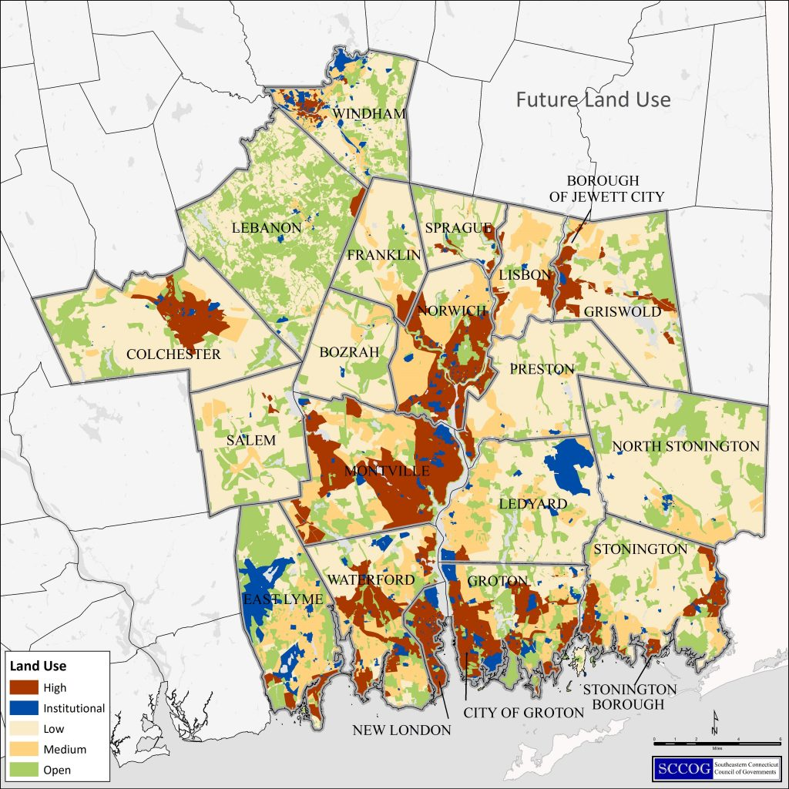
FUTURE LAND USE MAP EXAMPLE
SCCOG’s Future Land Use Map
An intensity-based vision for the region

Slide 9
FUTURE LAND USE MAP EXAMPLE
Future Land Use Maps often closely mirror existing land use, particularly in a region that favors infill development over expansion.
The example at right is from San Diego, CA

Slide 10
FUTURE LAND USE MAP EXAMPLE
Future Land Use Maps are often oriented along corridors.
This example from a Texas community reveals the transportation and corridor focus of growth in that region.
The RiverCOG region is oriented along a natural corridor (the CT River)

Slide 11
FUTURE LAND USE MAP EXAMPLE
Future Land Use Maps can be conceptual and approximate in geography.
This example from Camden, NJ takes a “broad brush” approach
It is directly linked to policy goals

Slide 12
FUTURE LAND USE MAP EXAMPLE
Future Land Use Maps can be conceptual and approximate in geography.
This example from Camden, NJ takes a “broad brush” approach
It is directly linked to policy goals

Slide 13
FUTURE LAND USE MAP EXAMPLE
The map starts with a conceptual diagram for a community or region’s priorities.
This example is from Richmond, VT

Slide 14
MAPPING WORKSHOP - PART B
At the next workshop, we will focus on mapping your region!
We will show you an interactive map of YOUR region
We will layer data on the map for you to consider
We will send you home with an assignment
Notes:
[Francisco]
[pass to Megan]

Slide 15
MAPPING WORKSHOP - PART B
We will be asking you to map the following features:
Town Centers
Integration of residential, commercial, employment, and civic uses
Activity hubs that serve as the pedestrian-friendly core of the community
Characterized by inviting and accessible streets and public spaces
Innovation Development Areas
Industrial, commercial service, and commercial retail uses (or a mixture of these)
Focus on areas for employment generating land uses
Notes:
[Megan]
Once the interactive tool is established, we will be asking you to identify some key features. We will be going over these again at the next meeting, but wanted to send you away with some descriptions in advance so you can be mulling them over over the holidays!
So first, we will be asking you to identify what we are calling "Town Centers". This may be a bit of a misnomer, because there can be more than one (or none) in a town, and they don't necessarily have to be in the center! What we are looking for are areas where you would like to see an integration of residential, commercial, employment, and civic uses. These areas will be pedestrian friendly activity hubs with inviting spaces and accessible streets that emphasize community character.
Next, we will be looking for "Innovation Development Areas". These are areas where you would like to see industrial, commercial services, and/or commercial retail uses (or some mixture of these). The focus here is on areas for employment or business generating uses that tie our built environment to our region's economic development.

Slide 16
MAPPING WORKSHOP - PART B
We will be asking you to map the following features:
Housing Opportunity Areas
A mixture of housing types that are suitable for households of various sizes and income levels
Focus on creating economically and socially diverse communities
Utility Expansion Areas
Areas for extended sewer, public water, gas, etc.
Internet, cellular, and fiber optics
Notes:
We will also ask you to identify "Housing Opporutnity Areas".
We heard from you at the last several workshops that our region needs more affordable housing. We also heard from you that we have a lot of attainable housing that a) doesn't qualify as statutorily affordable, and b) may not be the right fit for a diversity of residents (such as single person households, younger residents, older residents, or non-family households).
This category is meant to encapsulate all of that. We are looking for areas to target a mixture of housing types that are suitable for households of various sizes and income levels. This could be apartments, condos, townhomes, duplexes, or even just single family homes on smaller lots. By planning for a diversity of housing types, we can create economically and socially diverse communities.
There will also be an opportunity for you to identify areas for utility expansion. These may be areas for extended sewer, public water, gas, internet, cellular, or fiber optics. Of course, we recognize that these areas will likely overlap - if you identify an area for Innovation Development or Housing Opportunity that does not already have necessary utilities, you are essentially identifying that as a utility expansion area. However, we will include this as a stand alone option for your consideration as well.

Slide 17
MAPPING WORKSHOP - PART B
We will be asking you to map the following features:
Connections
Links or "connections" between important land use destinations
Focus on a variety of modes or types of connections (sidewalk, bike path, transit, etc.) that can meet the needs of a diverse group of users
Other
Anything else you find important
Opportunity to input your own ideas not listed here
Notes:
We will also ask you to identify "Connections" - these are key links between important land use destinations. We heard at all of our previous meetings and workshops that you feel our region needs better connectivity. Here, you can identify locations for sidewalks, bike paths, transit connections, etc. To help us better connect everything our region has to offer. A focus on variety of mode choice for these connections can also help to meet the needs of a diverse group of users.
Finally, we will have an "Other" category. This will be your opportunity to call out any other ideas you think are important that are not listed here.

Slide 18
MAPPING WORKSHOP - PART B
Things to think about:
What do you want a future land use map to look like for our region?
What do you hope this plan's future land use map will help achieve in the region?
Find a copy of your town's future land use map in the POCD
Bring up this topic with friends and family over the holidays!! (It will be fun!)
Make this presentation go viral!
Notes:
Again, I'd like to remind you that we will be going over all of these map features again at the next workshop, but we'd like for you to be thinking about them between now and then.
And since we are going into the holidays and everyone will have an abundance of free time and mental space, we'd also like for you to think about a few other things.... [read slide]

Slide 19
MAPPING WORKSHOP - PART B
Questions/Discussion

Slide 20
ANTICIPATED TIMELINE
Notes:
[Megan]
This is another refresher for those of you who were at the first workshop, so bear with me if this is redundant!
Here you can see a breakdown of the anticipated timeline for the creation of the RPOCD. We kicked off the project in the winter of 2019 and do not anticipate completion until Spring of 2021.
We are currently in Phase 4 of this process, at the Region Thematic Meetings (Fourth Column, First Line).
Following the Regional Thematic Meetings (the last one will be January 5, 2021), we we will be posting the draft RPOCD for public comment.
Check the website for access to the draft document and to provide your thougths and comments.

Slide 21
GET INVOLVED
Visit the website for project updates: RiverCOGRegionalPlan.org
Sign up for email notifications
Share this presentation with others in your community
Interact with your RPC Member
Provide comments on the draft document
Join us at the next meeting!
Notes:
[Megan]
Going forward, there are several ways that you can get involved, including visiting the project website, signing up for email notificaitons, and sharing this presentation with others in your community.
Most importantly, please join us at the upcoming workshops and have your opinions heard!

Slide 22
YOUR RPC MEMBERS
Notes:
[Sam]
The RPC oversees the creation of the RPOCD and its members are your representatives in this process.
Take a look at this list and find your representatives. You can reach out to them with your thoughts, comments, and concerns via the email links on the Project website.
You are also welcome to reach out to RiverCOG staff directly. Our email is also available on the website.

Slide 23
Contact Us
Chester ChesterRPC@gmail.com
Clinton ClintonRPC@gmail.com
Cromwell CromwellRPC@gmail.com
Deep River DeepRiverRPC@gmail.com
Durham DurhamRPC@gmail.com
East Haddam EastHaddamRPC@gmail.com
East Hampton EastHamptonRPC@gmail.com
Essex EssexRPC1@gmail.com
Haddam – HaddamRPC@gmail.com
Killingworth KillingworthRPC@gmail.com
Lyme LymeRPC@gmail.com
Middlefield MiddlefieldRPC@gmail.com
Middletown MiddletownRPC@gmail.com
Old Lyme OldLymeRPC@gmail.com
Old Saybrook OldSaybrookRPC@gmail.com
Portland PortlandRPC1@gmail.com
Westbrook WestbrookRPC1@gmail.com
Megan Jouflas MJouflas@Rivercog.org
RiverCOGRegionalPlan.org
Notes:
[Sam]
Here is a list of all of the RPC email addresses – generally, they are [town name]rpc@gmail.com (though a few have a 1 following, such as essex, portland, and westbrook.
You can also reach out to Megan – her email address is shown as well.
Really, the only address you need to remember is the one in pink at the bottom – links to all of these email addresses (and this presentation with this slide) are available on the project website, rivercogregionalplan.org.

Slide 24
NEXT STEPS
Upcoming Workshops:
Mapping Workshop (Part B) - January 5, 2021 at 6:00pm
Notes:
[Sam]
We have one workshops remaining in this process – the second in our mapping series – which will occur on January 5th.
If someone you know was unable to attend tonight's workshop, that’s ok, they can still come to the next one! Direct them to the project website (rivercogregionalplan.org) to view tonight's presentation online and they can come to part B ready to participate!
Thank you for your participation so far and we hope you can join us at our final workshop!

Slide 25
DON'T FORGET.....
Things to think about:
What do you want a future land use map to look like for our region?
What do you hope that this plan's future land use map will help achieve in the region?
Bring up this topic with friends and family over the holidays!! (It will be fun!)
Find a copy of your town's future land use map in the POCD
Make this presentation go viral!

Slide 26
Extra Slides

Slide 27
FUTURE LAND USE MAPPING HOW-TO
We will approach this task by mapping the following features:
Village Core
Innovation/Economic Development Areas
Housing Opportunity Areas
Connections

Slide 28
FUTURE LAND USE MAPPING HOW-TO
Village Core
Map existing village centers whether commercially, institutionally, or residentially oriented.
Map areas that have the potential to become a village core.
Existing
Potential

Slide 29
FUTURE LAND USE MAPPING HOW-TO
Innovation/Economic Development Areas
Map existing innovation and economic development areas whether an arts and cultural district or an industrial park.
Map areas that have the potential to expand or emerge as an innovation or economic development area
Existing
Potential

Slide 30
FUTURE LAND USE MAPPING HOW-TO
Housing Opportunity Areas
Map existing housing opportunities areas such as town centers with diverse housing, housing in dense village areas, senior housing areas, etc.
Map areas that have the potential to provide or expand housing opportunity.
Existing
Potential

Slide 31
FUTURE LAND USE MAPPING HOW-TO
Connections
Map existing vital regional and local connections and connected areas for all modes of transport that you would like to focus on.
Map potential vital regional and local connections and connected areas for all modes of transport that you would like more resources directed to.
Existing
Potential

Slide 32
VISION FOR THE REGION
Question 1: What is your vision for the Lower Connecticut River Valley?
Old Saybrook: Natural Environment, Historic Character, Shoreline Tourism, Connectivity
Durham/Middlefield: Agritourism, Eco-Tourism, Lifestyle Economy, Connectivity
Middletown: Eco-Tourism, River, Diversity of Business, Connectivity
Haddam: Natural Environment, Eco-Tourism, Historic Character, Connectivity
Clinton: Shoreline Tourism, Connectivity
Westbrook: Natural Environment, Shoreline Tourism, River/Waterfront, Historic Character, Lifestyle Economy, Connectivity

Slide 33
VISION FOR THE REGION
Question 1: What is your vision for the Lower Connecticut River Valley?
Lyme/Old Lyme: Natural Environment, River/Waterfront, Connectivity
Chester/Essex/Deep River: Natural Environment, River, Historic Character, Eco-Tourism, Arts and Culture, Connectivity
Killingworth: Natural Environment, Historic Character, River/Waterfront, Connectivity
East Hampton/Portland: Agriculture, Arts and Culture, River/Waterfront, Connectivity, Diversity
Cromwell: River/Waterfront, Connectivity
East Haddam: Eco-Tourism, Waterfront

