Slide 1
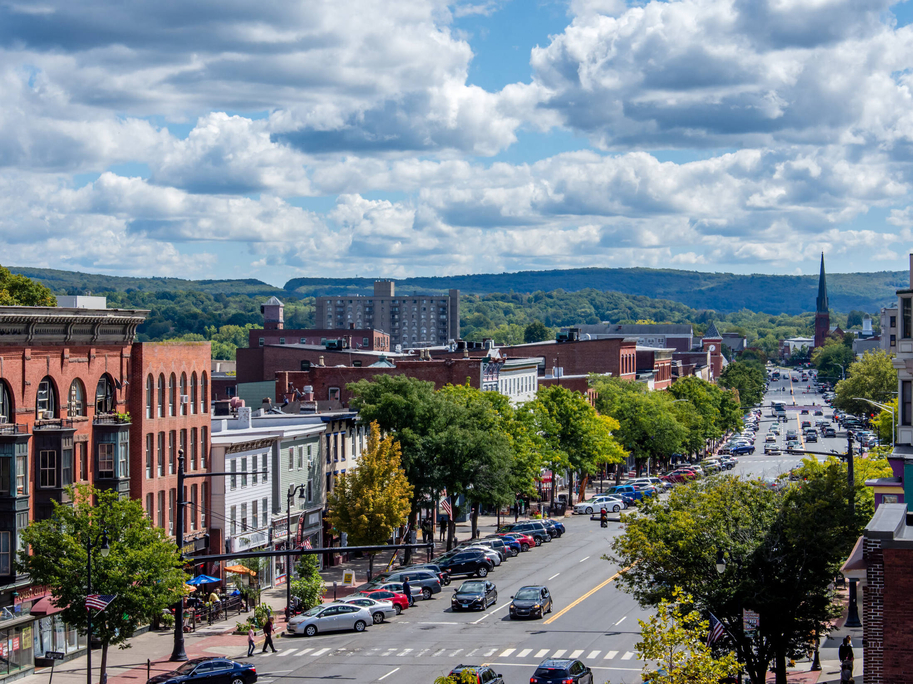
Middletown
Affordable Housing Plan (AHP)
Public Workshop
March 16, 2022

Slide 2
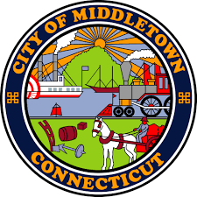
Project Team

Slide 3
Tonight's Agenda
1) Introduction
What is Affordable Housing and 8-30j?
What does this mean for Middletown?
2) Resources Review
Community Survey Results
Existing Conditions: Demographics + Housing
Housing Needs Assessment
3) Potential Strategies & Live Polling
4) Q&A Session

Slide 4
Tonight's Agenda
Your primary role tonight is to:
Learn more about affordable housing and why it is important to your community
Provide us with input on potential affordable housing strategies for your community
Ask questions you may have on the subject. Please type them in the chat - questions will be answered at the end of the workshop
Live Polling will be conducted later so have your phone or
a 2nd web browser window open

Slide 5
Introduction

Slide 6
Relationship to regional housing
Regional Housing Plan
Follow up to Regional Plan of Conservation and Development (RPOCD)
Completed in two parts:
Regional Housing Analysis
Focus on region-wide trends / challenges
Recommendations focus on how the region can assist the towns in housing coordination and creation
Municipal 8-30j Plans (Annexes)
Focus on municipality specific affordability conditions and strategies
Regional
Analysis
Municipal Plans
Each part of the process will inform the other

Slide 7
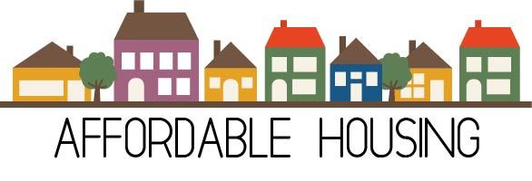
What is Affordable Housing?
Affordable housing is typically defined as housing that costs less than 30% of monthly income for households earning below the Area Median Income (AMI).
What does this really mean?
The aim is to create housing affordability options for households that earn less than the median income in their part of the State. To be attainable and sustainable, housing for this group should cost no more than 1/3 of what these households earn.
HOUSING AFFORDABILITY

Slide 8
What is Affordable Housing?
Affordable housing is typically defined as housing that costs less than 30% of monthly income for households earning below the Area Median Income (AMI).
{
Two Categories:
Naturally Occurring: Housing at market rates that may cost a low-income household less than 30% of income today but is not protected from increasing nor reserved for low-income occupants only
Protected Units: Housing reserved for low-income occupants and restricted through deed-restriction or subsidy to a cost that is no more than 30% of their income

Slide 9
Who is affordable housing targeting?
Typically, those earning less than 80% of the Area Median Income
Households of all sizes – individuals, families
Renters and homeowners
All age groups
Local workers
Area Median Income
Below Median/Low Income
Median/Moderate Income
Above Median/High Income
< 80%
80% to 120%
> 120%

Slide 10
Who is affordable housing targeting?
Typically, those earning less than 80% of the Area Median Income
Households of all sizes – individuals, families
Renters and homeowners
All age groups
Local workers
Area Median Income
Below Median/Low Income
Median/Moderate Income
Above Median/High Income
< 80%
80% to 120%
> 120%

Slide 11
Why is it important to consider?
Households that spend too much of their income (typically more than 30%) on housing costs are considered “cost-burdened.”
Households that are housing “cost-burdened” may
not have enough disposable income left over for necessities such as food, transportation and clothes.
Affordable housing options help low-income households from becoming “cost-burdened” by high housing costs in Connecticut.

Slide 12
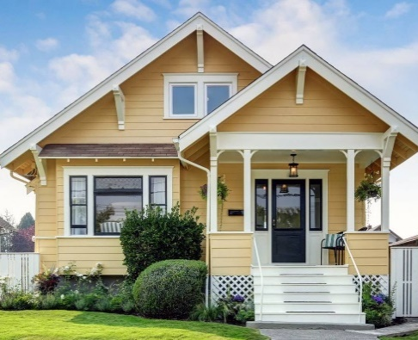
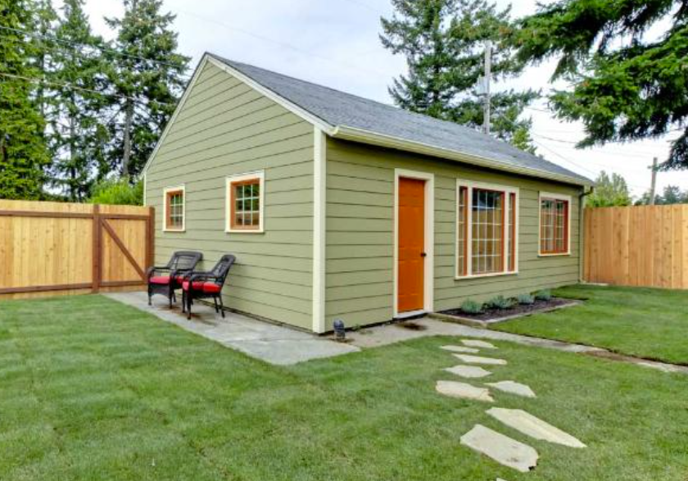
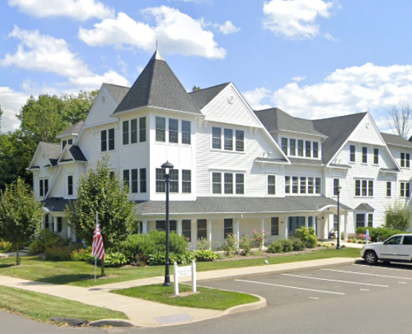
What can affordable housing be?
There is no one-size-fits all approach to creating housing that fits these income standards and provides affordable opportunities.
Housing that is affordable to low-income households can be achieved in many ways ranging from the type of unit to financing strategies. It could be:
A private rental apartment
Owner-occupied single-family homes
A mixed-income, medium-density community
An Accessory Dwelling Unit (ADU)
Notes:
See the storymap for more explanation of these types

Slide 13
Connecticut Affordable Housing Statutes
Based on these definitions, CT has adopted two key pieces of legislation that codify housing affordability goals and targets:
CT General Statutes Sec. 8-30g (1989)
Housing Land Use Appeals Procedure
Defines protected units
% of set-aside units
Sets income limits and cost maximums
Towns with more than 10% are exempt
Exempt from local zoning requirements
Can be denied only for health or safety
CT General Statutes Sec. 8-30j (2017)
Requires towns to adopt a plan
Increase amount of affordable housing
Focuses on strategies not numbers
Limited guidance in statute
Due by
June 1, 2022
Update
Every 5 years
12

Slide 14
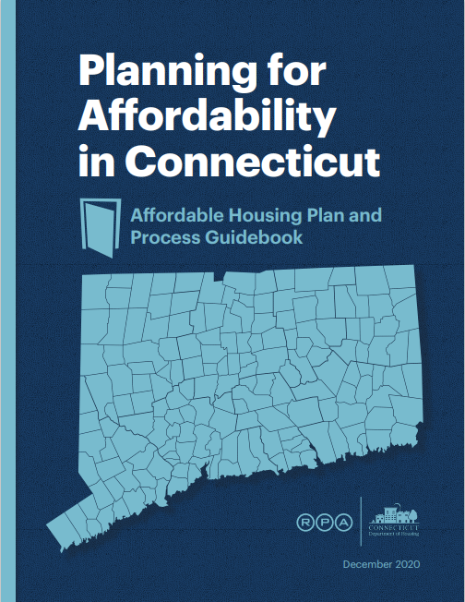
What is an Affordable Housing Plan?
State-required Plan under 8-30j:
Bottom-up approach to increase the State’s affordable housing supply
Show actionable progress towards meeting State goals
Each community decides what strategies are best for their community
Guidance on Plan creation:
Create a community values statement
Review local land use/zoning to identify barriers to development
Conduct a housing needs assessment
Develop plan goals, strategies and actions
Apply best practices to implement

Slide 15
How does this apply in MIDDLETOWN?
Based on the targeted income groups described previously, in Middletown:
Income Limits and Housing Budgets for Middletown
 | Income Level | Yearly Income | Monthly Housing Budget (Rent or Own)
Household Size of 1 | <80% AMI | <$52,150 | $1,399 per month
Household Size of 4 | <80% AMI | <$79,900 | $1,998 per month
Source: FY 2021 Income Limits Hartford HUD Metro FMR Area
Note: Housing costs include rent or mortgage payments, property taxes, utilities, HOA fees, and maintenance costs. Income-based calculation includes monthly income but not assets or savings.

Slide 16
This is an opportunity to begin a conversation about how to create affordable housing that reflects Middletown’s values and priorities.
Notes:
The POCD is currently being updated but the existing 2012 Plan is still our guide at this point.

Slide 17
How do we begin?
We have a series of resources or tools to help begin the conversation:
Zoning Analysis
>>
What can be built in Middletown and where?
Demographics
>>
Who lives here now and will in the future?
Housing Trends
>>
What kinds of housing exist today?
Housing Needs Assessment
>>
What housing needs are met and unmet?

Slide 18
Existing Conditions:
Planning + Zoning Review

Slide 19
2020 pocd: housing + residential strategies
Mix uses to ensure neighborhood vitality
Create
walkable neighborhoods
Concentrate development along major corridors
Encourage low-impact development
Create a range of housing choices
Limit development where water + sewer exists
Protect unique character of neighborhoods
Encourage compact building design
19
Notes:
Note: the 2022 POCD is currently being updated and will include housing recommendations from this process

Slide 20
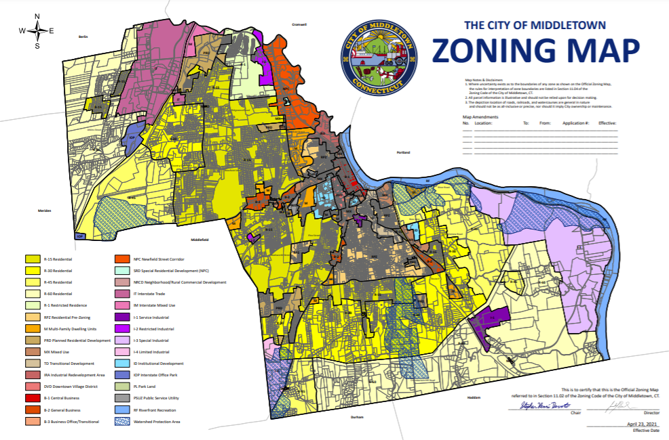
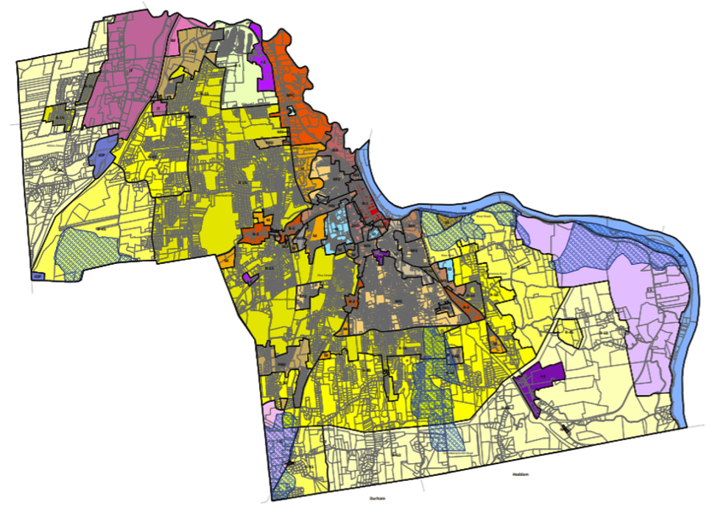
Zoning
20
Notes:
Residential Zones: R-1, R-15, R-30, R-45, R-60, RPZ
M (Multi-Family Dwellings)
PRD (Planned Residential Development)
Special Residential Development (SRD),
RDD (Redevelopment Design District)

Slide 21
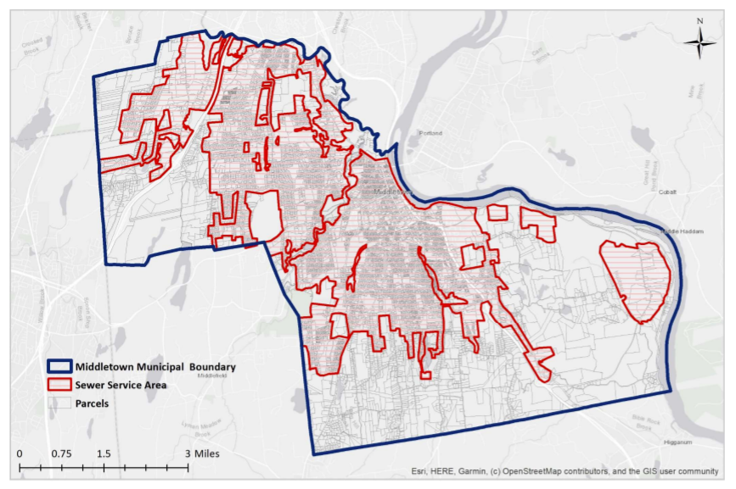
Infrastructure
21
Notes:
Residential Zones: R-1, R-15, R-30, R-45, R-60, RPZ
M (Multi-Family Dwellings)
PRD (Planned Residential Development)
Special Residential Development (SRD),
RDD (Redevelopment Design District)

Slide 22
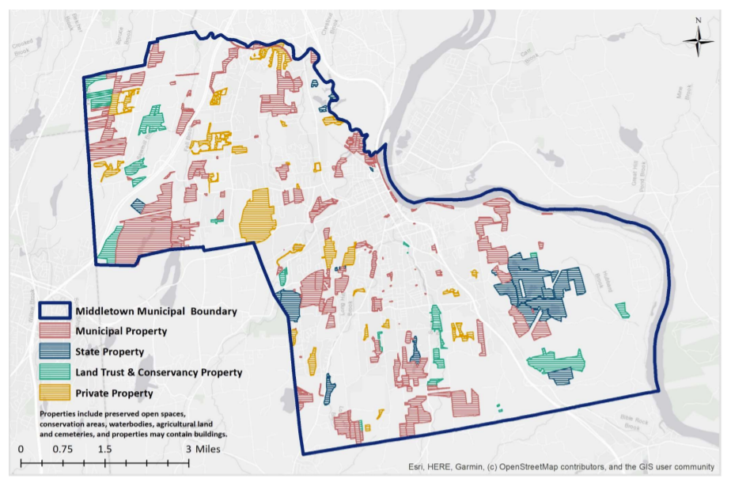
Buildable land
22
Notes:
Residential Zones: R-1, R-15, R-30, R-45, R-60, RPZ
M (Multi-Family Dwellings)
PRD (Planned Residential Development)
Special Residential Development (SRD),
RDD (Redevelopment Design District)

Slide 23
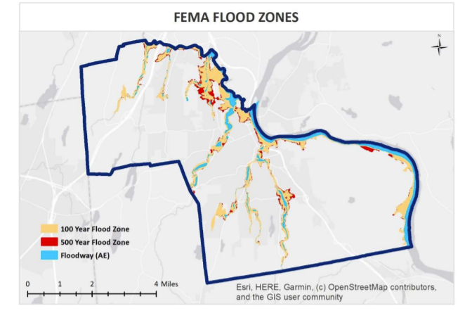
Natural constraints
23
Notes:
Residential Zones: R-1, R-15, R-30, R-45, R-60, RPZ
M (Multi-Family Dwellings)
PRD (Planned Residential Development)
Special Residential Development (SRD),
RDD (Redevelopment Design District)

Slide 24
ZONING + BUILDABLE LAND TAKEAWAYS
A wide range of zoning districts with range of permitted uses and densities
Many areas of the City are single-family districts
Natural constraints limitations:
Environmentally sensitive areas wetlands, flood zones from the Connecticut River
Protected open space areas
Fewer natural constraints due to urban nature
Moderate infrastructure limitations
Water and sewer is present in a substantial portion of the City
POCD does not support expanding the existing service areas

Slide 25
EXISTING CONDITIONS:
Demographic Trends

Slide 26
POPULATION TRENDS
Total Population:
2000
43,167
2010
47,648
2020
47,717
2040
57,662
Age Distribution:
“Baby Boomers”
<15 years
30s to 50s
15.3% of population is over 65
Source: 2019 ACS 5-Year Estimates, Tables B01001

Slide 27
Household composition Trends
2.2
Average Household Size
37%
Married- Couple Households
38%
Individual Households
70%
One or Two Person Households
Source: 2019 ACS 5-Year Estimates, Tables B01001

Slide 28
Employment trends
Where People Who Work in Middletown Live (ACS 2019)
All Workers | 23,188 | 100.0%
Middletown, CT | 3,808 | 16.40%
Meriden, CT | 1,199 | 5.20%
New Britain, CT | 785 | 3.40%
Hartford, CT | 529 | 2.30%
Bristol, CT | 493 | 2.10%
East Hartford, CT | 389 | 1.70%
Newington, CT | 386 | 1.70%
West Hartford, CT | 373 | 1.60%
New Haven, CT | 327 | 1.40%
Portland, CT | 321 | 1.40%
Waterbury, CT | 313 | 1.30%
Wethersfield, CT | 304 | 1.30%
28,112 jobs in Middletown
Largest sector: Health care + social assistance
84% of workers commute from out of Middletown
Major Employers 2021 (AdvanceCT)
Pratt & Whitney
Fedex Ground
Middlesex Health
Connecticut Valley Hospital
Community Health Center
Notes:
84% of people who work in Middletown commute from other communities which indicates that many local workers do not reside in Middletown
Potential jobs vs. housing mismatch
Meriden – 77%
Waterbury – 67%
New Britain – 80%
Hartford – 88%

Slide 29
EXISTING CONDITIONS:
Housing Market Trends

Slide 30
HOUSING TENURE
Source: 2019 ACS 5-Year Estimate, Table B25023
Middletown’s tenure is almost evenly split between owner-occupied and renter-occupied
Middletown has a larger percentage of renters than Middlesex County as a whole
Correlates with the high availability of rental multi-family and apartment-style housing options
30

Slide 31
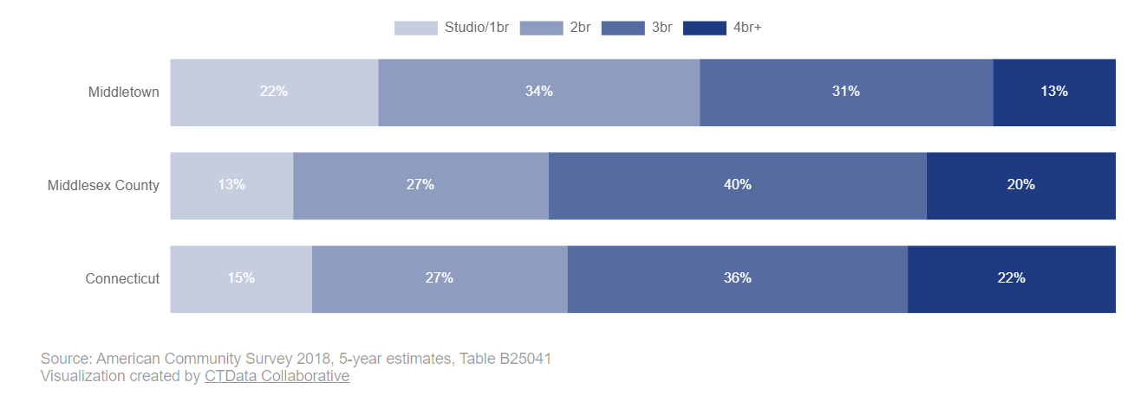
Housing Typology
Distribution of Housing Units, by Number of Bedrooms
Compared to the region and state, Middletown has a good mix of housing at varying sizes
44% of housing units in Middletown have 3 or more bedrooms
22% are studios or one bedrooms which meet needs of small households
31

Slide 32
Housing Typology
44% of dwellings are detached single-family homes
52% of all units are multi-family: much stronger mix of units than State and County
According to RPOCD, 81% of Region’s multi-family housing is in Middletown
City of Middletown contains 26% of Region’s housing units and most diverse​
Source: 2019 ACS 5-Year Estimate

Slide 33
Housing Permits
New housing construction dropped off significantly in Middletown since 2008
2015 saw 123 permits issued due to permitting of new development on College St.
The number of annual permits has not exceeded 25 in the past five years
33

Slide 34
Home Value Distribution
Source: 2019 American Community Survey, 5-Year Estimates, Table B25075
Data shows home value ranges that provide naturally affordable options
72% of homes are valued under $299,999
However, this does not mean that all needs for all population and income groups are being met
34

Slide 35
Gross Rent Distribution
Middletown had a total of 9,124 rental units in 2019
Majority of these units cost less than $1,500 per month
35.4% of rental units are under $1,000
Naturally affordable rental options existing but this does not mean all need is currently being met
35

Slide 36
HOUSING NEEDS ASSESSMENT

Slide 37
PROTECTED AFFORDABLE HOUSING
The State maintains a list of the protected affordable units in each municipality
As of 2020, 4,756 units, or 21.9% of Middletown’s total housing units were protected affordable units.
Middletown is the only community in the Region to meet the goal and has one of the highest rates of affordable units in the State
Source: DECD Affordable Housing Appeals List, 2021
37

Slide 38
Affordable housing needs
How many Middletown Families Need Affordable Housing?
Low Income
51% to 80% of AMI
<$55,950 for an individual
<$79,900 for a family of 4
Very Low Income
31% to 50% of AMI
<$36,550 for an individual
<$52,150 for a family of 4
Extremely Low Income
30% of less of AMI
<$21,950 for an individual
<$31,300 for a family of 4
3,005
Low income HHs
2,260
Very Low income HHs
3,025
Extremely Low income HHs
1,035
Homeowners
1,345
Homeowners
515
Homeowners
1,970
Renters
915
Renters
2,510
Renters
Source: U.S. Department of Housing and Urban Development (HUD) Comprehensive Housing Affordability Survey (CHAS): 2014-2018
There are 8,290 households in Middletown (43% of total) who meet the definition of low income (household income <80% of AMI)
A mix of homeowners and renters

Slide 39
Affordable housing: renter needs
Maximum Monthly Costs for Low Income Renters
Low Income
51% to 80% of AMI
<$55,950 for an individual
<$79,900 for a family of 4
Very Low Income
31% to 50% of AMI
<$36,550 for an individual
<$52,150 for a family of 4
Extremely Low Income
30% of less of AMI
<$21,950 for an individual
<$31,300 for a family of 4
$1,236/month
for an individual
$1,765/month
for a family of 4
$808/month
for an individual
$1,152/month
for a family of 4
$485/month
for an individual
$692/month
for a family of 4
Source: U.S. Department of Housing and Urban Development (HUD) Income Limits. Based on income limits for the Hartford, CT HUD Metro FMR Area
30% Rule: HUD recommends that households spend no more than 30% of their income on housing costs including rent or mortgage payments, property taxes, utilities, HOA fees, and maintenance costs
39

Slide 40
Affordable housing: homeowner needs
Maximum Home Value Affordable to Low Income Homeowners
Low Income
51% to 80% of AMI
<$55,950 for an individual
<$79,900 for a family of 4
Very Low Income
31% to 50% of AMI
<$36,550 for an individual
<$52,150 for a family of 4
Extremely Low Income
30% of less of AMI
<$21,950 for an individual
<$31,300 for a family of 4
$182,000
for an individual
$261,000
for a family of 4
$119,000
for an individual
$170,000
for a family of 4
$71,000
for an individual
$102,000
for a family of 4
Source: U.S. Department of Housing and Urban Development (HUD) Income Limits. Based on income limits for the Hartford, CT HUD Metro FMR Area Calculation assumes 20% down payment, 30-year mortgage at 5% interest, annual property tax payments, and 1.5% carrying costs for insurance and utilities
30% Rule: HUD recommends that households spend no more than 30% of their income on housing costs including rent or mortgage payments, property taxes, utilities, HOA fees, and maintenance costs
40

Slide 41
Cost Burden: Existing Conditions
In 2018, about 62% of Middletown’s low-income households are cost-burdened
Compares to 8% for households who are not considered low-income
Senior households are more likely to experience cost burden (44%) followed closely by households under 35 years
Renters are much more likely to be cost-burdened compared to homeowners
41

Slide 42
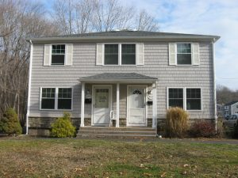
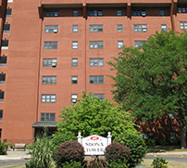
MIDDLETOWN HOUSING AUTHORITY
Operates 8 housing developments
Units range from small units to 4-bedroom units
Elderly and disabled communities
Family-oriented communities

Slide 43
Affordable Housing gap Analysis
Affordable Housing Supply - Affordable Housing Demand = Housing Gap
 | Renter |  | Owner
 | Individual | Family of 4 | Individual | Family of 4
Low | X
Very Low | X |  | X
Extremely Low | X | X | X
Source: HUD Income Limits; Comprehensive Housing Affordability Survey (CHAS): 2014-2018; ACS Five-Year Estimates B25063
In Middletown, there are numerous populations that have a housing surplus
A housing gap exists for individuals across almost all categories – points to lack of small sized units
A housing gap exists for extremely low income families looking for rentals
Notes:
In Heritage Village, numbers look similar but there are more options for owners in some of the “very low” range

Slide 44
Why pursue housing strategies?
Remain competitive in the ever-changing housing market
Provide a housing stock for workers in order to retain and attract jobs
Create economic prosperity, generational wealth and upward mobility
Diverse communities are more resilient to change and disturbance
Establish the next generation of homebuyers – older generation needs younger generation to purchase their homes
Attracting a wide variety of residents through a diverse offering of housing types is important to the vitality of communities.
Housing market needs to remain strong to support home values which have implications on City’s grand list, mill rate and tax burden

Slide 45
Overview of potential strategies
Accessory Dwelling Units
(ADUs)
Middle Housing
CHFA Mortgages and Education
Rehabilitation and
Preservation
Adaptive Reuse
Micro-units
Housing Trust Funds
Financial Incentives
Inclusionary Zoning
Housing Overlay Zones
Lower parking requirements
Leverage Municipal Land

Slide 46
Overview of potential strategies
Accessory Dwelling Units
(ADUs)
Middle Housing
CHFA Mortgages and Education
Rehabilitation and
Preservation
Adaptive Reuse
Micro-units
Housing Trust Funds
Financial Incentives
Inclusionary Zoning
Housing Overlay Zones
Lower parking requirements
Leverage Municipal Land

Slide 47
Overview of potential strategies
Encourage low-impact development
Create
walkable neighborhoods
CHFA Mortgages and Education
Protect unique character of neighborhoods
Adaptive Reuse
Encourage Compact Building Design
Housing Trust Funds
Financial Incentives
Inclusionary Zoning
Housing Overlay Zones
Create a range of housing choices
Leverage Municipal Land

Slide 48
POTENTIAL STRATEGIES + LIVE POLLING

Slide 49
Audience Polling Intro
We are going to use interactive polling during this workshop. You will need access to a phone, a tablet or an additional webpage in your browser.
Let's get started!
Go to pollev.com/slr2021

Slide 50
Notes:
Poll Title: Do not modify the notes in this section to avoid tampering with the Poll Everywhere activity. More info at polleverywhere.com/support What is your favorite flavor of ice cream? https://www.polleverywhere.com/multiple_choice_polls/wNIRAStMiqy1MkokCGU56?display_state=chart&activity_state=opened&state=opened&flow=Default&onscreen=persist

Slide 51
Notes:
Poll Title: Do not modify the notes in this section to avoid tampering with the Poll Everywhere activity. More info at polleverywhere.com/support Have you attended either of the Regional Housing Plan workshops in October or January? https://www.polleverywhere.com/multiple_choice_polls/sLtaLiHadzc1kbST3CAeA

Slide 52
Notes:
Poll Title: Do not modify the notes in this section to avoid tampering with the Poll Everywhere activity. More info at polleverywhere.com/support Have you completed the Regional Housing Plan survey? https://www.polleverywhere.com/multiple_choice_polls/aBzZ8J7k62SW74kCNKwL8

Slide 53
Notes:
Poll Title: Do not modify the notes in this section to avoid tampering with the Poll Everywhere activity. More info at polleverywhere.com/support After listening to this presentation, do you feel you have a better understanding of housing affordability? https://www.polleverywhere.com/multiple_choice_polls/ppdfIZtyGFYf9roXc8KSK?state=opened&flow=Default&onscreen=persist

Slide 54
Potential Strategies
Update regulations for and expand knowledge of Accessory Dwelling Units (ADUs)
Encourage Middle Housing unit types to increase housing diversity in village centers
Explore micro-unit concepts to create opportunities for individual households
Consider revisions to parking requirements to facilitate new types of housing units
Promote the preservation and rehabilitation of existing, older naturally occurring affordable housing stock

Slide 55
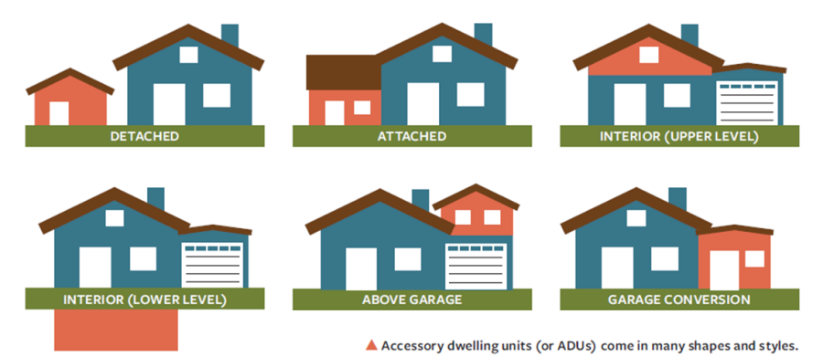
STRATEGY #1: Accessory Dwelling Units
What is this strategy?
ADUs are small dwellings on the same property as a single-family home.
ADUs can provide naturally affordable housing options and can provide homeowners with additional income, which can reduce overall costs.
Deed restriction requirements can ensure that these meet State definition of "affordable.“
PA 21-29 requirements

Slide 56
Strategy #1: Accessory Dwelling Units
Case Study: Town of Mansfield Zoning Regulations
Permitted with Zoning Permit in single-family residential zones.
ADU can be detached or attached.
ADU or principal dwelling must be owner-occupied for >6 months/yr.
Size limits of 1,000 square feet or 50% of the area of the principal dwelling, whichever is less.
Must have separate kitchen, bathroom, and entrance from main dwelling. If attached to the main dwelling, entrance can't be located on the front façade.
Maximum occupancy requirements.
Certification with Town Planner required every 5 years.

Slide 57
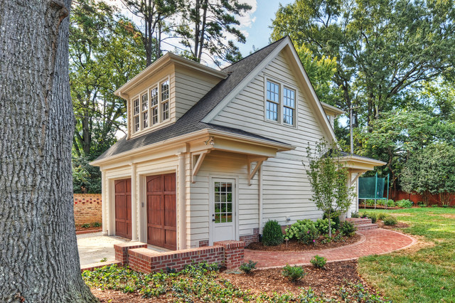
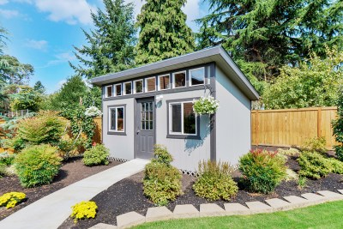
STRATEGY #1: Accessory Dwelling Units
How could we achieve it?
Review existing Middletown ADU regulations for potential revisions
Allow greater flexibility to encourage residents to consider ADUs in terms of detached units, conversion of accessory structures, size, parking, etc.
Increase awareness through handouts, brochures, webpage on the Planning Department website, an FAQs page, etc.
Expand understanding of zoning process and options

Slide 58
Notes:
Poll Title: Do not modify the notes in this section to avoid tampering with the Poll Everywhere activity. More info at polleverywhere.com/support How familiar are you with ADUs? https://www.polleverywhere.com/multiple_choice_polls/JuBoA0NN1rjmoR9125tT9

Slide 59
Notes:
Poll Title: Do not modify the notes in this section to avoid tampering with the Poll Everywhere activity. More info at polleverywhere.com/support Would you support exploring ways to promote ADUs as a housing option in Middletown? https://www.polleverywhere.com/multiple_choice_polls/e1DN0IEJQUK0iMCPU7TRe

Slide 60
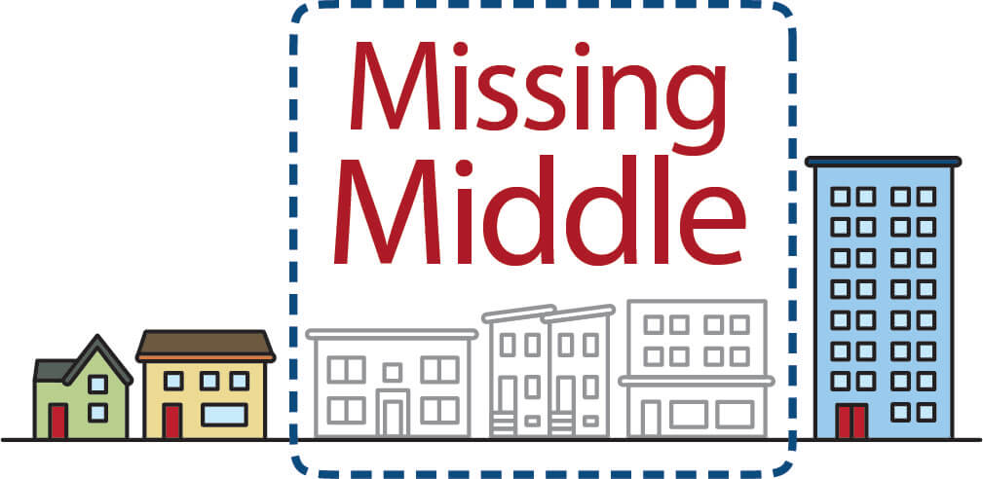
Strategy #2: MIDDLE HOUSING
What is this strategy?
“Middle Housing” = types multi-family units compatible in scale and form with single-family homes, 1.5 to 2.5 stories in height
Includes two-family, three-family, fourplex, cottage courts
New construction or conversion of larger homes
Particularly beneficial in walkable areas, town centers, village districts

Slide 61
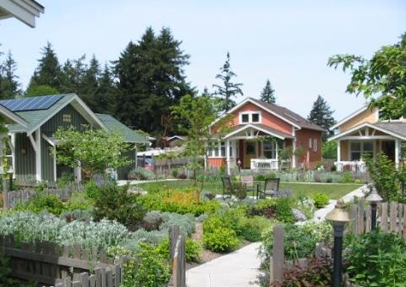
Strategy #2: MIDDLE HOUSING
Case Study: Cottage Courts – Langley, WA
Targeted at one- and two-person households that are traditionally overlooked by developers
8 cottages of 2/3 of an acre
Community-oriented setting
Developed under a new innovative cottage zoning code allowing double density for cottages less than 700 square feet in size
Shared gardens and common areas
Confirmed the strong market for this housing type
Largely located in the Pacific NW

Slide 62
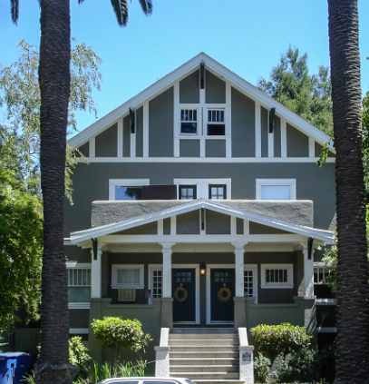
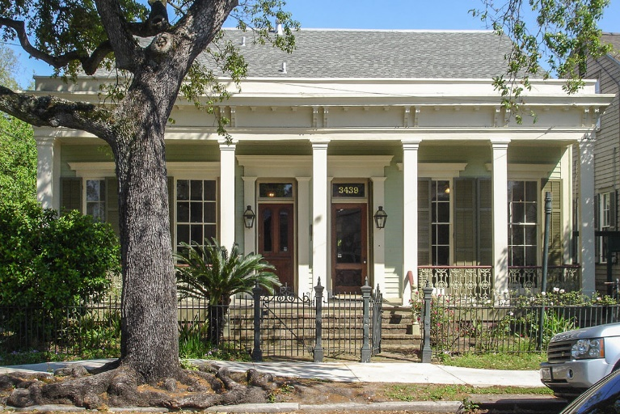
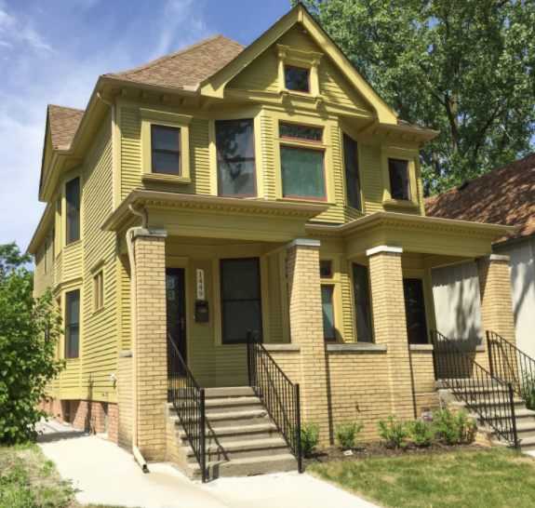
Strategy #2: MIDDLE HOUSING
Case Study: Duplexes
1 to 2.5 story detached structures with two housing units
Units can be stacked or side by side
Appearance of single-family home
New construction or conversion of single-family home
Reminiscent of common older housing types from 1920s and 1930s

Slide 63
Strategy #2: MIDDLE HOUSING
How could we achieve it?
Consider amending zoning regulations to allow for increased density for middle housing typologies in appropriate areas of Middletown – neighborhood and village centers
Allow for some middle housing development by right
Target areas closest to amenities and centers
Conversion of existing single-family homes where appropriate
Units could be naturally affordable or combined with other strategies to encourage deed-restricted affordable units

Slide 64
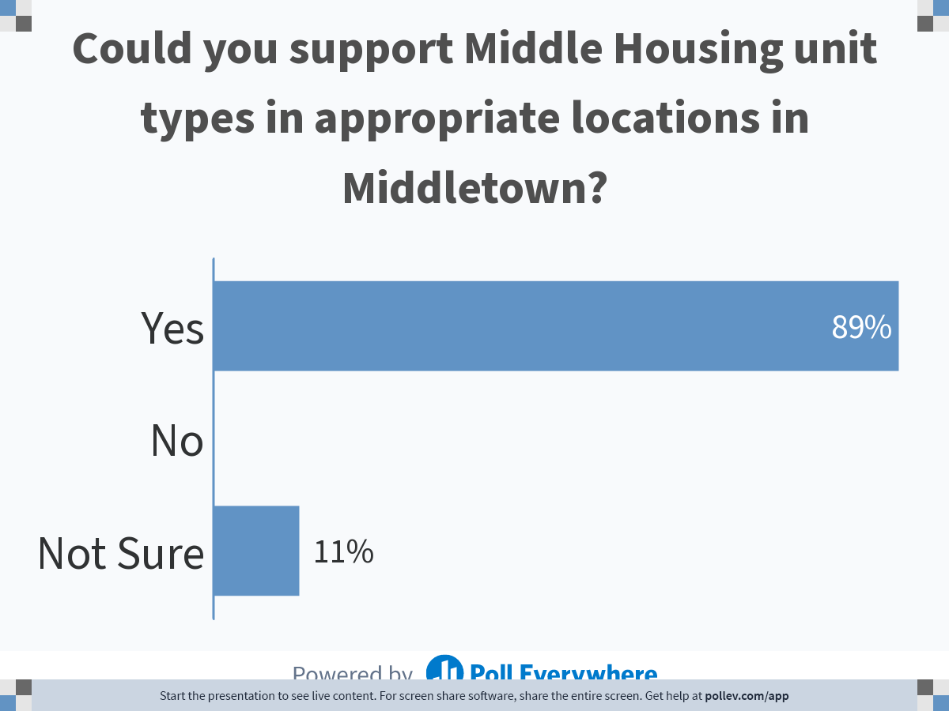
Notes:
Poll Title: Do not modify the notes in this section to avoid tampering with the Poll Everywhere activity. More info at polleverywhere.com/support Could you support Middle Housing unit types in appropriate locations in Middletown? https://www.polleverywhere.com/multiple_choice_polls/J11ucv5K5VCR6YK4DqzRt

Slide 65
Notes:
Poll Title: Do not modify the notes in this section to avoid tampering with the Poll Everywhere activity. More info at polleverywhere.com/support What types of Middle Housing units could you support in Middletown? https://www.polleverywhere.com/multiple_choice_polls/7XovOHzDP0ct8khWQf8Lr

Slide 66
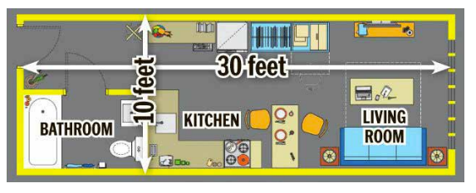
Strategy #3: Micro-units
What is this strategy?
Fully-equipped apartments with their own kitchen and bathroom, that are smaller a conventional studio, typically around 250 to 350 square feet
Leasing at approximately 20% to 30% lower than conventional units
Opportunity to convert or improve existing properties
Appropriate in urban areas near transit, services and walkable amenities
$4.62 to $4.86 per square foot
Target market audience is young professional singles – household trends

Slide 67
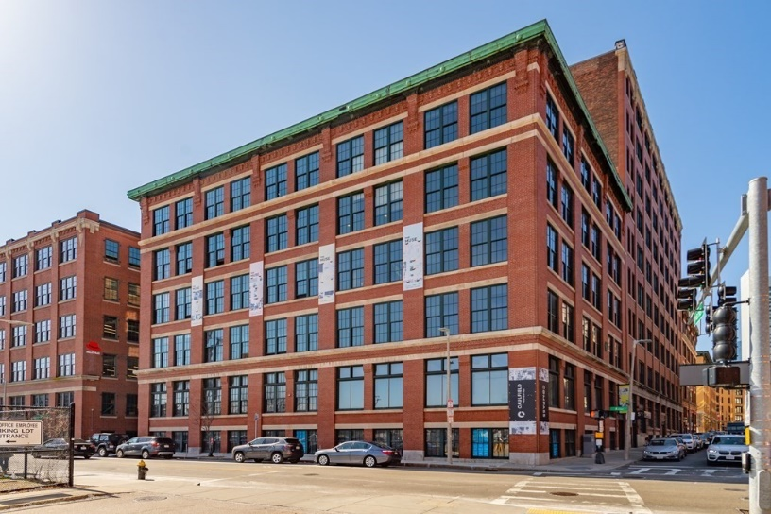
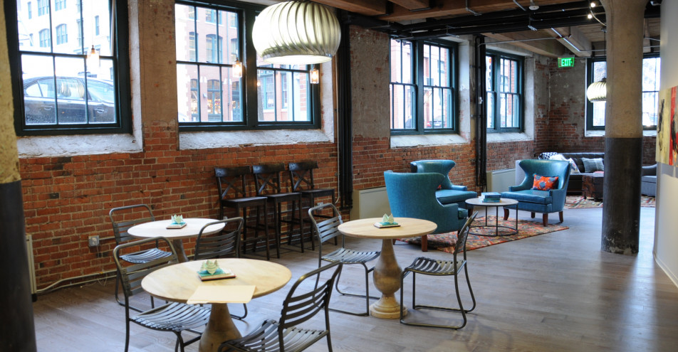
Strategy #3: Micro-units
Case Study: Boston, MA
Factory 63 – a new micro-unit community with 38 units of which 23 are microunits
Range from 368 to 504 square feet
Rents begin at $1,699

Slide 68
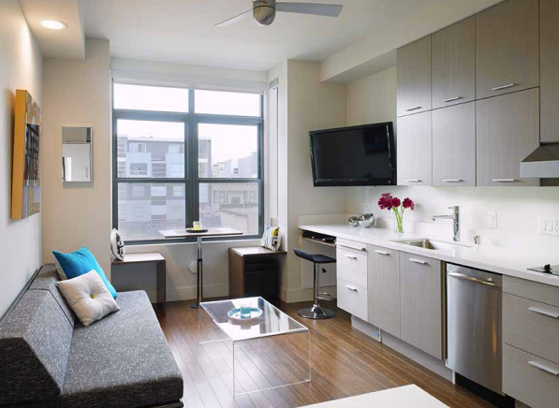
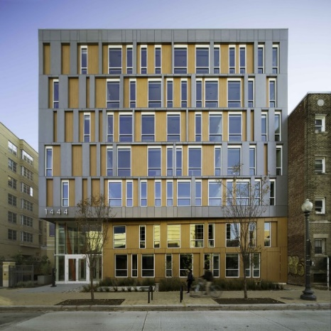
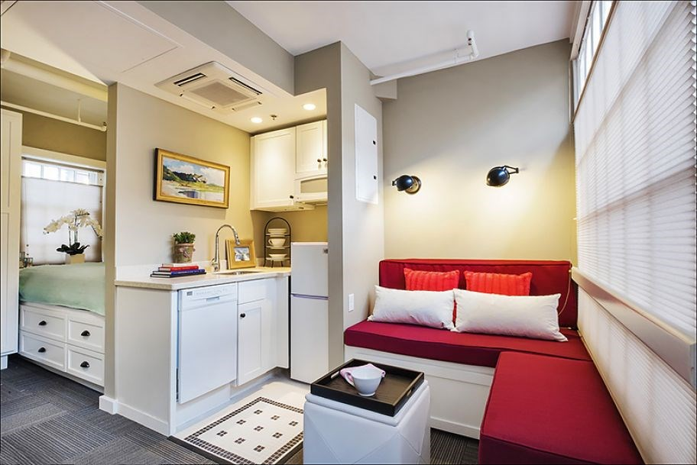
Strategy #3: micro-units
How can we achieve it?
Consider zoning amendments related to site and density requirements – lot coverage, height, setbacks, interior space
Review existing minimum unit size regulations (International Building Code)
Consider requiring an affordability set-aside threshold
Encourage certain types of common spaces
Explore parking requirements per unit – impacts on feasibility
Permitting process requirements – as of right?

Slide 69
Notes:
Poll Title: Do not modify the notes in this section to avoid tampering with the Poll Everywhere activity. More info at polleverywhere.com/support Could you support the concert of micro-units to provide housing targeted at individual households in Middletown? https://www.polleverywhere.com/multiple_choice_polls/DVbe01b2ROlkQgIqPy8z8

Slide 70
Notes:
Poll Title: Do not modify the notes in this section to avoid tampering with the Poll Everywhere activity. More info at polleverywhere.com/support What do you think is an appropriate minimum size for a micro-unit? https://www.polleverywhere.com/multiple_choice_polls/AEZFXdjPIe23V8E5LGmBJ

Slide 71
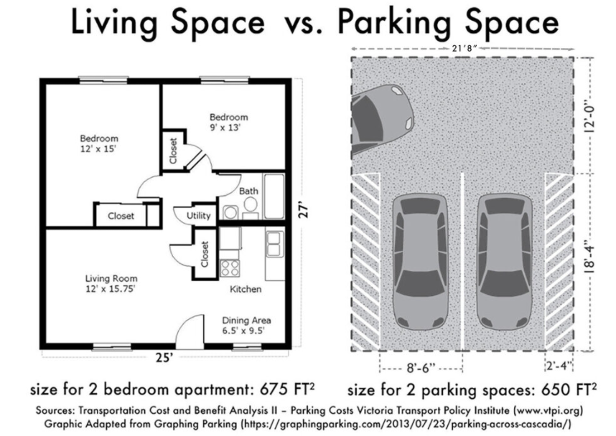
Strategy #4: parking requirements
What is this strategy?
Increase feasibility of options such as microunits by lowering off-street parking requirements
Off-street parking is expensive or not physically possible for many potential lots
Parking requirements significantly increase construction costs - developers pass the cost of parking on to tenants or owners
Studies show the cost of garage parking is 17% of a housing unit’s rent.
Car ownership trends are decreasing in cities – adapt to modern needs
Parking increases impervious surfaces and impacts runoff and pollution
Notes:
40.04.14 MULTIPLE-FAMILY One or fewer Bedrooms 1 DWELLINGS Two bedrooms 2 (Including former Three or more bedrooms 2 category of Housing for Elderly) Building or buildings, parking spaces, driveway and other vehicular ways shall not in their total area exceed more than forty (40) percent of the lot area. Commission specifically retains the right to require additional visitor and overflow parking as deemed necessary based on site characteristics. (Section amended eff. 11/2/02 and 5/27/14)

Slide 72
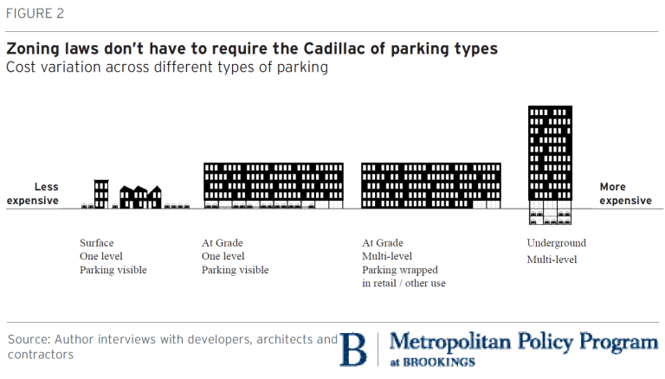
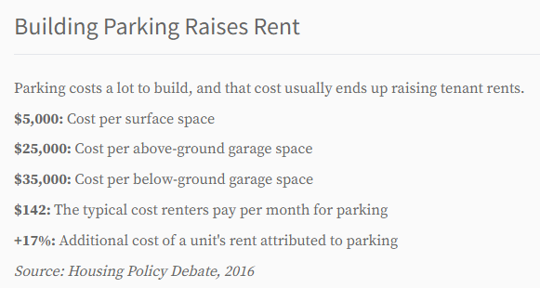
Strategy #4: parking requirements
Case Study: Cambridge, MA
In 2020, an Affordable Housing Overlay (AHO) was created
The AHO is intended to make 100% affordable housing projects economical.
It allows for as of right development and waives off-street parking requirements are waived for AHO projects

Slide 73
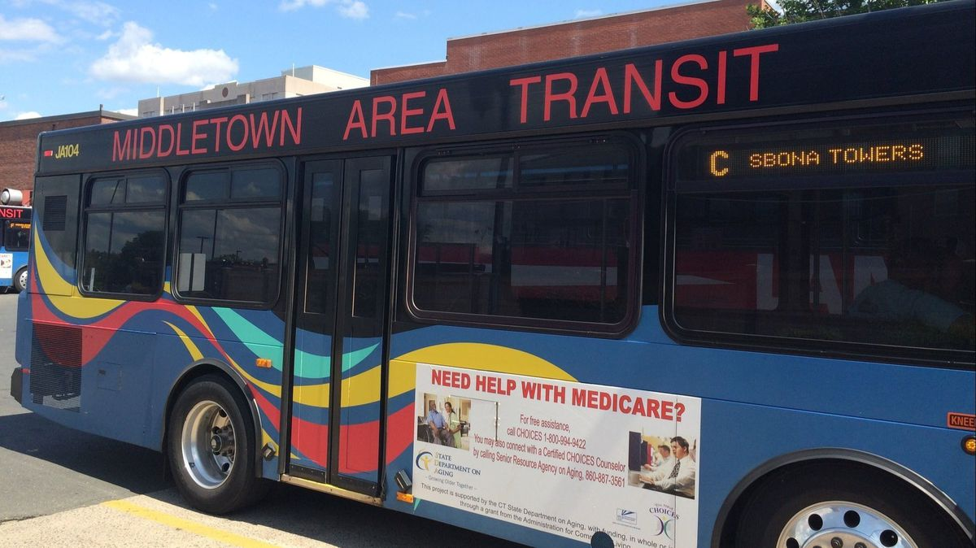
Strategy #4: parking requirements
How can we achieve it?
Reducing parking requirement through zoning amendment
Could be tied to affordable housing development or portions of the City
Based on a development’s proximity to transit access, the neighborhood Walk Score, access to amenities, or some other relevant metric.
Allowing a range of alternatives to providing parking such as:
Transit passes
Shared parking, off-site parking
Pick-up/drop-off areas for ride shares

Slide 74
Notes:
Poll Title: Do not modify the notes in this section to avoid tampering with the Poll Everywhere activity. More info at polleverywhere.com/support Could you support reducing parking requirements to faciliate housing such as micro-units? https://www.polleverywhere.com/multiple_choice_polls/H9oBQTQNbZItf7huP6OHN?state=opened&flow=Default&onscreen=persist

Slide 75
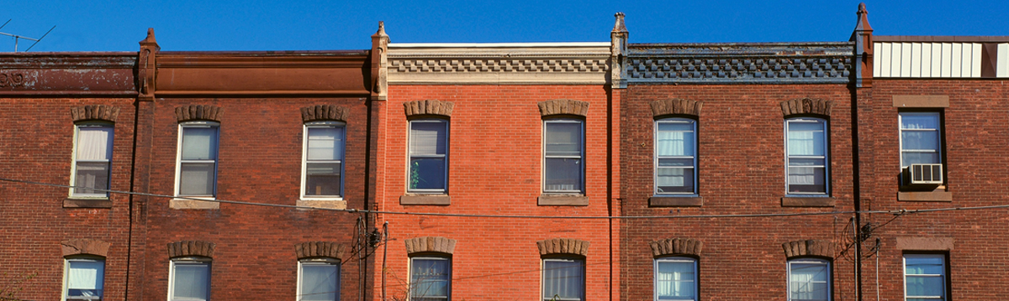
Strategy #5: preservation
What is this strategy?
Preserve and rehabilitate the City’s existing older, affordable housing
New construction alone does not meet demand and cost is much higher (30% to 50% more)
Preservation prevents displacement of residents – gentrification
Preserves mixed-income neighborhoods, keeps communities intact
Existing buildings already fit within neighborhoods – no new land needed
Local, state and federal funding tools are needed
Notes:
Acquisition and rehabilitation of existing affordable housing is complicated. As with new construction, developers need to weave together federal, state, and local funding sources; employ state and municipal policy tools; and collaborate with stakeholders. The importance of local context means that most preservation deals look and function differently, but understanding how preservation efforts work in one place can nonetheless inform efforts in another.
Preservation of affordable housing is key to a diversified and stable housing stock and economic diversity by creating or sustaining a mixed-income neighborhood.
Preservation is less likely to displace longterm residents who may otherwise have to move and change jobs when rents are no longer affordable.
Preservation keeps families, communities and social networks intact and safe. Displaced residents often have to move to a more affordable but less safe neighborhood. For those who remain, the loss of a tight-knit community means less protection, reduced communication and more isolation of individuals who no longer look out for each other.
Preservation restores vacant buildings to a city’s housing stock, and research shows that restoration also benefits neighborhoods by attracting private investment and improving community safety.
First, although research suggests that not all projects will leave their affordability programs at the expiration of their compliance period, projects located in higher-performing areas are at particular risk of conversion, threatening the overall supply and accessibility of affordable housing in desirable or high-opportunity areas. Second, the cost of preserving existing units as affordable often is less than the cost of creating a newly constructed affordable unit, making preservation a cost-effective strategy. Third, legacy units may be in neighborhoods that have become (or are becoming) more advantageous in the years since their creation, giving residents better access to opportunity in areas where building new affordable housing might be more difficult. Finally, although more research is needed, preserving affordability may promote housing stability for residents, particularly in transitioning neighborhoods where rents may be rising. Next, Reina outlined three risks to the subsidized housing stock: that a housing subsidy will expire or that units will exit their subsidy program — an acute concern as the nation’s most important affordable housing programs mature and the number of units approaching the expiration of their subsidy or compliance period increases, tempting owners in more lucrative markets to convert their properties; that depreciation will erode the quality of affordable housing, potentially threatening eligibility in some programs; and that lawmakers will curtail public spending or incentives supporting affordable housing.
As affordable housing programs mature and the buildings they created age, preserving existing units at affordable rents and at an adequate standard of quality is an increasingly important aspect of housing policy. Although each program and each jurisdiction have their unique circumstances, the presenters demonstrated the breadth of the problem and the reasons compelling increased preservation efforts. Greater focus on the issue of preservation can be an important strategy in confronting the nation’s ongoing crisis of housing affordability.

Slide 76
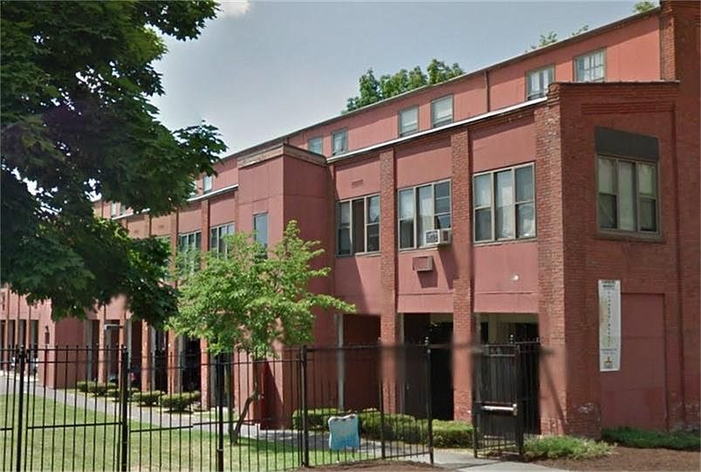
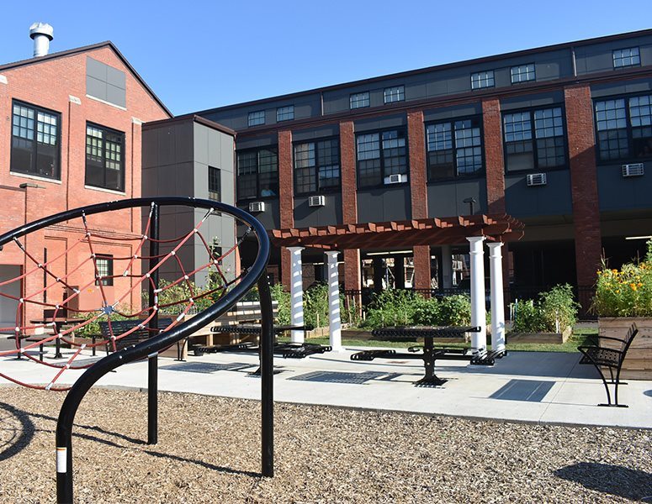
Strategy #5: preservation
Case Study: Hartford, CT
Billings Forge Apartments, Frog Hollow Neighborhood, 2013
112-unit, 43% Section 8 family complex created in a historic mill
Preservation of Affordable Housing, Inc. (POAH) leveraged investment for capital improvements while ensuring continued housing affordability and increasing resident services.
POAH’s property rehabilitation included unit updates, common area improvements, and systems upgrades @ $90,000 per unit
No resident displacement
Low-Income Housing Tax Credits (LIHTC)

Slide 77
Strategy #5: preservation
How can we achieve it?
Rent regulation and protection from condo conversions
Work with landlords to keep affordable properties viable
Legal assistance and eviction prevention programs
Incentives for proposal to preserve existing affordable rental housing – tax relief
Discourage loss of affordable rentals through fees and demo taxes
Adopt right of first refusal policy giving tenants option to purchase their building
Create preservation inventories that identify affordable rentals with expiring use restrictions.
Allocation of Low-Income Housing Tax Credits.
HUD can approve the transfer of project-based Section 8 subsidies to a different property
Notes:
Although federal subsidies remain critical for preserving affordable housing, preservation efforts often need additional resources. Local and state agencies provide short- and long-term financing, acquisition and predevelopment funds, and tax credits. In Minneapolis, preserving and renovating one of the largest affordable housing complexes in the city involved city, regional, state, and federal funds.
While funding availability is central, preservation efforts are also facilitated through local and state policy frameworks. For example, “opportunity to purchase” legislation, which requires owners to notify tenants of intent to sell and provide them (or an approved third party) an opportunity to purchase, played a role in three cases. In Washington, DC, residents could select a buyer who met their needs and had the authority to negotiate a sale from the previous owner.
Strong developer capacity is crucial for bigger projects with complex financing or multiple partners. Historic buildings, resident services, temporary relocation programs, and special needs of residents (such as elderly residents), can add to project complexity and cost. Elsewhere, dynamics in a given market may require a specialized intervention: in Chicago’s Austin neighborhood, where financing for development had been difficult to obtain, a community development financial institution provided credit access to the buyers of a multifamily rental building.
Collaboration between buyers and sellers helps, too. In two of our case studies, cities benefited from mission-oriented sellers motivated to work with buyers to retain affordable housing and other community features. In Cambridge, Massachusetts, and Hartford, Connecticut, sellers remained involved in the properties, funding resident services and other on-site activities.
Preserving affordable housing is an exercise in sustainability. Affordable housing is not a one-time construction project; it requires flexibility as neighborhoods and needs change. As the need for affordable housing grows, those working to expand and preserve our nation’s affordable housing stock need a wide range of tools and serious engagement from private and public actors.
Poor physical condition of properties is another challenge to addressing this housing through economies of scale. Research shows that privately owned multifamily rentals typically are older and therefore have higher upkeep. Such properties often have insignificant reserves, in part because of their low rents, and require substantial rehabilitation.20 In addition, because of their small scale and scattered ownership, these multifamily rentals often miss out on energy-efficiency programs offered through utility companies. Together, these qualities make small-scale, privately owned affordable housing unattractive to large-scale investors, which in turn makes adequate property maintenance difficult.

Slide 78
Notes:
Poll Title: Do not modify the notes in this section to avoid tampering with the Poll Everywhere activity. More info at polleverywhere.com/support Which do you see as a preferable strategy for affordable housing in Middletown? https://www.polleverywhere.com/multiple_choice_polls/PzQJPC4j3HQvCbzX78fqQ?state=opened&flow=Default&onscreen=persist

Slide 79
Notes:
Poll Title: Do not modify the notes in this section to avoid tampering with the Poll Everywhere activity. More info at polleverywhere.com/support How would you rank the following potential strategies in order from most preferable to least preferable, in your opinion? https://www.polleverywhere.com/ranking_polls/9mQHZSwzG4PesaTw9sId2

Slide 80
Next Steps
Continue to develop strategies based on tonight’s input
Draft Middletown’s 8-30j annex plan
Drafts will be available for public review in mid-spring
Adoption of 8-30j plan and submission to state by June 1st

Slide 81
QUESTIONS AND ANSWERS
If you have any questions or comments, please type them in the chat.
How do you feel about the current state of housing in your community?
Are there additional ways to address housing affordability that you would like to see your city pursue?
Did anything you heard today change your opinion?
Is there anything you would like more information on or that you feel we should have covered or needs more detail?

Slide 82
Thank You!

