Slide 1
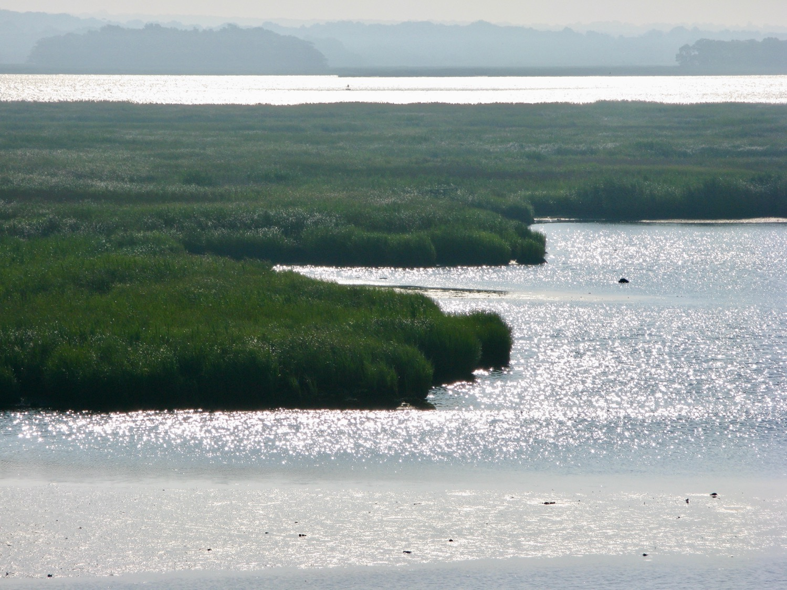
“One of the least-disturbed large-river tidal marsh systems in the United States; the most pristine large-river tidal marsh system in the Northeast.”
Connecticut River Estuary
Ragged Rock Brackish Tidal Marsh
Old Saybrook

Slide 2
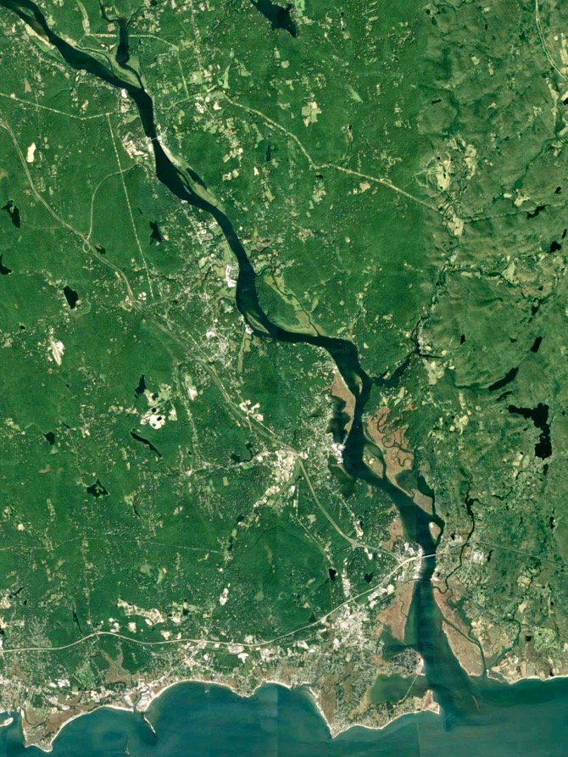
Connecticut River Estuary at Long Island Sound
Notes:
KEY POINT 1: This place is UNIQUE:
There are no other areas in the Northeast that support such extensive or high quality fresh and brackish tidal wetland systems.
halfway between New York and Boston
Shifting sands at mouth prevented a port city.
The estuary is a single integrated complex of many individual wetland units (core sites) and shallow riverine systems, linked by tidal waters of the CTR and Long Island Sound (NEP)

Slide 3
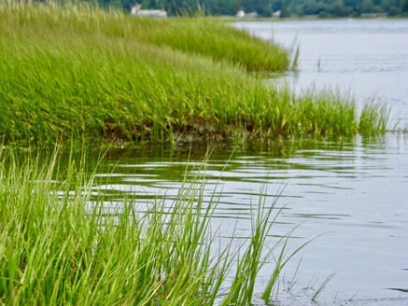
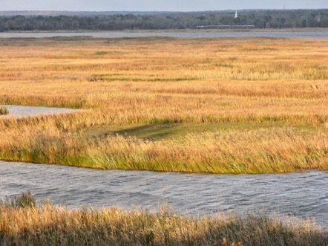
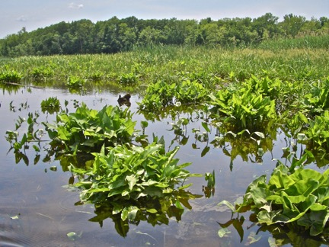
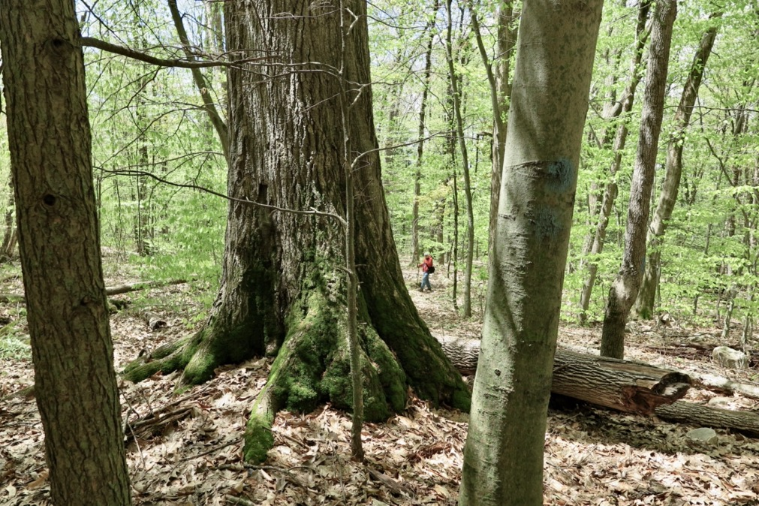
Salt, Brackish, Freshwater Tidal marshes
and shallow riverine systems
Notes:
Tremendous degree of ecological interaction and interdependence among its tidal waters, tidal wetlands, and adjacent uplands.
36 miles up from LIS. CT Col Bulletin: One of the least-disturbed large-river tidal marsh systems in the US; the most pristine large-river tidal marsh system in the northeast. Concentrations of waterfowl
Tremendous degree of ecological interaction and interdependence among its tidal waters, tidal wetlands, and adjacent uplands.
highest concentrations of biological diversity are located in the lower portion of the Connecticut River, in the estuary, where there are exchanges of resources from tides and inputs from the watershed. Species have evolved over time to rely on this healthy biological system. It's the entire, intact suite of species in the estuary that make this place special, and biologically significant.

Slide 4
Connecticut River Estuary Designations
1973 CT River Gateway Conservation Zone (Gateway Commission)
1987 Estuary of National Significance, Long Island Sound (National Estuary Program)
1991 Silvio O. Conte National Fish and Wildlife Refuge
1993 The Nature Conservancy Last Great Place
1994 Wetland of International Importance under the Ramsar International Convention
1998 American Heritage River, U.S. Environmental Protection Agency (EPA)
2007 State of Connecticut Greenway along the estuary of the Connecticut River
2008 Eightmile Wild and Scenic River Act
2012 National Blueway America’s Great Outdoors Initiative
[Spring 2022] National Estuarine Research Reserve site (NERRS) Nat’l Oceanic and Atmospheric Administration (NOAA)
Notes:
multiple designations over the past 46 years, acknowledging its ecological value and persistence through time.
Next Year – 2023 will be 50 years of effort.

Slide 5
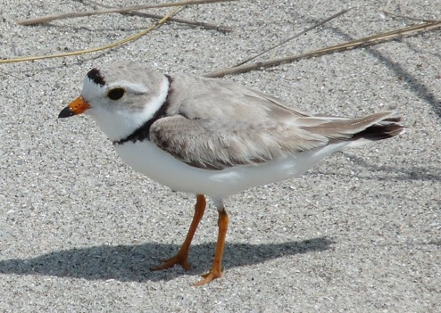
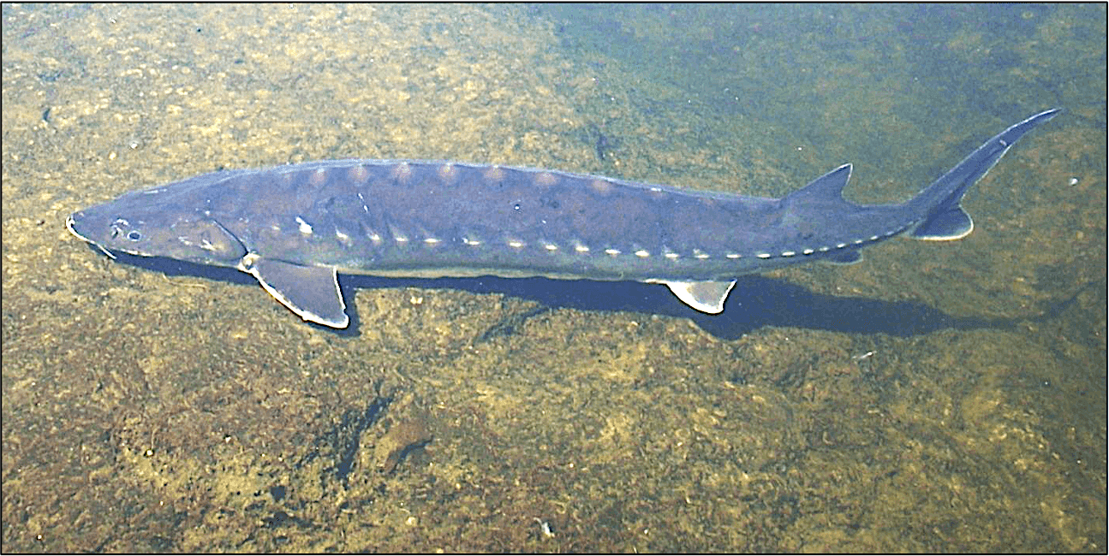
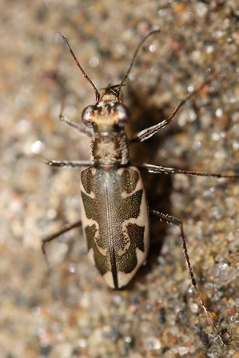
Federally Threatened
Piping Plover
Charadrius melodus
CT Audubon
Federally Threatened
CT Endangered
Puritan Tiger Beetle
Cicindela puritana
CT River Conservancy
Federally Endangered
Shortnose Sturgeon
Acipenser brevirostrum
USFWS/Susan Wojtowicz
Notes:
7 globally rare and over 40 state listed species
Essential habitat for federally listed and candidate species and globally rare species (bald eagle, Shortnose Sturgeon, piping plover, puritan tiger beetle)
Concentrations of waterfowl (esp BL duck) are among the highest and most significant in the region.
Fall migration spectacular: Swallow congregation in fall: as far away as 25 miles, up to a half million birds [RTPeterson: on par with the great mammal migrations of Africa]
One of largest osprey colonization in east coast (Clinton to East Lyme) come from as far away as Chile
Fish: Significant overwintering, spawning and feeding habitat for a large number of

Slide 6
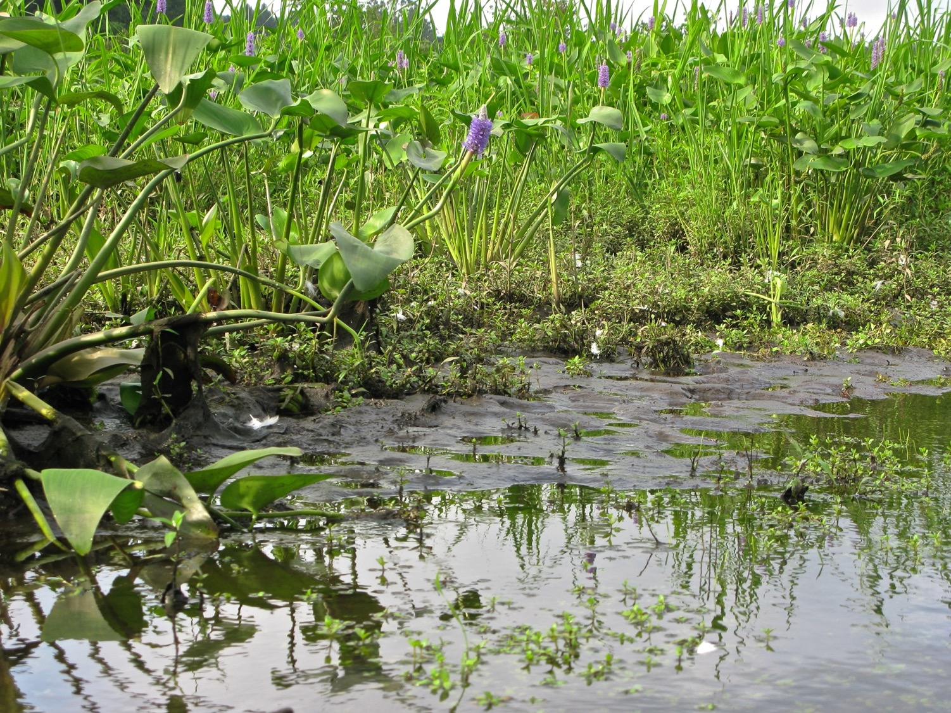
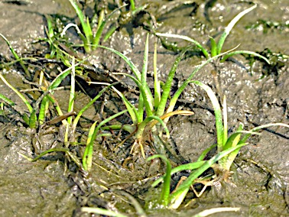
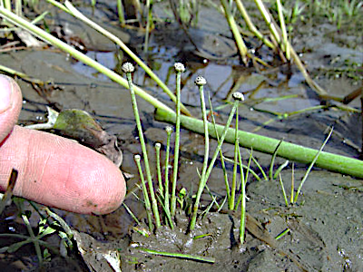
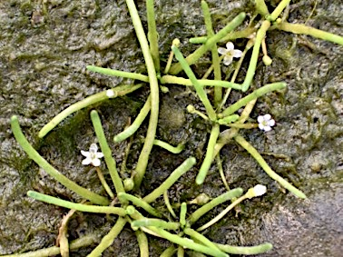
Vulnerable
Spongy Arrowhead
Sagittaria Montevedensis
ssp spongiosa
State Endangered:
Parkers Pipewort
Eriocaulon Parkerii
CT Special Concern:
Mudwort
Limosella subulata
Notes:
These plants rely on periodic exposure at low tide and shallow submersion at high tide, and always sun. Mats of invasive aquatic plants will rapidly diminish this habitat.
Sagittaria Montevedensis ssp spongiosa, Spongy Arrowhead; https://explorer.natureserve.org/Taxon/ELEMENT_GLOBAL.2.160865/Sagittaria_montevidensis_ssp_spongiosa
State endangered: Eriocaulon Parkerii (Parkers Pipewort) ; CT Special Concern species Limosella subulata (Mudwort)

Slide 7
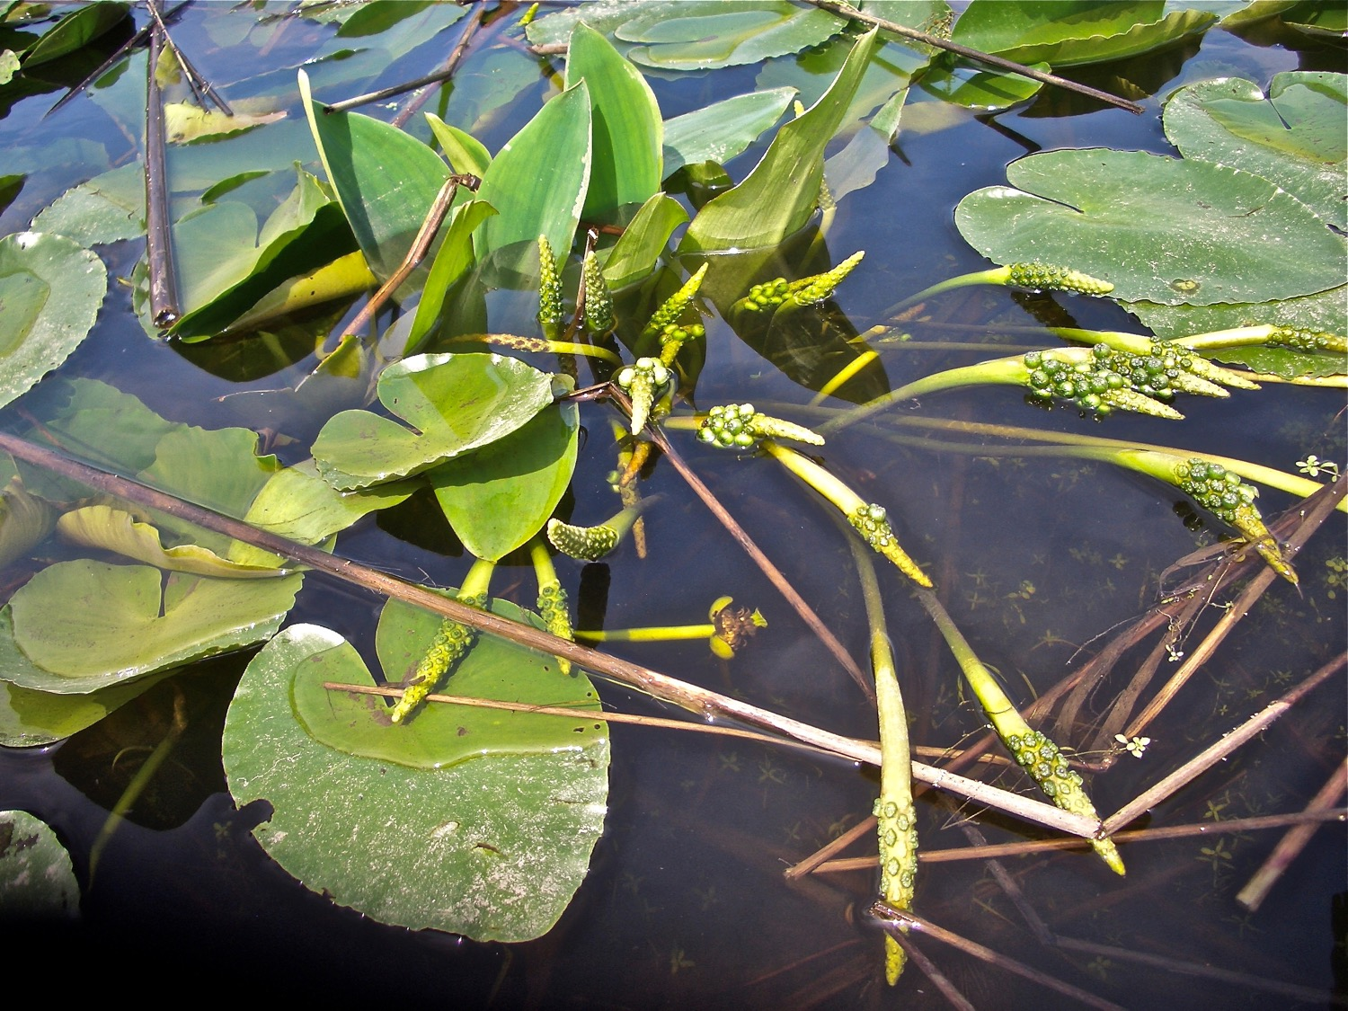
CT Special Concern
Golden Club
Orontium aquaticum
Notes:
Dies back, regrows in spring. Will be impacted by thick accumulation of Hydrilla

Slide 8
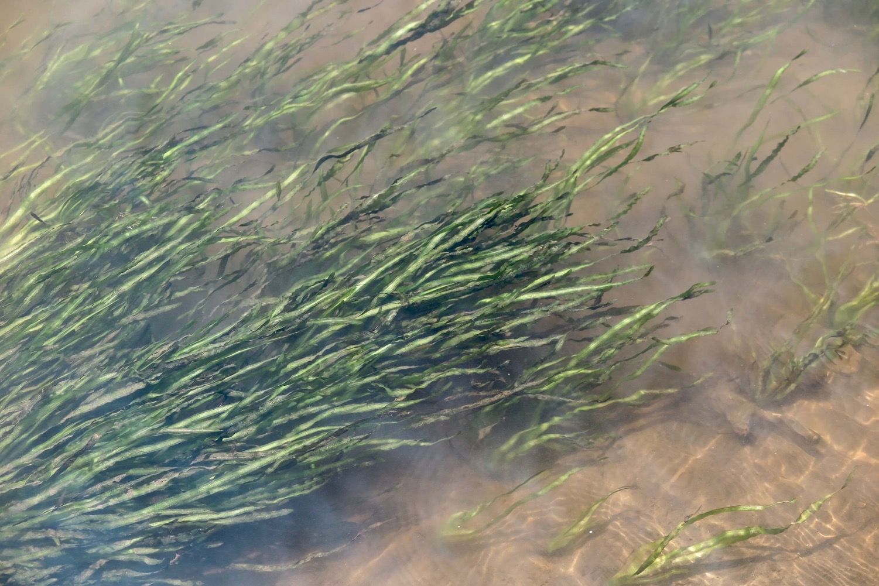
Tape Grass
Vallisneria americana
Notes:
1994? SAV study Julianna Barrett, TNC
Healthy diverse and native aquatic vegetation that grows entirely submerged below the water is an essential part of the estuary.
These underwater realms provide habitat for fish, especially important as nursery sites, and the invertebrates that thrive on the plants are an important part of the food web.
Submerged plants stabilize and manage erosion and cycle oxygen and nutrients.
Vallisneria americana, commonly called wild celery, water-celery, tape grass, or eelgrass

Slide 9
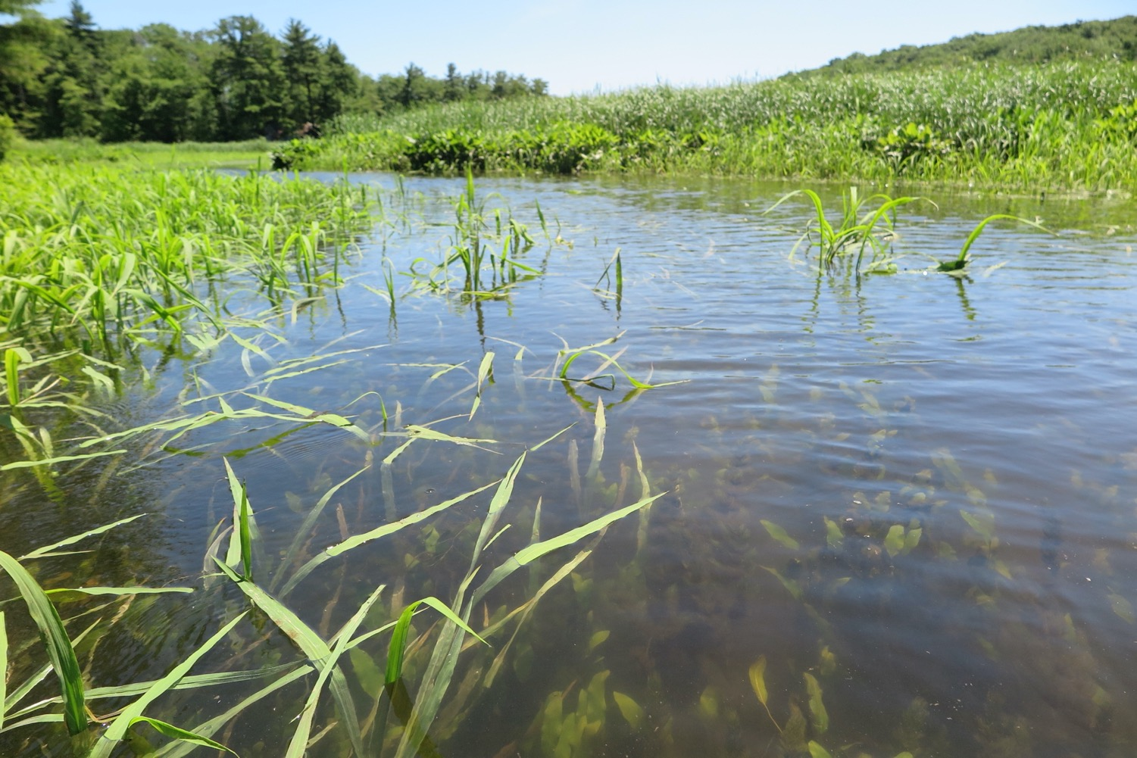
Emerging Wild Rice
Zizania aquatica
Whalebone Cove, Hadlyme
Freshwater Tidal Marsh
Notes:
Several high quality FW Tidal Marsh natural communities in estuary (best in state)
Hydrilla can eliminate spawning and feeding areas, and fundamentally change the composition and function of the freshwater tidal marsh plant, and animal, community.
Wintering ducks, migratory waterfowl rely on

Slide 10
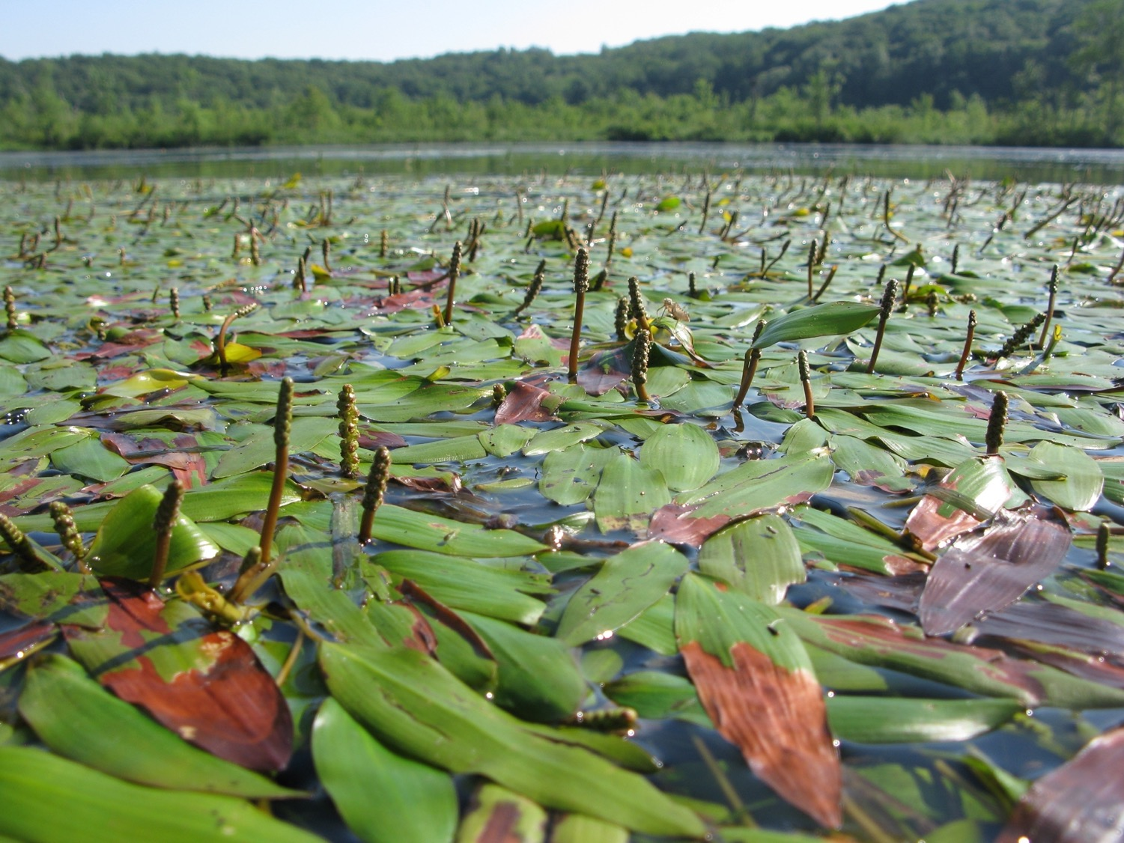
Long-leaved Pondweed
Potamogeton nodosus
Salmon Cove
Notes:
Freshwater Tidal Marsh
East Haddam

Slide 11
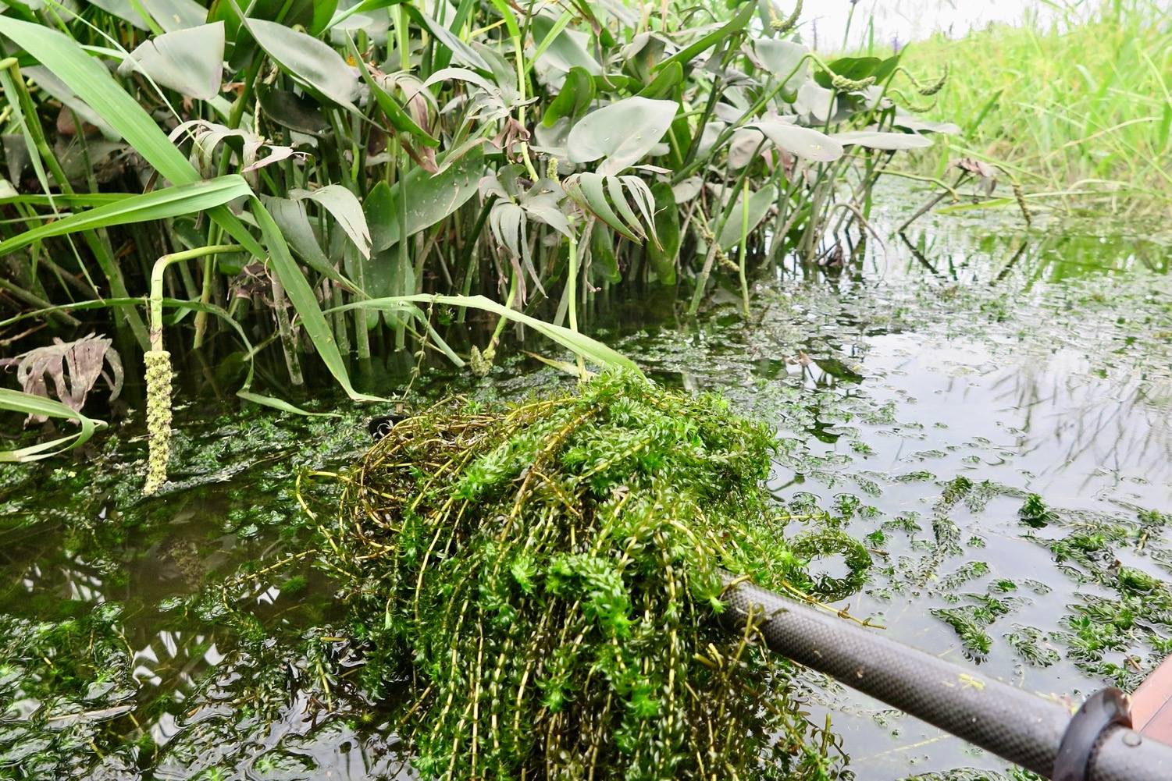
The presence of, and alarming increase in Hydrilla, is unprecedented in the Connecticut River estuary
Approaching 1,000 acres of hydrilla extending over 50+ miles from southern MA to Old Lyme in CT
Notes:
KEY POINT 2: Hydrilla has the capacity to be a game changer, a turning point
First recognized 2016
Surveys Greg Bugbee (CAES) in 2018-2019 indicate extends from Agawam, Massachusetts southward to Old Lyme, Connecticut

Slide 12
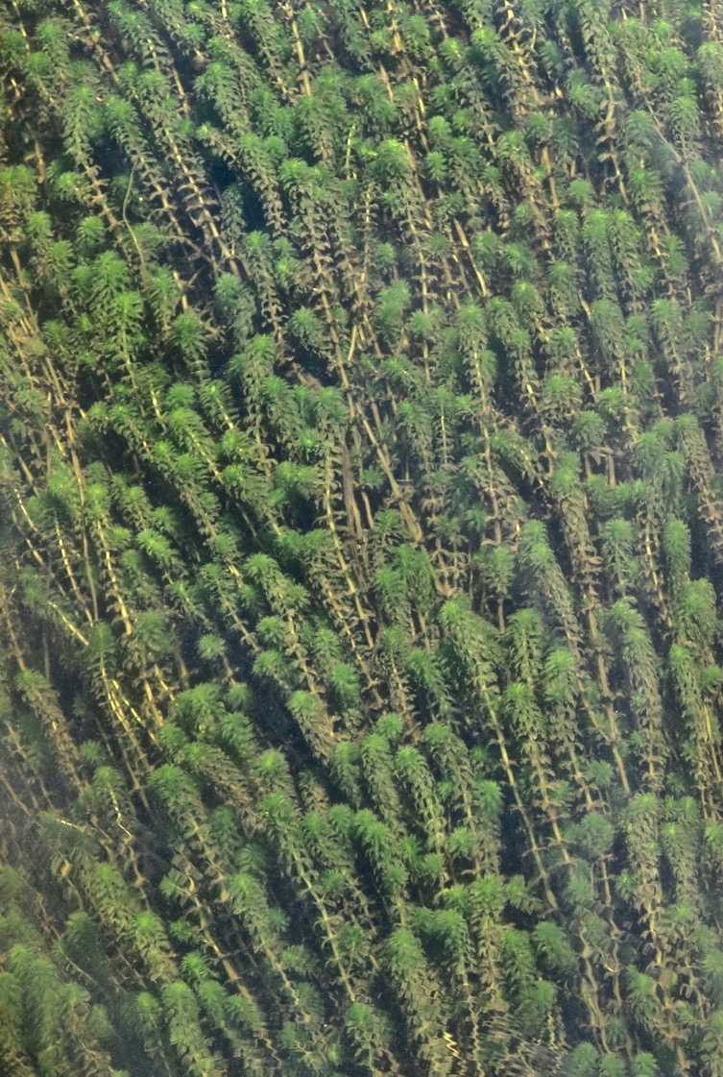
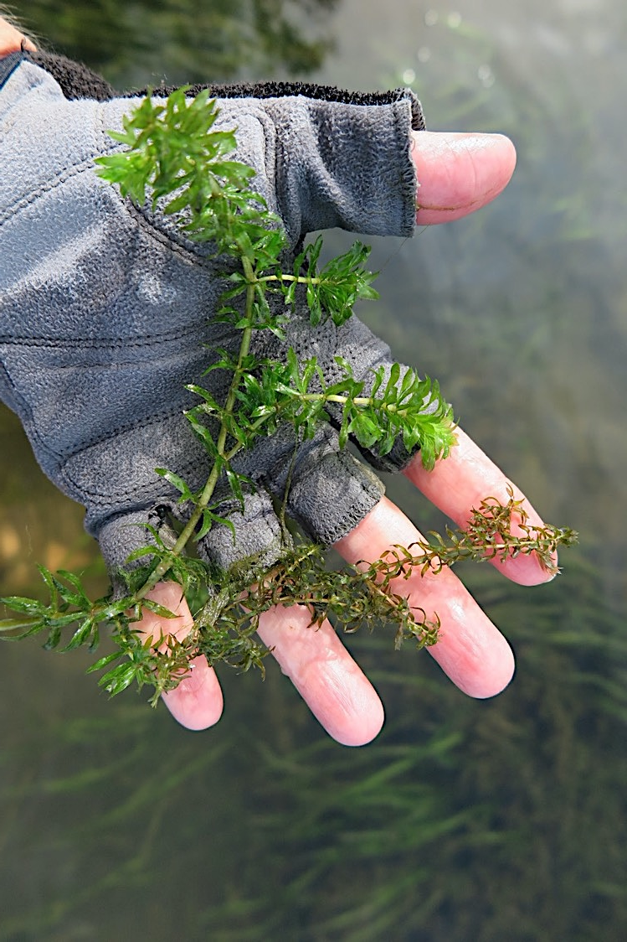
Hydrilla verticillata
Stems easily broken off; can float and establish downstream (and travel in with the tide)
Capable of existing as a free-floating mat at the surface
Stems have been known to grow up to 30 feet long
Requires very little light to succeed
Native Waterweed (Elodea sp)
Notes:
alter fish populations, cause shifts in plankton communities and affect water chemistry. Perhaps most insidious, Hydrilla, although generally growing from rooted plants, is capable of existing as a free-floating mat at the surface, and because the stems are easily broken off, they will float and establish downstream (and in with the tide). Stems of this pant have been known to grow up to 30 feet long, and it requires very little light to succeed.
There are a number of water-milfoils, native and non-native, that are easily confused. able to produce approximately 100 seeds per season, this plant spreads most successfully by fragmented pieces; between motorboat traffic and boat transport from waterbody to waterbody, its rapid establishment has been secured. Water Milfoil is tolerant of low water temperatures and can begin spring growth before other submerged plants, giving it a competitive advantage.
-- Likely not possible to eliminate; maintaining a healthy and competitive natural cove ecosystem with good water quality, diverse native SAV and emergent vegetation, and strategically removing Hydrilla may afford some protection.
1997 SAV work done by Julianna Barrett indicate a robust SAV community
native (American) waterweed (Elodea canadensis, E. nuttalii)

Slide 13
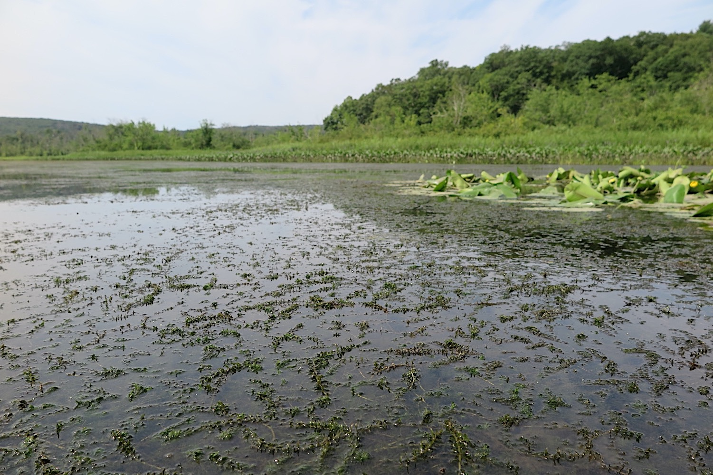
Impenetrable surface vegetation can
increase water temperature
raise pH
lower dissolved oxygen level
Inhibited water movement impacts gas exchange with the surface atmosphere
Decomposing vegetation in the fall can lead to low oxygen and potentially anoxic (no oxygen) conditions at depth
Salmon River Cove

Slide 14
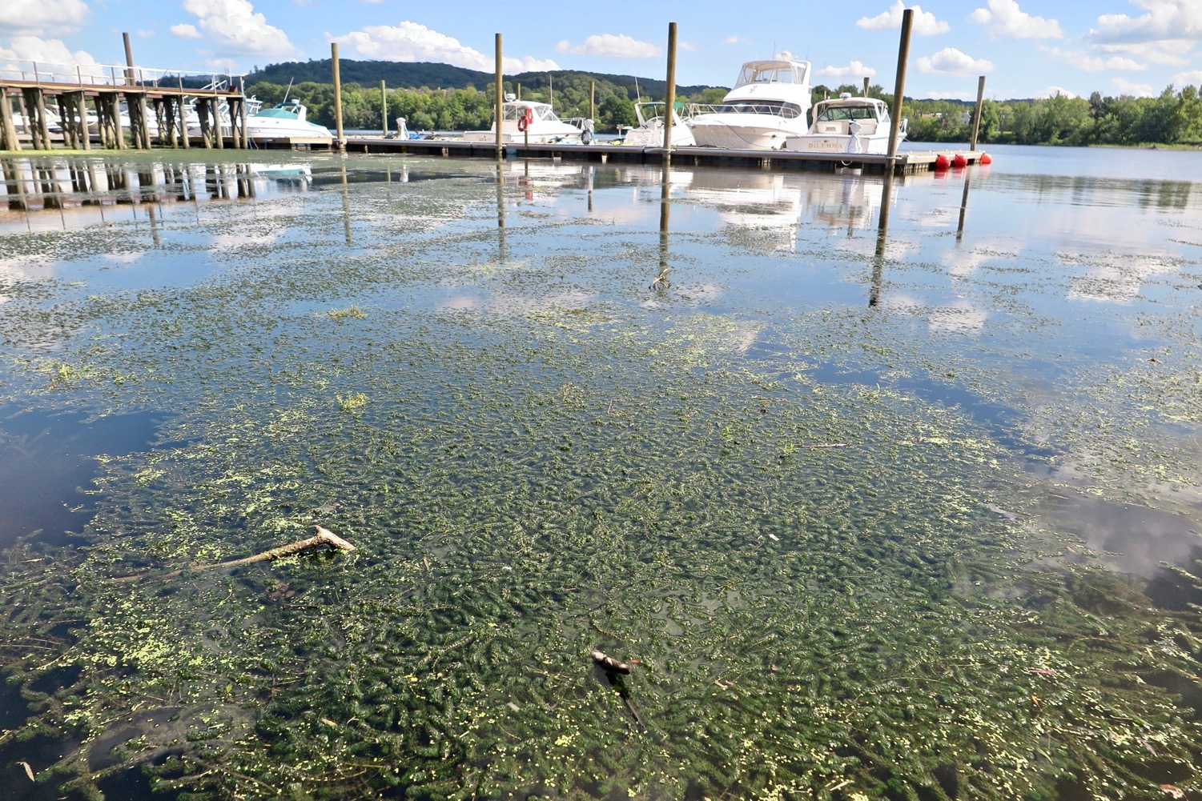
“Fishing and boating are Connecticut’s top contributor to the outdoor recreation economy”
-- 2021 Governor’s Council
on Climate Change
Notes:
Potential to move further up River: transient boaters navigating upstream through the river system, or by visiting multiple launch sites along.
high risk of regional spread to other waterways
impaired water access and navigation impacting commercial and recreational boating, as well as marinas .
thick mats of hydrilla have blocked access for boaters, anglers, and other recreationists; Marinas and municipalities have reported that they can no longer access boat slips and docks due to the severity of the hydrilla infestations, limiting business opportunity. impact public swimming and fishing areas
It’s not hard to imagine the impact to recreational uses of conversion from open water to a solid mat of vegetation:
the loss of quality habitat keeps fish smaller, resulting in fewer fish reaching legal harvestable size, and juvenile fish become easier prey for larger animals.
.
Loss of SAV’s that provide habitat

Slide 15
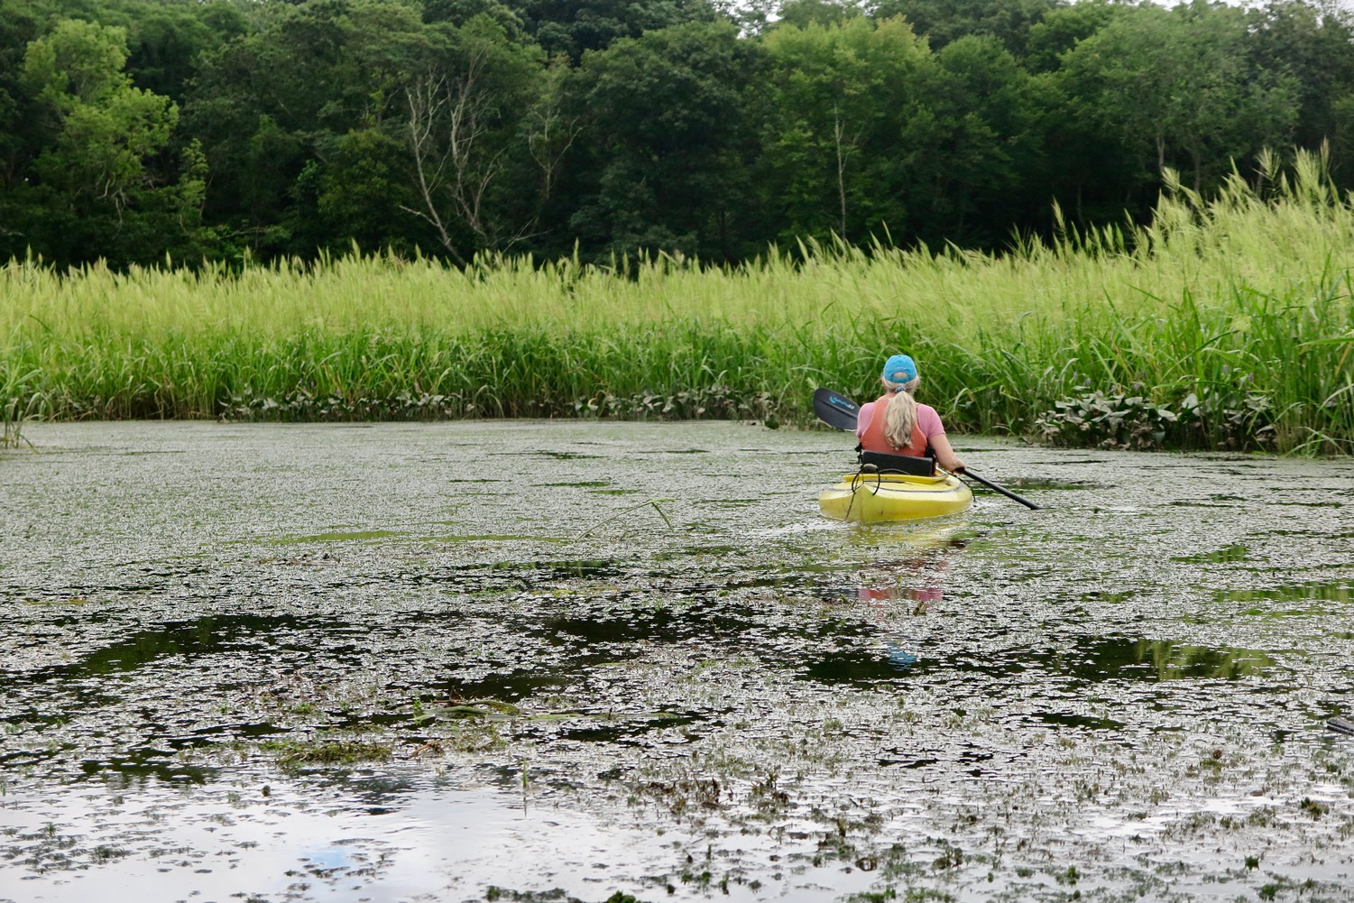
Notes:
Swimming, waterfowl hunting, even the passive recreational pastime of bird-watching can all be altered or eliminated

Slide 16
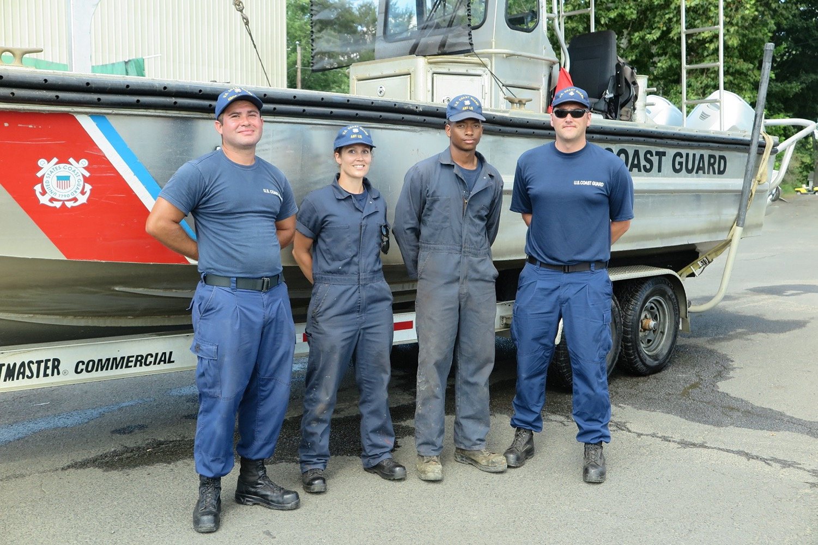
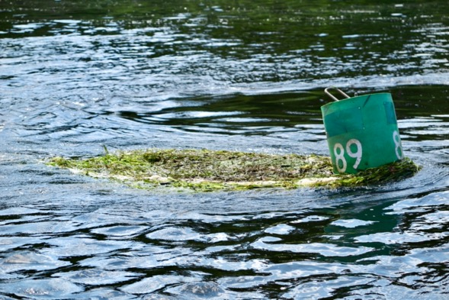
Notes:
impaired water access and navigation; need to keep navigation buoys clear

Slide 17
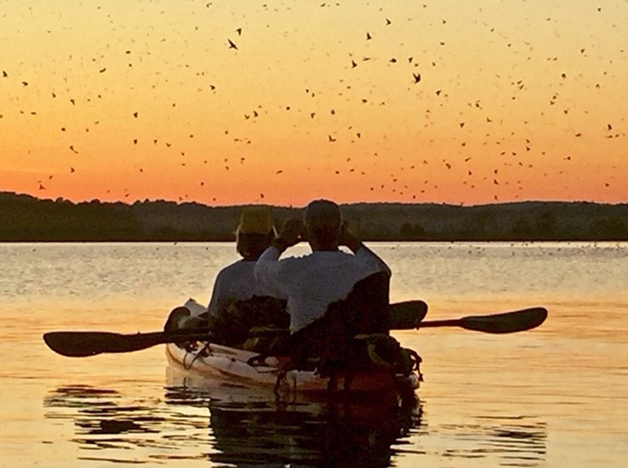
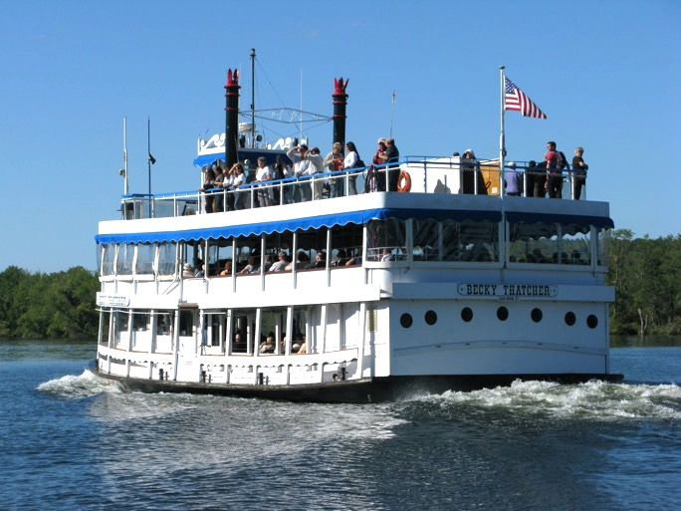
Fall Tree Swallow Congregation
River Tourism
Annual Shad Bake
CT River Museum
Essex
Notes:
Economic: proximity and use of the river
impaired water access and navigation impacting commercial and recreational boating, as well as marinas.
Tourism: cultural, water-driven, and natural resource assets. The estuary currently draws people who want to live in the region to benefit from its natural resources and recreation amenities and are in jobs that can be done from anywhere.
Benefits to construction and other services support these households and businesses
RC&D: (LCRVCOG GrowSmart Region Report) a high level estimate suggests a range of 5,000 to 7,000 jobs with a payroll range of $120 to $170 million.

Slide 18
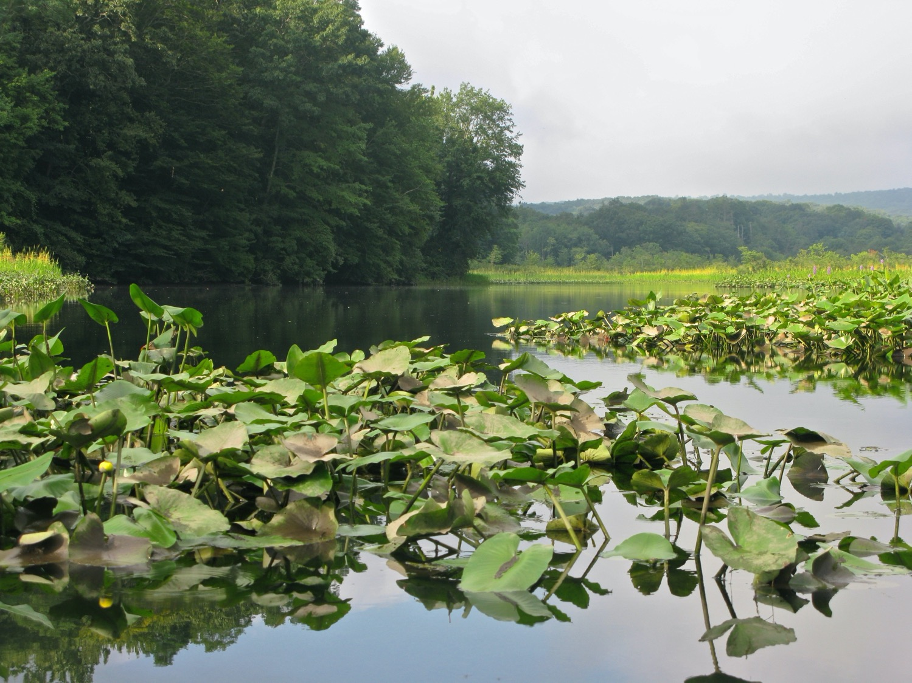
Of interest to local residents, municipalities and shoreline property owners, the loss of scenic amenities, in exchange for potentially harmful ones, can significantly impact property tax and tourism revenues
Notes:
Loss of views, erode attractiveness, sight-seeing
RC&D/ GrowSmart Region Report: people want to live here because of natural resources and recreation amenities; supports construction and service economy.
Tourism: cultural, water-driven, and natural resource assets. people want to live in the region to benefit from its natural resources and recreation amenities and are in jobs that can be done from anywhere. construction and other services support these households and businesses. impact the economic structure of housing values, property assessments and tourism dollars derived from proximity and use of the river.

Slide 19
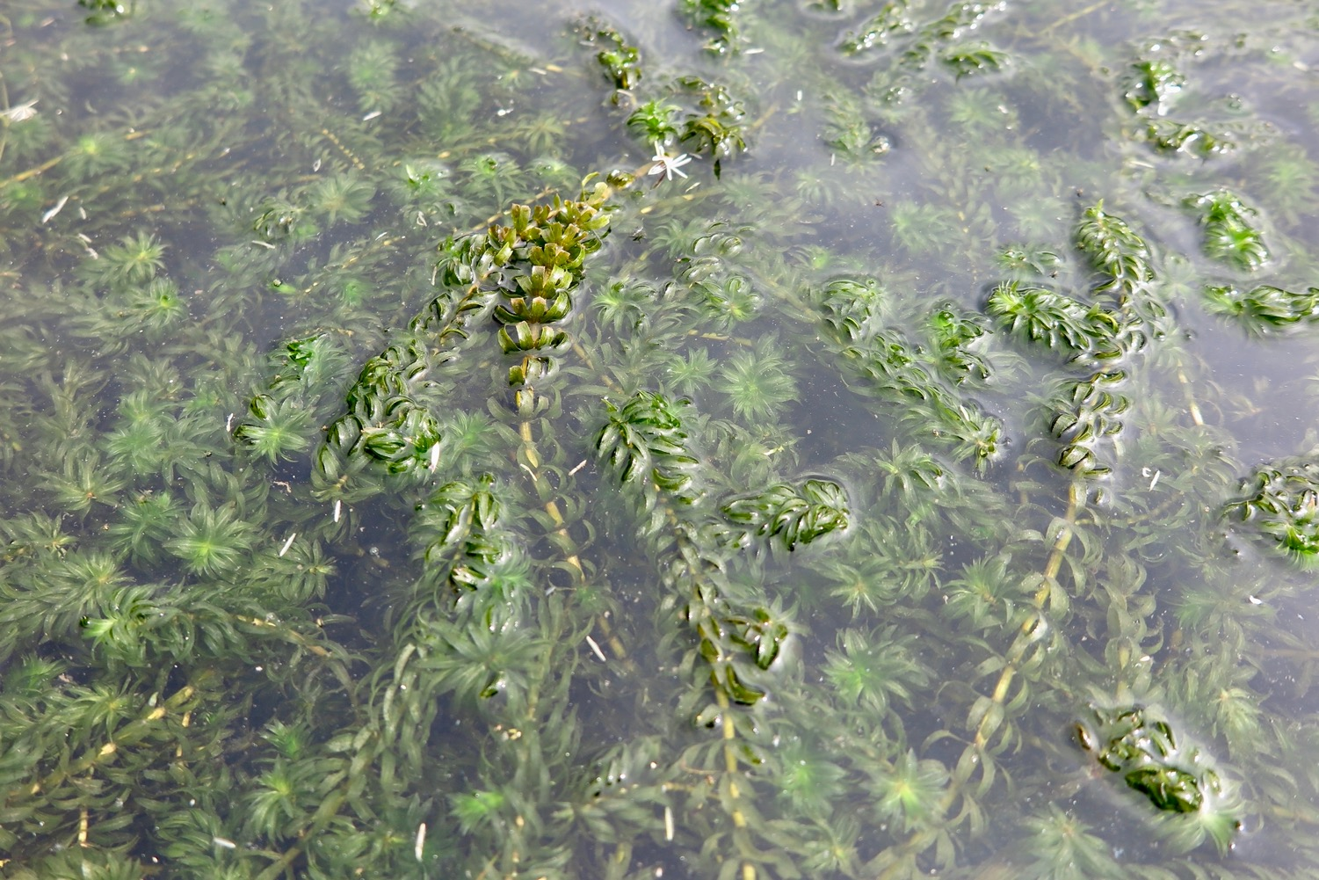
HYDRILLA
Alters native habitats
Impacts fisheries commercial & recreational boating & navigation
Can affect local economies housing values, property assessments, tourism
Is extremely difficult and expensive to remove
Notes:
Essential Message: This needs attention NOW
Multi-partner effort: federal, state (RivCOG), NGO’s (CRC) and 5 states (NY, VT, NH, MA, CT). NEANS - Northeast Aquatic Nuisance Species (NEANS) Panel (Management Plan)
extremely difficult and expensive to remove
In New York’s Hudson River estuary, entire coves have been ‘lost’ to this plant, which forms an impenetrable surface blanket. Lake Champlain.
Northeast Aquatic Nuisance Species (NEANS) Panel (Management Plan) is LEAD coordinator
Need for expanding communication, education and outreach, and assessing impacts

Slide 20
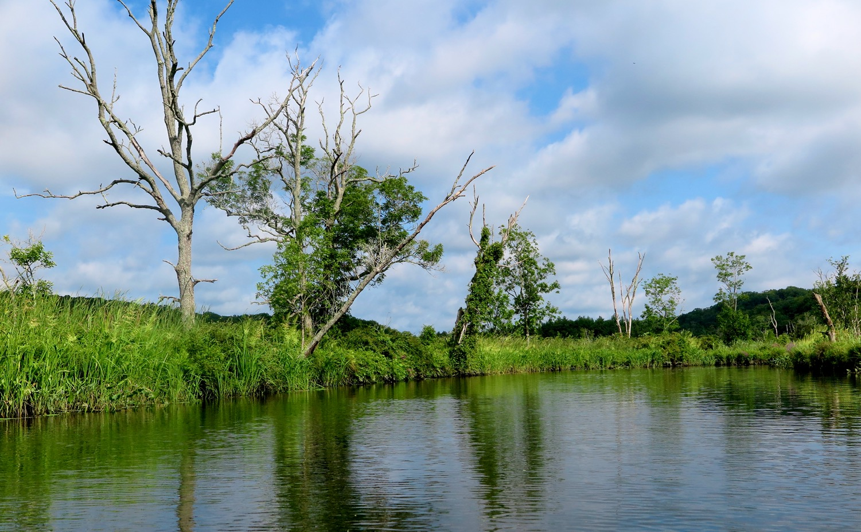
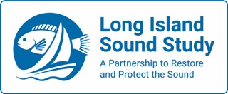
Judy Preston
Notes:
It's the entire, intact suite and diversity
of species in the estuary that make this place special, and biologically significant
Although disturbance for much of its existence is what has shaped the complexity of the estuary,
we’re now dealing with non-native species that are super competitors under changing conditions and disturbance, including CLIMATE CHANGE
desired levels of ecological function and invasive plant tolerance thresholds sufficient to maintain the viability of these conservation targets. It is possible to exert some control over invasive plant species, but collectively and individually they are a problem that requires long-term solutions. Managing invasive species demands a commitment to vigilance and some level of sustained action in perpetuity. resources devoted to control of invasives will never be sufficient to fund and staff all desirable management approaches. target control efforts to areas of the greatest ecological significance.
Natural systems must be managed with the flexibility to allow for change – responses to both natural, dynamic variation in weather and hydrology, as well as the less well understood or predictable parameters of climate change.

